Slide 2



Slide 3

What would YOU give up for Jesus?
Acts 7:54-8:4

Slide 4

What would YOU give up?
Your Possessions:
Early Christians-Acts 8:1, 3
Abraham- Genesis 13:2 & 12:1-5
Rich young ruler- Mt 19:16-24

Slide 5

What would YOU give up?
Your Family:
Persecuted & imprisoned-
Acts 8:3
Our own earthly families-
Luke 14:26; Matthew 10:37

Slide 6

What would YOU give up?
Your Freedom:
Saul- Acts 8:3
Persecutions-
2 Tim. 3:12
Paul & Silas- Acts 16:25
Paul- Phil 1:12-14

Slide 7
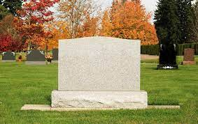
What would YOU give up?
Your Life:
Stephen- Acts 7:58-60
Paul- Philippians 1:21
Romans 10:9-10

Slide 8

What Would YOU Give Up For Jesus
Acts 7:54-8:4

