Slide 2
Lesson’s From Little Voices

Slide 3
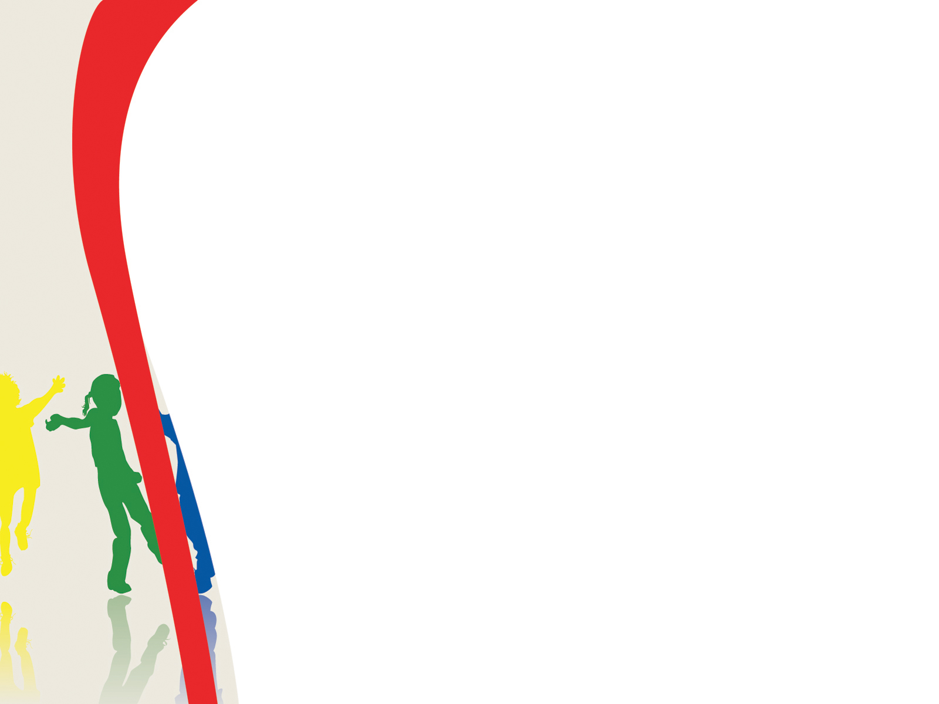
Wrapped, Tied, Tangled in Jesus
I’m wrapped up,
I’m tied up,
I’m tangled up in Jesus.
I’m wrapped up,
I’m tied up,
I’m tangled up in God.
I’m wrapped up,
I’m tied up,
I’m tangled up in Jesus.
I’m wrapped up, tied up, tangled up, in God.
.
(1 of 3)

Slide 4
Wrapped, Tied, Tangled in Jesus
This little light of mine,
I’m gonna’ let it shine.
This little light of mine,
I’m gonna’ let it shine.
This little light of mine,
I’m gonna’ let it shine.
Let it shine all the time, let it shine!
Repeat first verse.
I’m wrapped up, tied up, tangled up, in God.
(2 of 3)

Slide 5
Wrapped, Tied, Tangled in Jesus
I’m wrapped up,
I’m tied up,
I’m tangled up in Jesus.
I’m wrapped up,
I’m tied up,
I’m tangled up in God.
I’m wrapped up,
I’m tied up,
I’m tangled up in Jesus.
I’m wrapped up, tied up, tangled up, in God.
.
(3 of 3)

Slide 6
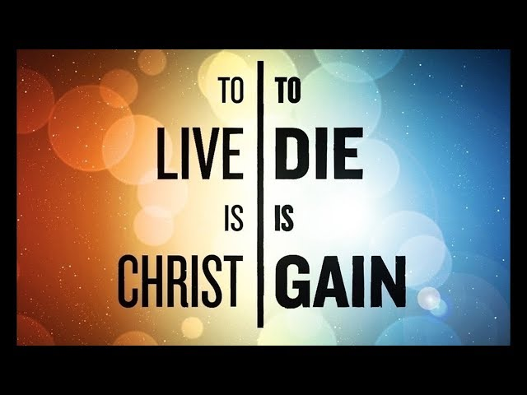

Slide 7
Paul desired to part from this life- II Corinthians 5:1-4; Romans 8:18-25
Paul’s death is gain because of what he would give up- II Corinthians 12:7-10; 11:23-28
Paul’s death is gain because of what he would receive- Philippians 1:23

Slide 8
To live was more opportunity to work- Philippians 1:22
To live was more opportunity to serve- Philippians 1:24-25
Are we humbled by Paul’s statement?
Note- Paul’s desire to live had nothing to do with what he would get out of it!

Slide 9
Our dying will only be gain, if our living is Christ!

