Slide 2
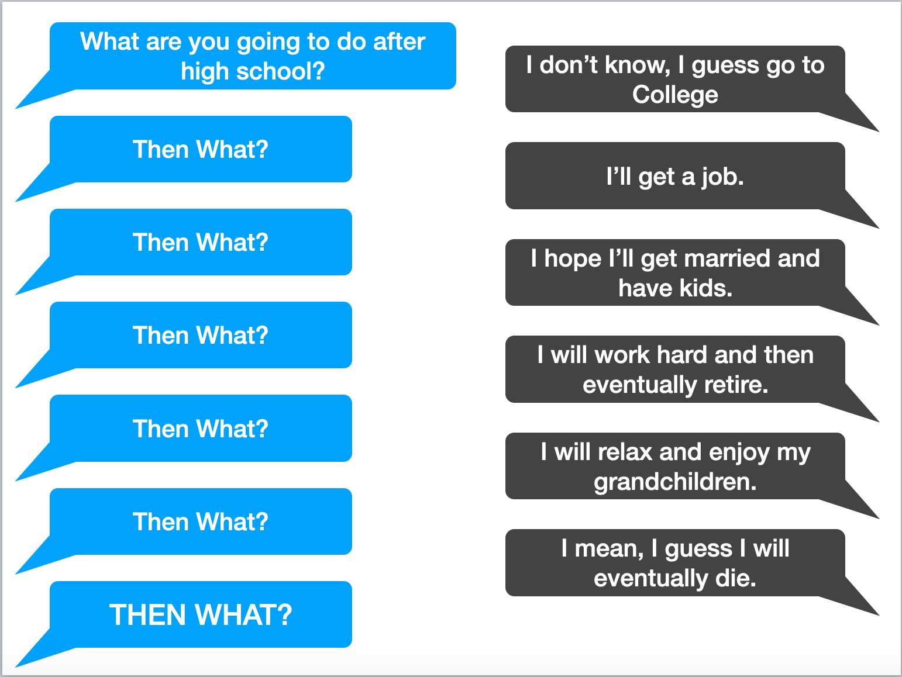

Slide 3

Finish The Race
II Timothy 4:6-8

Slide 4

How Many Races Are You Running?
School? Work? Fame? Money?
Are these races distracting you from the one that really matters?
Death is the moment that changes everything- Luke 16:19-31

Slide 5
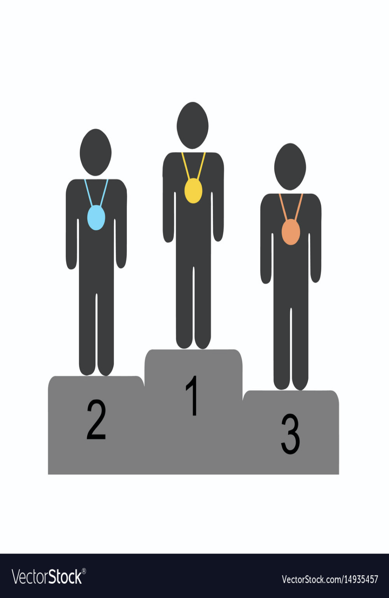
What’s The Prize?
School? Sports? Fame?
What about when you die- Eccl. 2:18-19
II Timothy 4:8- this race leads to a crown of righteousness

Slide 6

Finish The Race!
Acts 20:24
II Timothy 4:7
Hebrews 12:1-2

