Slide 2
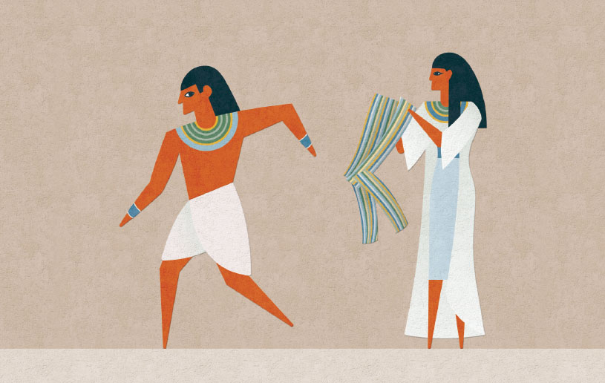
Don’t Give In!

Slide 3
Four principles to remember when we are tempted:
Satan is responsible for temptations
There is a difference between temptation and sin
There is a reason Satan tempts us
We can be victorious over temptation

