Slide 2


Slide 3
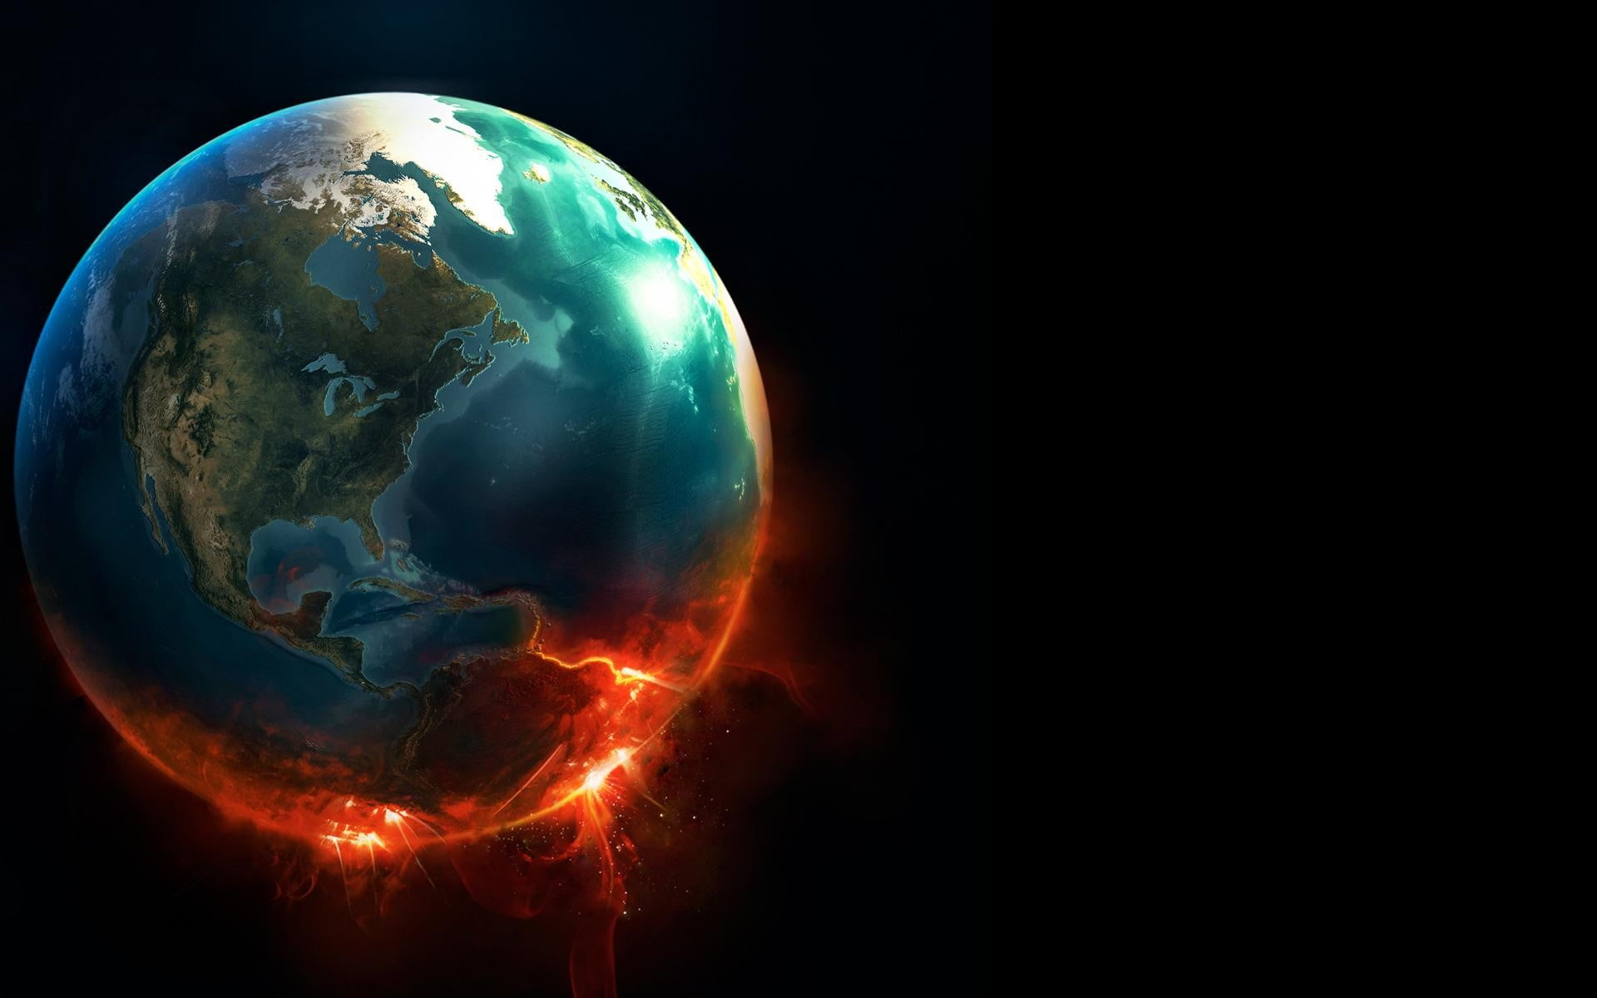
Where Will You Be When The World Stops Turning?
Will you be far from God?
Will you be behind God?
Will you be in front of God?
Will you be with God?

