Slide 2

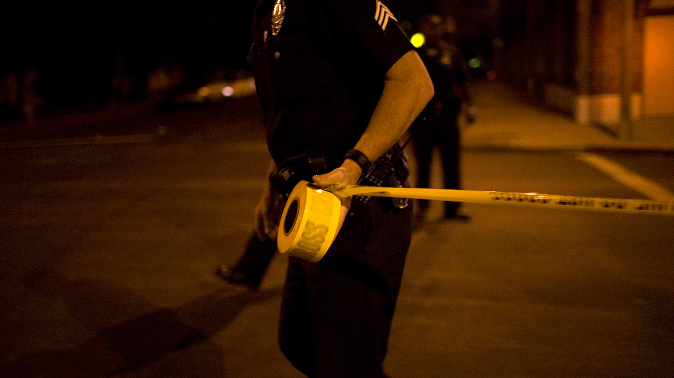
Why The violence?

Slide 3
Why the Violence
The bad influence of friends
The Poor example of friends

Slide 4
John Hopkins Center for gun Violence
Analyzed 110 shootings between 2014-2019. There are two major conclusions that were found.
  In more than two-thirds (68.2%) of mass shootings analyzed, the perpetrator either killed family or intimate partners or the shooter had a history of domestic violence
  Domestic Violence-related mass shootings were associated with a greater fatality rate. On average, only one in six people survive a DV-related mass shooting compared to one in three people for non-DV mass shootings.
A further breakdown of the 110 shootings reveal:
  59.1% (65 of the 110 total shootings) were DV-related;
  9.1% (10 of the 110 total mass shootings) were perpetrated by an individual with a history of DV
  68.2% (75 of the 110 total shootings) were either DV or history of DV-related
  31.8% (35 of the 110 mass shootings) were non-DV-related.

Slide 5
Why the Violence
The bad influence of friends
The Poor example of friends
The lax standards at home
Little time spent together as a family

