Slide 1
Lesson’s From Little Voices

Slide 2
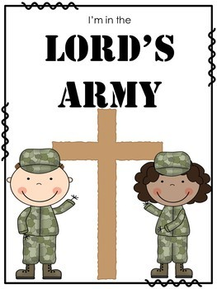
I’m In The Lord’s Army
I may never march in the Infantry,
Ride in the Cavalry,
Shoot the Artillery,
I may never fly o’er the enemy,
But I’m in the Lord’s Army.
I’m in the Lord’s Army,
I’m in the Lord’s Army,
Oh, I may never march in the Infantry,
Ride in the Cavalry,
Shoot the Artillery,
I may never fly o’er the enemy,
But I’m in the Lord’s Army.

Slide 3
I’m In The Lord’s Army
Who’s in the Lord’s Army?
Who’s our enemy?

Slide 4
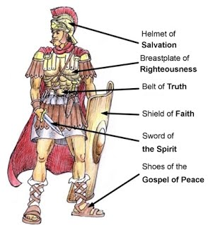
I’m In The Lord’s Army
Who’s in the Lord’s Army?
Who’s our enemy?
What’s our armor?

