Slide 2

Understanding

Slide 3
Understanding
The Work

Slide 4
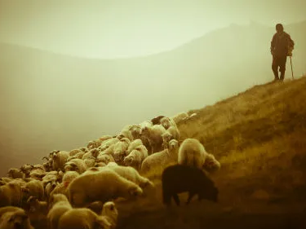
This is a work!
Ephesians 4:11-12
A church without elders is lacking- Titus 1:5
If there are no elders, there is a work going undone in the church

Slide 5

Terms Used To Describe The Work
Elders- Acts 14:23; Titus 1:5; Acts 11:30; I Timothy 5:17-19; James 5:14
Overseer/bishop- Acts 20:28
  Philippians 1:1; I Timothy 3:2; Titus 1:7- NKJV uses “bishop”
Shepherd/Pastor
  Ephesians 4:11- (NKJV, NASB use “pastor”)
  I Peter 5:2
  Acts 20:28- ESV- “to care for”; NKJV/NASB- “Shepherd”

Slide 6

Understanding Their Work
Maintain Proven Character- Titus 1; I Timothy 3- qualifications/qualities of an elder
Willingness to spend and be spent- II Corinthians 12:15; I Peter 5:1-3
Lead in what matters most- I Peter 5:1-3; Acts 6:1-4; 20:28-32; Hebrews 13:17
Teach God’s will- II Timothy 2:24-25
Equip us for Spiritual work- Ephesians 4:11-12

