Slide 2

Understanding

Slide 3
Understanding
Character

Slide 4

Putting what remains in order
Titus 1:5- Appoint Elders in every church
Local oversight is what God wants for each congregation
Churches without elders are lacking
Elders are neither an option or a luxury- They are a part of God’s plan

Slide 5
Above Reproach
Husband One Wife
Sober Minded
Self-Controlled
Respectable
Hospitable
Able to Teach
Not A Drunkard
Not Violent
Gentle
Not Quarrelsome
Not A Lover of Money
Manage Household Well
Keep Children In Submission
Not Recent Covert
Well Thought of By Outsiders
Above Reproach
Husband One Wife
Children Are Believers
No Charge of Insubordination
Above Reproach
Not Arrogant
Not Quick Tempered
Not Drunkard
Not Violent
Not Greedy
Hospitable
Lover of Good
Self Controlled
Upright
Holy
Disciplined
Hold Firm to Trustworthy Word
1 Timothy 3
Titus 1

Slide 6
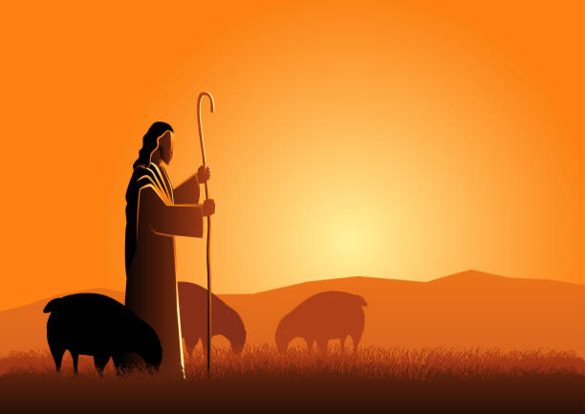
Problems with the traditional approach
We focus on disqualifications more than qualifications
We give to much attention to quantifiable qualities
We focus on terms rather than the concept

Slide 7
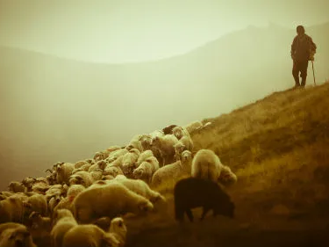
Elders are men on character
The two lists are not identical in terms
The two lists ARE identical in what matters- character
Repetition shows greater significance
  Note: I Timothy 3:2 & 7
  Note: Titus 1: 6 & 7
Shepherds are men of Character!

Slide 8
Understanding

