Slide 2

Understanding

Slide 3
Understanding
As Sheep

Slide 4
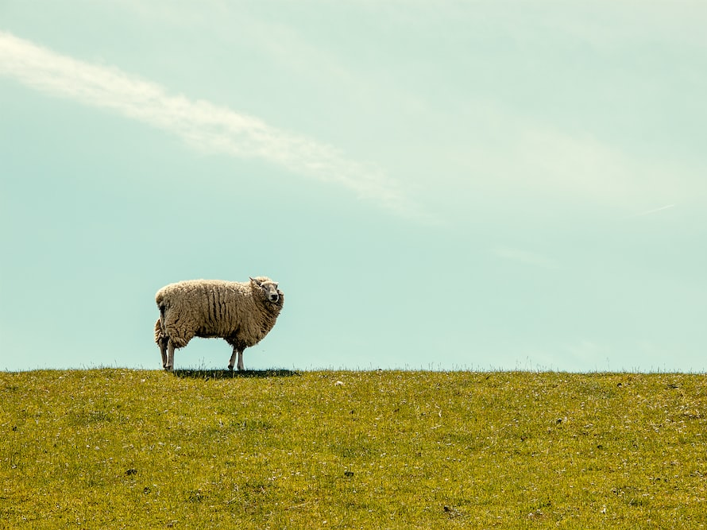
If they are shepherds, we are sheep
I Peter 5:1-4- what constitutes a flock?
Elders only oversee the group they worship with.
Points to the importance of membership

Slide 5
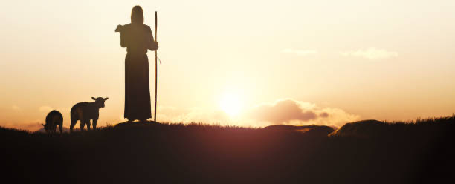
Sheep need to know the shepherds
I Thessalonians 5:12-13
“Respect” also translates to “know”
We think it’s the elder’s job to know us…the expectation is for them to put forth all the effort

Slide 6
Sheep need to respect the shepherds
I Thessalonians 5:12
Hebrews 13:7- imitate their faith
    Vs. 13- Esteeming them highly, respecting them, looking to them as shepherds produces peace among the flock
    Nothing breeds division more than when brethren are constantly criticizing and judging and putting down the spiritual leadership

Slide 7

Sheep need to allow the shepherds to lead spiritually
Hebrews 13:17- they lead, we follow
I Timothy 5:17- “let those who rule well”
John 10:1-6- principle of shepherds/sheep
James 5:13-15- “call for the elders”

Slide 8
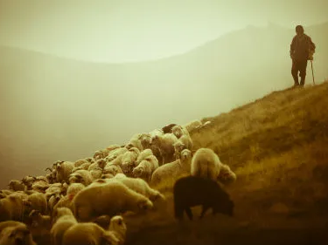
Reprove them if they sin
Being an elder does not mean they are perfect- Rom. 3:23
Showing respect does not mean they cannot be corrected
How do we do this
  I Timothy 5:19- a public charge
  After we follow Matthew 18:15-20
  Just because they are an elder doesn’t mean we ignore other commands
  Galatians 2:11-14
  Remember- Matthew 7:1-5

