Slide 2
Lesson’s From Little Voices

Slide 3
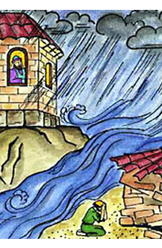
The Wise Man
The wise man built his house upon the rock.
The wise man built his house upon the rock.
The wise man built his house upon the rock.
And the rains came tumbling down.
The rains came down and
the floods came up.
The rains came down and
the floods came up.
The rains came down and
the floods came up.
And the wise man’s house stood firm.
The foolish man built his house upon the sand.
The foolish man built his house upon the sand.
The foolish man built his house upon the sand.
And the rains came tumbling down…
(1 of 2)

Slide 4
The rains came down and
the floods came up.
The rains came down and
the floods came up.
The rains came down and
the floods came up.
And the foolish man’s house fell flat!
So build your house on the Lord Jesus Christ.
So build your house on the Lord Jesus Christ.
So build your house on the Lord Jesus Christ.
And the blessings will come down.
The blessings come down
as the prayers go up.
The blessings come down
as the prayers go up.
The blessings come down
as the prayers go up.
So build your house on the Lord Jesus Christ.
(2 of 2)

Slide 5
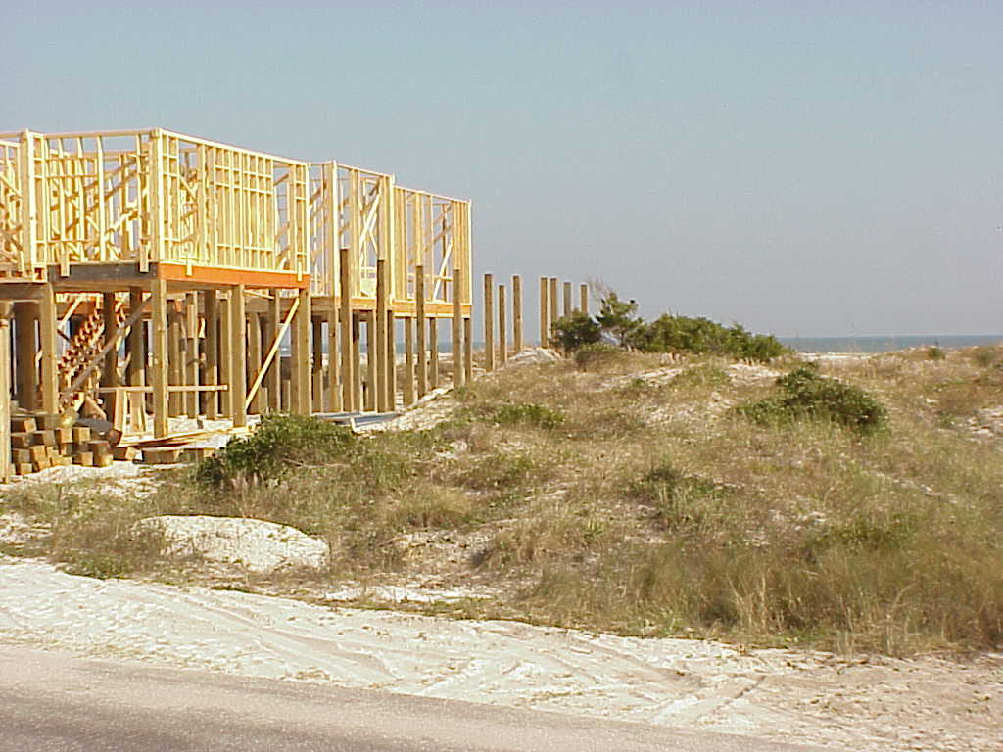
FIVE STEPS TO BUILD YOUR LIFE ON THE SAND
Matthew 7:24-27

Slide 6
Step 1- Read God’s Word
Matthew 7:26- both the wise man and foolish man heard the word!
Go to church, listen to sermons, participate in bible classes
Here’s what makes this step so important- if you go to church and read your bible, you can easily deceive yourself into believing you are building on the rock!

Slide 7
Step 2- Ignore It
Matthew 7:26- the foolish man ignores God’s word
Examples:
Matthew 6:33- Why seek God first?
Matthew 18:15- why go to your brother/sister
Luke 17:3-4- Why forgive?

Slide 8
Step 3- Justify how you are living
Not specifically mentioned- but could it of happened?
Common Justification statements:
Nobody else is doing what that rock builder is doing.
Everybody else is building like I am.
Surely God doesn’t really expect that from me.
That’s just not natural, normal people don’t behave like that.
I think God just wants me to be happy.
That’s just too hard.

Slide 9
Step 4-Blame God when things go wrong
Again, not specifically mentioned- but could who controls the weather?
Why didn’t God keep the ”storms” from happening in my life?
Getting fired
unemployment
Illness
Death of a loved one
Marriage issues
Family issues

Slide 10
Step 5- Watch your life crumble
Matthew7:27- the sand builders house falls
When do we need a good house the most?
A sandy foundation will fail right when you need it the most!

Slide 11
Lord’s Plan Of Salvation
Hear- Romans 10:17
Believe- John 8:24
Repent- Acts 2:38
Confess- Romans 10:9-10
Be Baptized- Acts 22:16
Live Faithfully- Revelation 2:10

