Slide 2
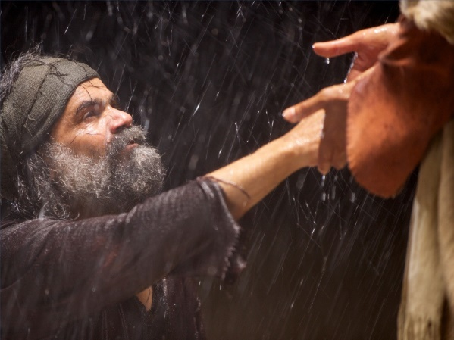
I. Doubt Is Real

Slide 3
II. What Brings About Doubt?
A) Ups and downs of life (Psalm 23; 1 Kings 18-19)
B) Response to failures/deliverance

Slide 4
“I have not hid thy righteousness within my heart; I have declared thy faithfulness and thy salvation; I have not concealed thy lovingkindness and thy truth from the great assembly. Withhold not thou thy tender mercies from me, O Jehovah; Let thy lovingkindness and thy truth continually preserve me. For innumerable evils have compassed me about; Mine iniquities have overtaken me, so that I am not able to look up; They are more than the hairs of my head; And my heart hath failed me.”
(Psalm 40:10-12)

Slide 5
II. What Brings About Doubt?
A) Ups and downs of life (Psalm 23; 1 Kings 18-19)
B) Our response to failures
C) Not listening to God (Romans 10:17)
D) Unwillingness to learn & grow

Slide 6
III. How to Deal with the Doubter

Slide 7
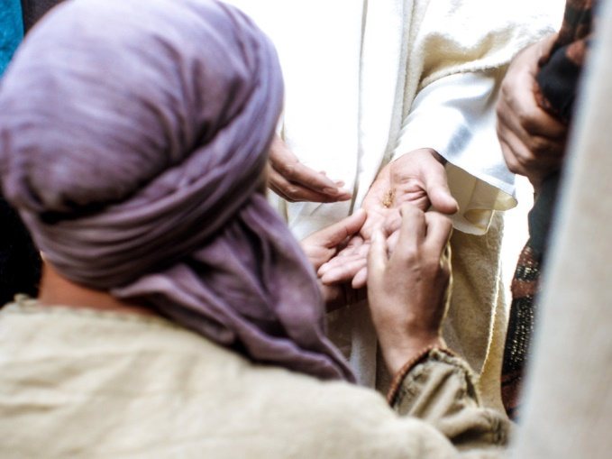
III. How to Deal with the Doubter
A) How did Jesus deal with them?
1. Thomas – showed & drew closer
2. Peter – reaffirmed his love for him & others he’d lead
3. Disciples – 40 days & sent them on a mission

Slide 8
III. How to Deal with the Doubter
B) “Have mercy on those who doubt”
C) What do I do with my doubt?
(Jude 1:20-22)
1. Build up your faith (vs. 20)
2. Pray in the Holy Spirit (vs. 20)
3. Keep the love of God (vs. 21)
4. Waiting for the mercy of Lord
5. Wait for heaven

Slide 9
3 Groups in Jude 1:22
1. Have mercy on those who doubt
2. Save some by snatching them them out of the fire
3. Save some even if you get ”dirty”

