Slide 1
Are You My Mother?

Slide 3
Who is the baby bird’s mother?
Kitten
Hen
Dog
Cow
Car
Boat
Plane
Snort

Slide 4
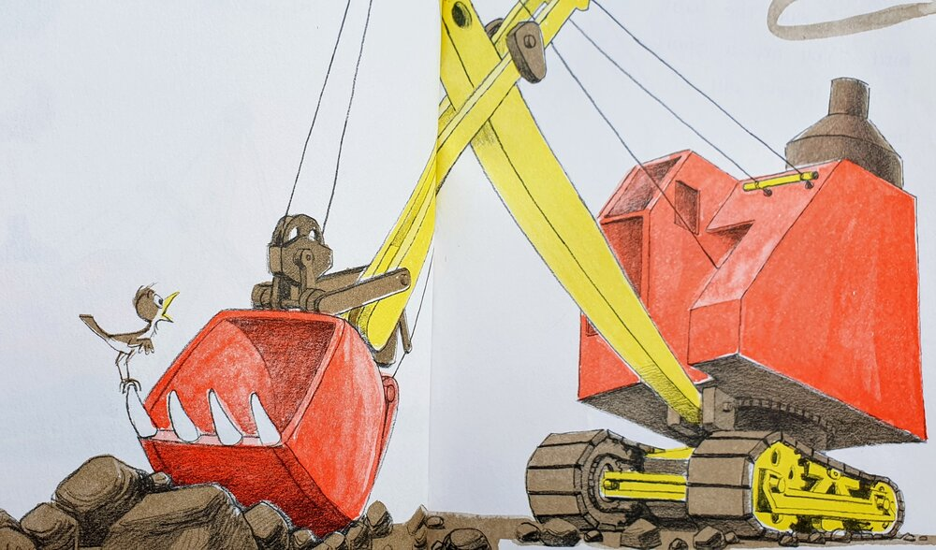

Slide 5
Who is my mother?
Matthew 12:46-50
While [Jesus] was still speaking to the people, behold, his mother and his brothers stood outside, asking to speak to him. But he replied to the man who told him, “Who is my mother, and who are my brothers?” And stretching out his hand toward his disciples, he said, “Here are my mother and my brothers! For whoever does the will of my Father in heaven is my brother and sister and mother.”

Slide 6
Who is my mother?
Luke 11:27-28
As he said these things, a woman in the crowd raised her voice and said to him, “Blessed is the womb that bore you, and the breasts at which you nursed!” But he said, “Blessed rather are those who hear the word of God and keep it!”

Slide 7
Who can be motherly?
Titus 2:3-5
Older women likewise are to be reverent in behavior, not slanderers or slaves to much wine. They are to teach what is good, and so train the young women to love their husbands and children, to be self-controlled, pure, working at home, kind, and submissive to their own husbands, that the word of God may not be reviled.

Slide 8
Who can be motherly?
1 Timothy 5:1-2
Do not rebuke an older man but encourage him as you would a father, younger men as brothers, older women as mothers, younger women as sisters, in all purity.

Slide 9
Who can be motherly?
1 Thessalonians 2:1-8
For you yourselves know, brothers, that our coming to you was not in vain. But though we had already suffered and been shamefully treated at Philippi, as you know, we had boldness in our God to declare to you the gospel of God in the midst of much conflict. For our appeal does not spring from error or impurity or any attempt to deceive, but just as we have been approved by God to be entrusted with the gospel, so we speak, not to please man, but to please God who tests our hearts. For we never came with words of flattery, as you know, nor with a pretext for greed—God is witness. Nor did we seek glory from people, whether from you or from others, though we could have made demands as apostles of Christ. But we were gentle among you, like a nursing mother taking care of her own children. So, being affectionately desirous of you, we were ready to share with you not only the gospel of God but also our own selves, because you had become very dear to us.

Slide 10
Who can be motherly?
According to Jesus, and Paul, all people have the capacity to be motherly!
This does not diminish the honor due to mothers, but rather magnifies it.
There is an aspect of God’s character in motherly character.

Slide 11
Godliness in motherly character
Matthew 23:37
“O Jerusalem, Jerusalem, the city that kills the prophets and stones those who are sent to it! How often would I have gathered your children together as a hen gathers her brood under her wings, and you were not willing!”

Slide 12
Godliness in motherly character
Isaiah 66:7-14
“Before she was in labor
she gave birth;
before her pain came upon her
she delivered a son.
Who has heard such a thing?
Who has seen such things?
Shall a land be born in one day?
Shall a nation be brought forth in one moment?
For as soon as Zion was in labor
she brought forth her children.
Shall I bring to the point of birth and not cause to bring forth?”
says the Lord;
“shall I, who cause to bring forth, shut the womb?”
says your God.

Slide 13
Godliness in motherly character
Isaiah 66:7-14
“Rejoice with Jerusalem, and be glad for her,
all you who love her;
rejoice with her in joy,
all you who mourn over her;
that you may nurse and be satisfied
from her consoling breast;
that you may drink deeply with delight
from her glorious abundance.”

Slide 14
Godliness in motherly character
Isaiah 66:7-14
For thus says the Lord:
“Behold, I will extend peace to her like a river,
and the glory of the nations like an overflowing stream;
and you shall nurse, you shall be carried upon her hip,
and bounced upon her knees.
As one whom his mother comforts,
so I will comfort you;
you shall be comforted in Jerusalem.
You shall see, and your heart shall rejoice;
your bones shall flourish like the grass;
and the hand of the Lord shall be known to his servants,
and he shall show his indignation against his enemies.

Slide 15
Godliness in motherly character
Isaiah 49:13-21
Sing for joy, O heavens, and exult, O earth;
break forth, O mountains, into singing!
For the Lord has comforted his people
and will have compassion on his afflicted.
But Zion said, “The Lord has forsaken me;
my Lord has forgotten me.”

Slide 16
Godliness in motherly character
Isaiah 49:13-21
“Can a woman forget her nursing child,
that she should have no compassion on the son of her womb?
Even these may forget,
yet I will not forget you.
Behold, I have engraved you on the palms of my hands;
your walls are continually before me.
Your builders make haste;
your destroyers and those who laid you waste go out from you.
Lift up your eyes around and see;
they all gather, they come to you.
As I live, declares the Lord,
you shall put them all on as an ornament;
you shall bind them on as a bride does.

Slide 17
Godliness in motherly character
Isaiah 49:13-21
“Surely your waste and your desolate places
and your devastated land—
surely now you will be too narrow for your inhabitants,
and those who swallowed you up will be far away.
The children of your bereavement
will yet say in your ears:
‘The place is too narrow for me;
make room for me to dwell in.’
Then you will say in your heart:
‘Who has borne me these?
I was bereaved and barren,
exiled and put away,
but who has brought up these?
Behold, I was left alone;
from where have these come?’”

Slide 18
Who can be motherly?
Because there is an aspect of God’s character in motherly character, all people have the capacity to be motherly! We are all made in the image of God.
But what about the Snort?

