Slide 1
Notes:
Last week, we attempted to look at some functions of light—guides, protects, enjoyable, salvation is light. But Satan appears as light. Today God and Light.

Slide 2
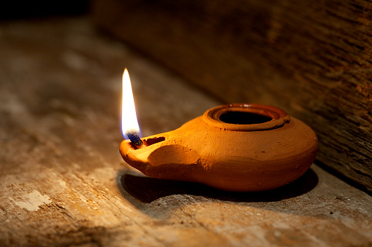
God and Light
Notes:
The Bible ultimately is about who God is. It is not a self-help book. It is not just about things to believe. It’s about God. 1. God creates. 2. God provides. 3. God is light.

Slide 3
God is the creator of light.
Notes:
Sun and moon, knowledge, morally good.

Slide 4
God is the creator of light.
Then God said, “Let there be light”;
and there was light.
Genesis 1:3
Notes:
God is the creator of light. God is the creator and interestingly, God makes light. This is before sin enters the world or anything else really happens. Through God’s Words.

Slide 5
God is the creator of light.
I form the light and create darkness, I make peace and create calamity; I, the Lord, do all these things.
Isaiah 45:7
Notes:
The book of Isaiah is highlighting God’s rule over all things. God is in control. The people need to know this. In their captivity, God is in control. When they’re not in captivity, God is in control.

Slide 6
God is the creator of light.
For it is the God who commanded light to shine out of darkness, who has shone in our hearts to give the light of the knowledge of the glory of God in the face of Jesus Christ. 2 Corinthians 4:6
Notes:
We need to know that God is the creator of light. 1) God is the creator of the sun and the moon. Have you seen the sun? The moon? God made it? 2) God is the creator of knowledge. 3) God is the creator of all that is good.

Slide 7
God is the creator of light.
Notes:
We need to know that God is the creator of light. 1) God is the creator of the sun and the moon. Have you seen the sun? The moon? God made it? 2) God is the creator of knowledge. 3) God is the creator of all that is good.

Slide 8
God is the provider of light.
For with You is the fountain of life; In Your light we see light.
Psalm 36:9
Notes:
As the creator of light, God is also the one who provides us. It is in God’s light that we have light. We have used the image of a flashlight. It is God who holds the flashlight!! We walk in his light. I don’t provide the light.

Slide 9
God is the provider of light.
Oh, send out Your light and Your truth! Let them lead me; Let them bring me to Your holy hill And to Your tabernacle. Psalm 43:3
Notes:
As the creator of light, God is also the one who provides us. It is in God’s light that we have light. We have used the image of a flashlight. It is God who holds the flashlight!! We walk in his light. I don’t provide the light.

Slide 10
God is the provider of light.
Notes:
As the creator of light, God is also the one who provides us. It is in God’s light that we have light. We have used the image of a flashlight. It is God who holds the flashlight!! We walk in his light. I don’t provide the light.

Slide 11
God is light.
Your sun will never set again, and your moon will wane no more; the Lord will be your everlasting light, and your days of sorrow will end. Isaiah 60:20
Notes:
Light is not just what God creates and provides, but it is who God is.

Slide 12
God is light.
For by their own sword they did not possess the land, And their own arm did not save them, But Your right hand and Your arm
and the light of Your presence, For You favored them.. Psalm 44:3
Notes:
Light is not just what God creates and provides, but it is who God is.

Slide 13
God is light.
You have placed our iniquities before You, Our secret sins in the light of Your presence. Psalm 90:8
Notes:
Light is not just what God creates and provides, but it is who God is.

Slide 14
God is light.
This is the message which we have heard from Him and declare to you, that God is light and in Him is no darkness at all. 1 John 1:5
Notes:
Light is not just what God creates and provides, but it is who God is.

Slide 15
Jesus is light.
The people who walk in darkness Will see a great light; Those who live in a dark land, The light will shine on them.
Isaiah 9:2
Notes:
In the OT, God creates light, provides light, God is light. Carries forward in the NT—God is light. But, the world is dark. Jesus comes into the world to bring light into this dark world.

Slide 16
Jesus is light.
In Him was life, and the life was the light of men. And the light shines in the darkness, and the darkness did not comprehend it. John 1:4-5
Notes:
The Gospel of John is connecting to creation. In the beginning was the Word. And, the theme of light.

Slide 17
Jesus is light.
This was the true Light that, coming into the world, enlightens every person. John 1:9
Notes:
The Gospel of John is connecting to creation. In the beginning was the Word. And, the theme of light.

Slide 18
Jesus is light.
And this is the condemnation, that the light has come into the world, and men loved darkness rather than light, because their deeds were evil.. John 3:19
Notes:
The Gospel of John is connecting to creation. In the beginning was the Word. And, the theme of light.

Slide 19
Jesus is light.
Then Jesus spoke to them again, saying,
“I am the light of the world. He who follows Me shall not walk in darkness, but have the light of life.” John 8:12
Notes:
The Gospel of John is connecting to creation. In the beginning was the Word. And, the theme of light.

Slide 20
Jesus is light.
As long as I am in the world,
I am the light of the world. John 9:5
Notes:
The Gospel of John is connecting to creation. In the beginning was the Word. And, the theme of light.

Slide 21
The city had no need of the sun or of the moon to shine in it, for the glory of God illuminated it. The Lamb is its light. Revelation 21:23
Notes:
Even the Garden of Eden had the sun and moon, even the temple and the tabernacle needed light.

Slide 22
There shall be no night there: They need no lamp nor light of the sun, for the Lord God gives them light. And they shall reign forever and ever. Revelation 22:5
Notes:
Light is not just what God creates and provides, but it is who God is.

