Slide 2
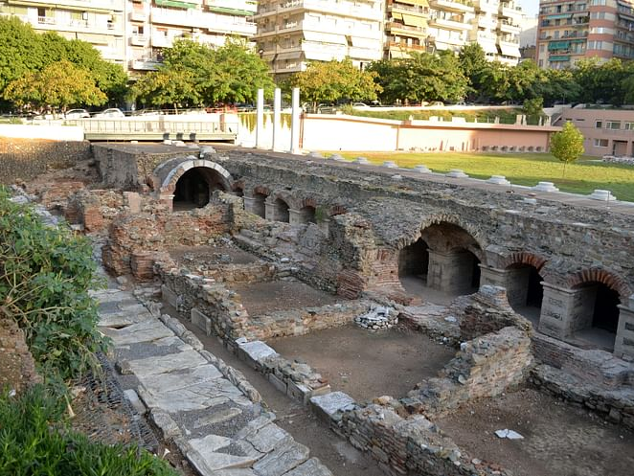
Preparing for Christ’s Coming
1 Thessalonians 5:1-11
Notes:
Christ’s coming has been mentioned several times. But how do we prepare for it? If someone is coming over to your house, there are preparations. Imagine if the governor came over. Or, if you were in these times, what if Caesar came over or the King? We miss that aspect of this. Christ is coming, so how do we make preparations and get ready?

Slide 3
¹ Now as to the times and the epochs, brethren, you have no need of anything to be written to you. ² For you yourselves know full well that the day of the Lord will come just like a thief in the night. ³ While they are saying, “Peace and safety!” then destruction will come upon them suddenly like labor pains upon a woman with child, and they will not escape. ⁴ But you, brethren, are not in darkness, that the day would overtake you like a thief;
Notes:
First, notice that it is called the day of the Lord.

Slide 4
¹ Now as to the times and the epochs, brethren, you have no need of anything to be written to you. ² For you yourselves know full well that the day of the Lord will come just like a thief in the night. ³ While they are saying, “Peace and safety!” then destruction will come upon them suddenly like labor pains upon a woman with child, and they will not escape. ⁴ But you, brethren, are not in darkness, that the day would overtake you like a thief;
Notes:
This is wording we see in the OT to talk about the “Lord will have his day.” Or, the Lord’s Day. God is not being honored, but the day will come when all will recognize who the Lord is. Same concept in the NT with the coming of the Christ.

Slide 5
¹ Now as to the times and the epochs, brethren, you have no need of anything to be written to you. ² For you yourselves know full well that the day of the Lord will come just like a thief in the night. ³ While they are saying, “Peace and safety!” then destruction will come upon them suddenly like labor pains upon a woman with child, and they will not escape. ⁴ But you, brethren, are not in darkness, that the day would overtake you like a thief;
Notes:
If you need to flesh out, use p. 109. Day of Christ, Jesus Christ, etc.

Slide 6
¹ Now as to the times and the epochs, brethren, you have no need of anything to be written to you. ² For you yourselves know full well that the day of the Lord will come just like a thief in the night. ³ While they are saying, “Peace and safety!” then destruction will come upon them suddenly like labor pains upon a woman with child, and they will not escape. ⁴ But you, brethren, are not in darkness, that the day would overtake you like a thief;
Notes:
There will be an element of surprise to the day. Throughout history, people have tried to predict the end of the world. Especially, in recent times. Someone once said, anytime a person gives a date as to the end of the world, it won’t be that day.

Slide 7
But the day of the Lord will come as a thief in the night, in which the heavens will pass away with a great noise, and the elements will melt with fervent heat; both the earth and the works that are in it will be burned up.
2 Peter 3:10

Slide 8
¹ Now as to the times and the epochs, brethren, you have no need of anything to be written to you. ² For you yourselves know full well that the day of the Lord will come just like a thief in the night. ³ While they are saying, “Peace and safety!” then destruction will come upon them suddenly like labor pains upon a woman with child, and they will not escape. ⁴ But you, brethren, are not in darkness, that the day would overtake you like a thief;
Notes:
Another image: like labor pains. This is something I don’t know that much about personally. It’s my understanding that it is a sudden kind of thing. An unexpected sort of thing. While they are saying Peace—like those in the time of the prophets. “Everything is ok. It’s fine.” Peace, peace. No.

Slide 9
¹ Now as to the times and the epochs, brethren, you have no need of anything to be written to you. ² For you yourselves know full well that the day of the Lord will come just like a thief in the night. ³ While they are saying, “Peace and safety!” then destruction will come upon them suddenly like labor pains upon a woman with child, and they will not escape. ⁴ But you, brethren, are not in darkness, that the day would overtake you like a thief;
Notes:
We don’t know when, but we shouldn’t be surprised. Silly example I know. Like Thanksgiving dinner. You don’t know when it will be ready, but it will be sometime.

Slide 10
¹ Now as to the times and the epochs, brethren, you have no need of anything to be written to you. ² For you yourselves know full well that the day of the Lord will come just like a thief in the night. ³ While they are saying, “Peace and safety!” then destruction will come upon them suddenly like labor pains upon a woman with child, and they will not escape. ⁴ But you, brethren, are not in darkness, that the day would overtake you like a thief;
Notes:
We live as people who have knowledge about this. Also, darkness is a motif of evil. We knowledge but also we live in the light as John uses it. We live righteously.

Slide 11
for you were formerly darkness, but now you are Light in the Lord; walk as children of Light
Ephesians 5:8
If we say that we have fellowship with Him and yet walk in the darkness, we lie and do not practice the truth
1 John 1:6

Slide 12
⁶ so then let us not sleep as others do, but let us be alert and sober. ⁷ For those who sleep do their sleeping at night, and those who get drunk get drunk at night. ⁸ But since we are of the day, let us be sober, having put on the breastplate of faith and love, and as a helmet, the hope of salvation. ⁹ For God has not destined us for wrath, but for obtaining salvation through our Lord Jesus Christ, ¹⁰ who died for us, so that whether we are awake or asleep, we will live together with Him.
Notes:
What are the implications of us not being in the darkness—both in terms of knowledge but also morally?

Slide 13
⁶ so then let us not sleep as others do, but let us be alert and sober. ⁷ For those who sleep do their sleeping at night, and those who get drunk get drunk at night. ⁸ But since we are of the day, let us be sober, having put on the breastplate of faith and love, and as a helmet, the hope of salvation. ⁹ For God has not destined us for wrath, but for obtaining salvation through our Lord Jesus Christ, ¹⁰ who died for us, so that whether we are awake or asleep, we will live together with Him.
Notes:
First, be alert (NASB). Other translations might have be awake, or watch. When used literally, the word means to be awake. It can be used figurately. A sports commentator might say the team was asleep on a play. The defense isn’t staying awake. Same sort of thing. We need to stay awake. If someone is coming to visit you, stay watchful.

Slide 14
⁶ so then let us not sleep as others do, but let us be alert and sober. ⁷ For those who sleep do their sleeping at night, and those who get drunk get drunk at night. ⁸ But since we are of the day, let us be sober, having put on the breastplate of faith and love, and as a helmet, the hope of salvation. ⁹ For God has not destined us for wrath, but for obtaining salvation through our Lord Jesus Christ, ¹⁰ who died for us, so that whether we are awake or asleep, we will live together with Him.
Notes:
Second, be sober. Sobriety refers to being able to have clear judgment and good thinking. If someone is coming to visit, be sober.

Slide 15
Be sober-minded; be watchful. Your adversary the devil prowls around like a roaring lion, seeking someone to devour.
1 Peter 5:8
Notes:
The same wording is used in 1 Peter to talk about resisting the devil.

Slide 16
⁶ so then let us not sleep as others do, but let us be alert and sober. ⁷ For those who sleep do their sleeping at night, and those who get drunk get drunk at night. ⁸ But since we are of the day, let us be sober, having put on the breastplate of faith and love, and as a helmet, the hope of salvation. ⁹ For God has not destined us for wrath, but for obtaining salvation through our Lord Jesus Christ, ¹⁰ who died for us, so that whether we are awake or asleep, we will live together with Him.
Notes:
Third, be ready for battle. These verses are probably not as remembered as the verses in Ephesians 6 with the armor of God. There, it mentions the breastplate of righteousness and helmet of salvation. There is a battle going on as we wait for the King to return. We are to fight. This is defensive--faith and love.

Slide 17
⁶ so then let us not sleep as others do, but let us be alert and sober. ⁷ For those who sleep do their sleeping at night, and those who get drunk get drunk at night. ⁸ But since we are of the day, let us be sober, having put on the breastplate of faith and love, and as a helmet, the hope of salvation. ⁹ For God has not destined us for wrath, but for obtaining salvation through our Lord Jesus Christ, ¹⁰ who died for us, so that whether we are awake or asleep, we will live together with Him.
Notes:
We are also on the defense with our helmet—the hope of salvation.

Slide 18
⁶ so then let us not sleep as others do, but let us be alert and sober. ⁷ For those who sleep do their sleeping at night, and those who get drunk get drunk at night. ⁸ But since we are of the day, let us be sober, having put on the breastplate of faith and love, and as a helmet, the hope of salvation. ⁹ For God has not destined us for wrath, but for obtaining salvation through our Lord Jesus Christ, ¹⁰ who died for us, so that whether we are awake or asleep, we will live together with Him.
Notes:
This is the conclusion of the implications of this (we still have one verse to go). Returns to the metaphor of those living and those who have passed on. Whether we are alive at Jesus’ coming, or have passed on—we will live with Him. That answers the question that seems to be looming in the background of this. What about the deceased? Do they have no hope?

Slide 19
¹¹ Therefore encourage one another and build one another up, just as you are doing.
Notes:
Here is how this section concludes. Encourage one another and build one another up. When we think about applying all of this to us, what do we do with it? Encourage one another. 1) In regards to the loss of loved ones who were in Christ. 2. In regards to us living faithfully day after.

