Slide 2
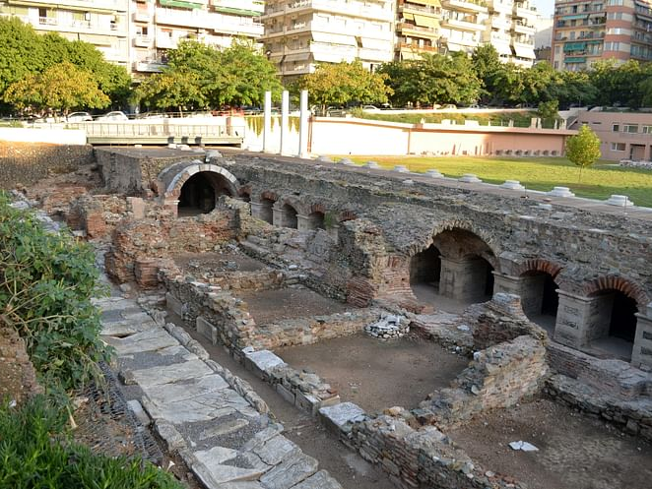
Responding to Leaders
1 Thessalonians 5:12-13
Notes:
We are heading in to the final portions of this letter. These verses deal with how the church is to respond to its leaders.

Slide 3
¹² We ask you, brothers, to respect those who labor among you and are over you in the Lord and admonish you, ¹³ and to esteem them very highly in love because of their work.
Be at peace among yourselves.
Notes:
This is the ESV. First, we should ask, “Who are these verses about?”

Slide 4
¹² We ask you, brothers, to respect those who labor among you and are over you in the Lord and admonish you, ¹³ and to esteem them very highly in love because of their work.
Be at peace among yourselves.
Notes:
Those who. This signifies that it is one group of people. And these people have 3 tasks.

Slide 5
¹² We ask you, brothers, to respect those who labor among you and are over you in the Lord and admonish you, ¹³ and to esteem them very highly in love because of their work.
Be at peace among yourselves.
Notes:
Those who 1. labor among you. They work hard.

Slide 6
¹² We ask you, brothers, to respect those who labor among you and are over you in the Lord and admonish you, ¹³ and to esteem them very highly in love because of their work.
Be at peace among yourselves.
Notes:
A group who 1. labors among you. And 2. are over you. Most translations have over you.

Slide 7
¹² We ask you, brothers, to respect those who labor among you and are over you in the Lord and admonish you, ¹³ and to esteem them very highly in love because of their work.
Be at peace among yourselves.
Notes:
A group who 1. labors among you. And 2. are over you. 3. admonish you (some translations instruct you) It means to reason with somebody.

Slide 8
¹² We ask you, brothers, to respect those who labor among you and are over you in the Lord and admonish you, ¹³ and to esteem them very highly in love because of their work.
Be at peace among yourselves.
Notes:
When we consider a group within the church who labors, leads, and admonishes. Personally, I think we have to conclude this is talking about elders. Three other verses in the NT to consider here.

Slide 9
Therefore take heed to yourselves and to all the flock, among which the Holy Spirit has made you overseers, to shepherd the church of God which He purchased with His own blood.
Acts 20:28

Slide 10
So I exhort the elders among you, as a fellow elder and a witness of the sufferings of Christ, as well as a partaker in the glory that is going to be revealed: shepherd the flock of God that is among you, exercising oversight, not under compulsion, but willingly, as God would have you; not for shameful gain, but eagerly; not domineering over those in your charge, but being examples to the flock.
1 Peter 5:1-3

Slide 11
Obey those who rule over you, and be submissive, for they watch out for your souls, as those who must give account. Let them do so with joy and not with grief, for that would be unprofitable for you.
Hebrews 13:17

Slide 12
¹² We ask you, brothers, to respect those who labor among you and are over you in the Lord and admonish you, ¹³ and to esteem them very highly in love because of their work.
Be at peace among yourselves.
Notes:
What should be our response to our elders? They do three things for us. We are to do three things for them. Let’s think about these three things.

Slide 13
¹² We ask you, brothers, to respect those who labor among you and are over you in the Lord and admonish you, ¹³ and to esteem them very highly in love because of their work.
Be at peace among yourselves.
Notes:
1. We respect them (ESV). Translation might have acknowledge, recognize, know (KJV). GK. It means to see what they’re doing among you. Awkward to translate as see. But that’s the idea. They are laboring, leading, instructing. There is a lot that doesn’t get seen! They watch out for our souls (Hebrews 3).

Slide 14
¹² We ask you, brothers, to respect those who labor among you and are over you in the Lord and admonish you, ¹³ and to esteem them very highly in love because of their work.
Be at peace among yourselves.
Notes:
In addition to respect, we need to esteem them very highly in love. It’s not because of their position but because of their work. We need to esteem everyone highly in love. We should appreciate our elders rather than complaining.

Slide 15
¹² We ask you, brothers, to respect those who labor among you and are over you in the Lord and admonish you, ¹³ and to esteem them very highly in love because of their work.
Be at peace among yourselves.
Notes:
Respect them, esteem them. What is a way that we show them our appreciation? By being at peace. The Bible has quite a bit to say about peace. In some ways, the whole book is about peace. Unity with God and unity with one another. This is part of the Christian life.

Slide 16
Behold, how good and pleasant it is when brothers dwell in unity!
Psalm 133:1

Slide 17
If possible, so far as it depends on you,
live peaceably with all.
Romans 12:18

Slide 18
So then let us pursue what makes for peace and for mutual upbuilding.
Romans 14:19

Slide 19
Finally, brothers, rejoice. Aim for restoration, comfort one another, agree with one another, live in peace; and the God of love and peace will be with you.
2 Corinthians 13:11

Slide 20
eager to maintain the unity of the Spirit in the bond of peace
Ephesians 4:3

Slide 21
And let the peace of Christ rule in your hearts, to which indeed you were called in one body. And be thankful. Colossians 3:15

Slide 22
So flee youthful passions and pursue righteousness, faith, love, and peace, along with those who call on the Lord from a pure heart.
2 Timothy 2:22

Slide 23
Strive for peace with everyone, and for the holiness without which no one will see the Lord.
Hebrews 12:14

Slide 24
Obey those who rule over you, and be submissive, for they watch out for your souls, as those who must give account. Let them do so with joy and not with grief, for that would be unprofitable for you.
Hebrews 13:17
Notes:
Why should we live in peace? As it pertains to our elders, so their jobs are joyful. Have you ever wanted to quit a job? Most probably have. I know of elders in churches who have. It’s not enjoyable.

Slide 25
Obey those who rule over you, and be submissive, for they watch out for your souls, as those who must give account. Let them do so with joy and not with grief, for that would be unprofitable for you.
Hebrews 13:17
Notes:
Notice it doesn’t say it would be unprofitable for them. Rather, it’s unprofitable for us.

Slide 26
¹² We ask you, brothers, to respect those who labor among you and are over you in the Lord and admonish you, ¹³ and to esteem them very highly in love because of their work.
Be at peace among yourselves.
Notes:
They do three things and we do three things.

Slide 27
¹² We ask you, brothers, to respect those who labor among you and are over you in the Lord and admonish you, ¹³ and to esteem them very highly in love because of their work.
Be at peace among yourselves.

