Slide 1
Notes:
I can remember the days of free samples (Sam’s still). The mall Chick-Fil-A in the early days. Chicken nugget. Our word example comes from sample. It means something like ‘to take out a sample.’

Slide 2
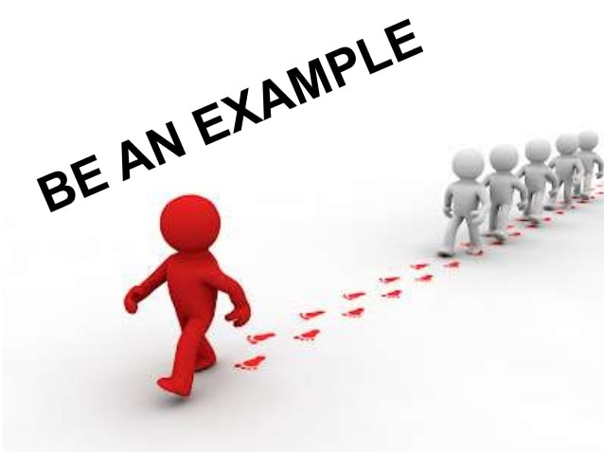
Notes:
First, we all have examples. Whether we think about it or not, we all take cues from others. Second, all of us are an example-a sample to someone. Somebody is watching.

Slide 3
Who are you following?
Notes:
Are we following Christ? He is our example.

Slide 4
Who are you following?
Let each of you look out not only for his own interests, but also for the interests of others. Let this mind be in you which was also in Christ Jesus,
Philippians 2:4-5
Notes:
Have the same mind (disposition, attitude) of lowliness and service. Downwardly mobile.

Slide 5
Who are you following?
Let each of us please his neighbor for his good, leading to edification. For even Christ did not please Himself; but as it is written, “The reproaches of those who reproached You fell on Me.”
Romans 15:2-3
Notes:
Jesus is our example of selflessness.

Slide 6
Who are you following?
Therefore be imitators of God as dear children. And walk in love, as Christ also has loved us and given Himself for us, an offering and a sacrifice to God for a sweet-smelling aroma.
Ephesians 5:1-2
Notes:
Jesus is our example of love and sacrifice. We are to love as Christ loved us. That is a high standard. Eph talks about love of one another. And love in the home.

Slide 7
Who are you following?
For to this you were called, because Christ also suffered for us, leaving us an example, that you should follow His steps
1 Peter 2:21
Notes:
Jesus is our example in suffering. We overlook this.

Slide 8
Who are you following?
Notes:
Another

Slide 9
Who are you following?
Imitate me, just as I also imitate Christ.
1 Corinthians 11:1
Notes:
Even Paul’s example is good so far as it is a sample of Jesus’ life.

Slide 10
Who are you following?
Brethren, join in following my example, and note those who so walk, as you have us for a pattern.
Philippians 3:17
Notes:
Join those who are following good examples.

Slide 11
Who are you following?
And you became followers of us and of the Lord, having received the word in much affliction, with joy of the Holy Spirit
1 Thessalonians 1:6
Notes:
The Thessalonians followed good examples.

Slide 12
Who are you following?
For you yourselves know how you ought to follow us, for we were not disorderly among you
2 Thessalonians 3:7
Notes:
The Thessalonians followed good examples.

Slide 13
Who are you following?
Notes:
There are a host of other good examples in the New Testament. Mary at the birth of Jesus. Lydia in the book of Acts. Hebrews 11. Who are we following? Family member, somebody on TV, celebrity, people in the workplace? We all take cues from other people. Who are they? We do it subconsciously. Fashion. Why am I dressed like this?

Slide 14
Who is following you?
Notes:
Turn the question around. We are all leaders. I understand what we mean by ‘be a leader.’ But, we are all leaders to somebody.

Slide 15
Who is following you?
so that you became examples to all in Macedonia and Achaia who believe.
1 Thessalonians 1:7
Notes:
They had not been Christians very long when this was written. In a very short time, they were examples.

Slide 16
Who is following you?
Let no one despise your youth, but
be an example to the believers in word, in conduct, in love, in spirit, in faith, in purity.
1 Timothy 4:12
Notes:
This is specific to Timothy in his situation, but it applies to all of us. There is no one who shouldn’t be a good example. Six specific things are mentioned.

Slide 17
Who is following you?
Notes:
Who are we an example to? First, children.

Slide 18
Who is following you?
Whoever causes one of these little ones who believe in Me to sin, it would be better for him if a millstone were hung around his neck, and he were drowned in the depth of the sea.
Matthew 18:6
Notes:
We are an example to the little ones—literally children but also those who humble themselves.

Slide 19
Who is following you?
Therefore, if food makes my brother stumble, I will never again eat meat, lest I make my brother stumble.
1 Corinthians 8:13
Notes:
We are an example to other Christians. The main thing here is an awareness of who we are with. Knowing them, and being willing to value their beliefs.

Slide 20
Who is following you?
having your conduct honorable among the Gentiles, that when they speak against you as evildoers, they may, by your good works which they observe, glorify God in the day of visitation.
1 Peter 2:12
Notes:
We are an example to the world around us. Be honorable among those who are on the outside of the church.

Slide 21
Notes:
Two questions: Who am I following? Who is following me? Really reflect on that. What kind of sample am I?

