Slide 1
Notes:
We live in a culture of abundance. The amount of food we eat, coffee or tea we drink. The square footage in our homes. It is so easy to take things for granted. There is a practice in ancient times meant to re-center us and make us reflect.

Slide 2
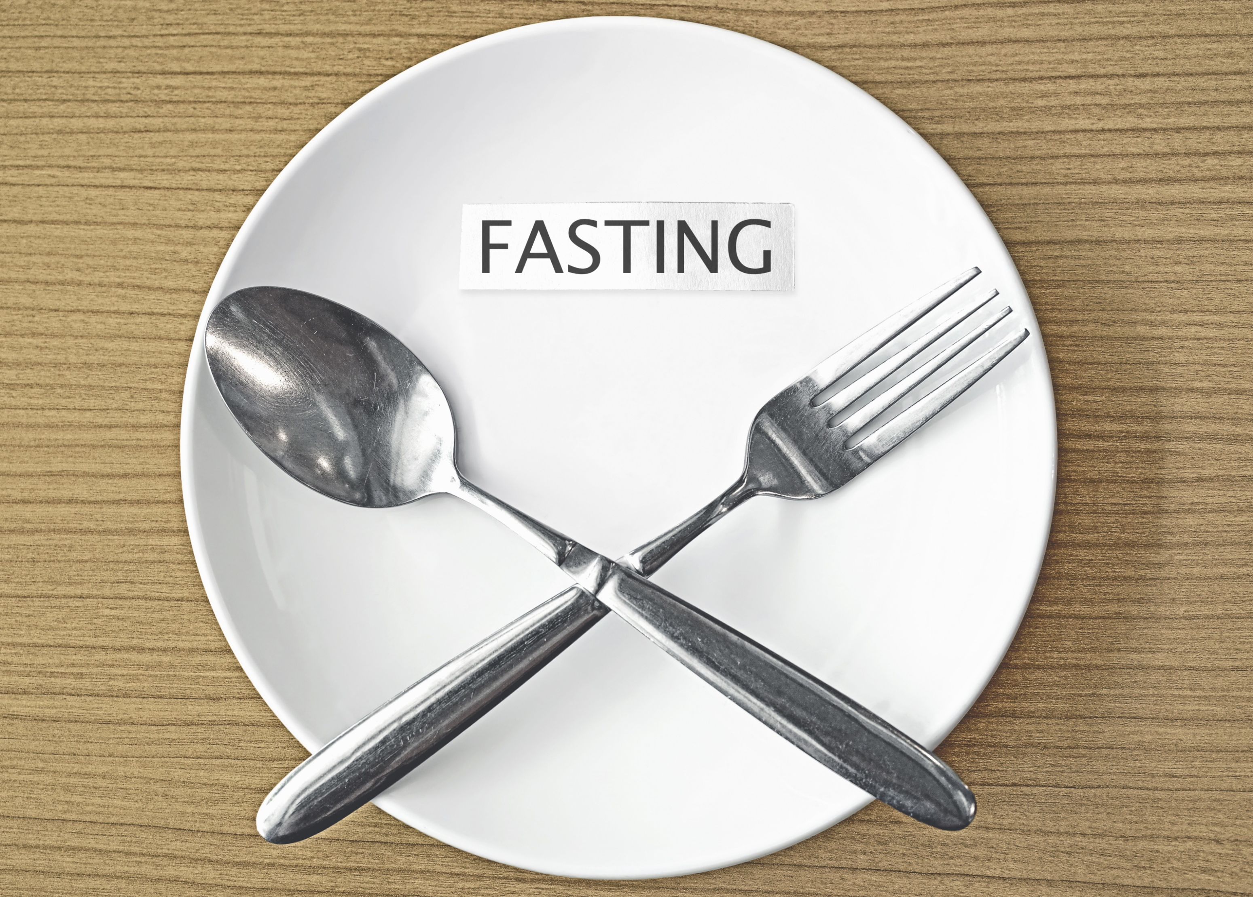
Notes:
Fasting in a feasting culture. Fasting is to intentionally take a break from something to realize that you can go without it. To reconnect with God. To reconnect with yourself.

Slide 3
Notes:
Although we typically think about fasting in relation to food, I want us to think about the topic in relation to a variety of things—our culture is different than biblical times. What is something that, by taking a break, you could reconnect with God, reconnect with self, establish healthy boundaries. Cell phone? Facebook? Cup of coffee? If you say, “I couldn’t give that up. I couldn’t go 30 minutes without it.” That’s a problem. That’s an idol. That is the point of fasting.

Slide 4
In the Old Testament

Slide 5
Mourning
Judges 20:24-26
In the Old Testament
Notes:
US: Mourning-sometimes, a feast during mourning is not necessarily by our own choice. A person might not be able to eat or to do things. But, other times it might be by choice. It’s a time to connect with God, self. If your going through a time of mourning, what might be wise for you give up for a time?

Slide 6
Impending Tragedy
2 Samuel 12:15-20
In the Old Testament
Notes:
US: David fasted, but once the child has dies, he then ends the fast. Looming disaster. There might times when we are in this situation. If you find yourself in that situation, what might be wise. Sometimes we distract ourselves from the issue. Helpful at times. Other times, we need to come to grips with what is going on.

Slide 7
Death
1 Chron
10:12
In the Old Testament
Notes:
US: Death. This is similar to what we saw in Judges. Mourning. There also might be an aspect of respect here. When someone dies, we have a big meal. In ancient times, when there is a death there is fasting.

Slide 8
Repentance
Jonah
3:5-10
In the Old Testament
Notes:
US: Repentance. As part of our own confession and repentance, what might be helpful for us to go without for a time?

Slide 9
In the New Testament
Notes:
US: Repentance. As part of our own confession and repentance, what might be helpful for us to go without for a time?

Slide 10
Transitions
Matthew
4:1-2
In the New Testament
Notes:
US: This is a transitional part of Matthew. Temptation which will lead to his ministry. We have transitions. Marriage. Having a child. Starting a job. Retiring from a job. Time of reflection and reconnection might be in order.

Slide 11
Prayer
Matthew
17:21
In the New Testament
Notes:
US: A demon being talked about. One place of many where prayer and fasting and coupled together. It is often implied, if not stated directly, that a component of the fast is time of prayer. What about us?

Slide 12
New Beginning
Acts
13:1-3
In the New Testament
Notes:
Goes along with transition.

Slide 13
New Beginning
Acts
14:23
In the New Testament
Notes:
Goes along with transition. Would we think about fasting as we as a congregation select a deacon or an elder? It’s not part of our culture, but if somebody wanted to do that it would certainly be appropriate.

Slide 14
Serving God
Luke 2:36-37
In the New Testament
Notes:
Within Jewish culture, it was part of serving God—regularly fasting, praying, and giving.

Slide 15
Matthew 6:16-18
Jesus’ Guidance
Notes:
Not something we do for an external show. Don’t put on a mask like the hypocrites—they change their face. Are we fasting for the sake of others or for connection with God? Pharisees were fasting, praying, giving but so they would be seen.

Slide 16
Notes:
We need to have balance in life. That really is what fasting is about. In today’s world, it is so easy for life to get out of balance. Fasting is an ancient practice that gets life back in balance and helps to reconnect with God, self, others. Fast from work, fast from technology, fast from being around people, fast from spending, fast from food. What is something that you need a break from in order to get back into balance? That’s what this ancient practice is about.

