Slide 1
Notes:
Tonight, we look at probably the most familiar verses of 1 Thess. Not many “memory verses” in this letter, but many know these verses.

Slide 2
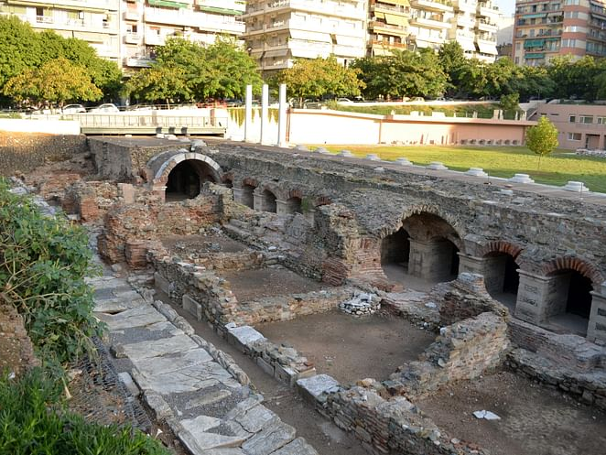
Christ’s Coming
1 Thessalonians 4:13-18
Notes:
This letter does not have a condemning tone. Even these verses are not that way. It’s different than I had heard 1 Thessalonians taught previously. Sometimes these verses are lifted out of the letter and taken out of context.

Slide 3
and to wait for His Son from heaven, whom He raised from the dead, even Jesus who delivers us from the wrath to come.
1 Thessalonians 1:10
Notes:
This event has been mentioned in this letter.

Slide 4
For what is our hope, or joy, or crown of rejoicing? Is it not even you in the presence of our Lord Jesus Christ at His coming?
1 Thessalonians 2:19

Slide 5
so that He may establish your hearts blameless in holiness before our God and Father at the coming of our Lord Jesus Christ with all His saints.
1 Thessalonians 3:13

Slide 6
¹³ But we do not want you to be uninformed, brethren, about those who are asleep, so that you will not grieve as do the rest who have no hope. ¹⁴ For if we believe that Jesus died and rose again, even so God will bring with Him those who have fallen asleep in Jesus. ¹⁵ For this we say to you by the word of the Lord, that we who are alive and remain until the coming of the Lord, will not precede those who have fallen asleep.
Notes:
We can think about this section as two parts. 1) The facts of His coming. 2) The events of His coming.

Slide 7
¹³ But we do not want you to be uninformed, brethren, about those who are asleep, so that you will not grieve as do the rest who have no hope. ¹⁴ For if we believe that Jesus died and rose again, even so God will bring with Him those who have fallen asleep in Jesus. ¹⁵ For this we say to you by the word of the Lord, that we who are alive and remain until the coming of the Lord, will not precede those who have fallen asleep.
Notes:
This is written with a desire for being informed. Paul, Silas, and Timothy want them to have the right information. US: That itself is great lesson for us. There is a lot of information out there about the Bible, especially online, but it can be bad information. We need to be informed.

Slide 8
¹³ But we do not want you to be uninformed, brethren, about those who are asleep, so that you will not grieve as do the rest who have no hope. ¹⁴ For if we believe that Jesus died and rose again, even so God will bring with Him those who have fallen asleep in Jesus. ¹⁵ For this we say to you by the word of the Lord, that we who are alive and remain until the coming of the Lord, will not precede those who have fallen asleep.
Notes:
Specifically, they aren’t to be uninformed about those who have died. It’s a euphemism. We do the same with “passed away.” It’s also a way of saying that the end has not really happened yet. Physical death isn’t death in a sense. That’s helpful to consider.

Slide 9
¹³ But we do not want you to be uninformed, brethren, about those who are asleep, so that you will not grieve as do the rest who have no hope. ¹⁴ For if we believe that Jesus died and rose again, even so God will bring with Him those who have fallen asleep in Jesus. ¹⁵ For this we say to you by the word of the Lord, that we who are alive and remain until the coming of the Lord, will not precede those who have fallen asleep.
Notes:
This is like ‘therefore.’ What is an implication of having the right information about death? And our loved ones? Why does it matter? There is a lot of bad information around death and what happens at death or after death—even in the church. Diagrams of the soul, etc. Is that true or bad information based on tradition.

Slide 10
¹³ But we do not want you to be uninformed, brethren, about those who are asleep, so that you will not grieve as do the rest who have no hope. ¹⁴ For if we believe that Jesus died and rose again, even so God will bring with Him those who have fallen asleep in Jesus. ¹⁵ For this we say to you by the word of the Lord, that we who are alive and remain until the coming of the Lord, will not precede those who have fallen asleep.
Notes:
When we have the right information about Christ’s coming, it changes how we grieve. Do we still grieve? Yes. But it changes. We have hope. Different from those who have no hope. How does someone with no religious belief get through the trials of life?

Slide 11
¹³ But we do not want you to be uninformed, brethren, about those who are asleep, so that you will not grieve as do the rest who have no hope. ¹⁴ For if we believe that Jesus died and rose again, even so God will bring with Him those who have fallen asleep in Jesus. ¹⁵ For this we say to you by the word of the Lord, that we who are alive and remain until the coming of the Lord, will not precede those who have fallen asleep.
Notes:
When we have the right information about Christ’s coming, it changes how we grieve. Do we still grieve? Yes. But it changes. We have hope. Different from those who have no hope. How does someone with no religious belief get through the trials of life?

Slide 12
¹³ But we do not want you to be uninformed, brethren, about those who are asleep, so that you will not grieve as do the rest who have no hope. ¹⁴ For if we believe that Jesus died and rose again, even so God will bring with Him those who have fallen asleep in Jesus. ¹⁵ For this we say to you by the word of the Lord, that we who are alive and remain until the coming of the Lord, will not precede those who have fallen asleep.
Notes:
Whatever we say about death and what comes after death must be grounded in the death and resurrection. That is how we understand all of our existence.

Slide 13
¹³ But we do not want you to be uninformed, brethren, about those who are asleep, so that you will not grieve as do the rest who have no hope. ¹⁴ For if we believe that Jesus died and rose again, even so God will bring with Him those who have fallen asleep in Jesus. ¹⁵ For this we say to you by the word of the Lord, that we who are alive and remain until the coming of the Lord, will not precede those who have fallen asleep.
Notes:
The point: If death was not the end of the story for Jesus, death is not the end of the story for us and for our loved ones. If Jesus can be raised, so too, those who die can be raised and live again.

Slide 14
¹³ But we do not want you to be uninformed, brethren, about those who are asleep, so that you will not grieve as do the rest who have no hope. ¹⁴ For if we believe that Jesus died and rose again, even so God will bring with Him those who have fallen asleep in Jesus. ¹⁵ For this we say to you by the word of the Lord, that we who are alive and remain until the coming of the Lord, will not precede those who have fallen asleep.
Notes:
This likely helps us with the backstory and questions that were being asked. Jesus returns We’re alive and our loved ones are not. What happens? Will those who have died miss out on this event?

Slide 15
¹⁶ For the Lord Himself will descend from heaven with a shout, with the voice of the archangel and with the trumpet of God, and the dead in Christ will rise first. ¹⁷ Then we who are alive and remain will be caught up together with them in the clouds to meet the Lord in the air, and so we shall always be with the Lord.
Notes:
These verses now talk about the events to take place.

Slide 16
¹⁶ For the Lord Himself will descend from heaven with a shout, with the voice of the archangel and with the trumpet of God, and the dead in Christ will rise first. ¹⁷ Then we who are alive and remain will be caught up together with them in the clouds to meet the Lord in the air, and so we shall always be with the Lord.
Notes:
This is not quiet, with some knowing about it and others not knowing. I’ll let JD sort it out in the resurrection class. It’s likely that this is meant to be military victory language. Announcement, yes, but the announcement that the final buzzer has sounded. The whistle in the 4th quarter has blown. There is a team who has won.

Slide 17
¹⁶ For the Lord Himself will descend from heaven with a shout, with the voice of the archangel and with the trumpet of God, and the dead in Christ will rise first. ¹⁷ Then we who are alive and remain will be caught up together with them in the clouds to meet the Lord in the air, and so we shall always be with the Lord.
Notes:
I want us to stay in 1 Thessalonians and not compare with others. It is being taught that it is advantageous to have died in Christ. They will be raised first. Don’t be worried that they will miss out. That is the rhetorical point.

Slide 18
¹⁶ For the Lord Himself will descend from heaven with a shout, with the voice of the archangel and with the trumpet of God, and the dead in Christ will rise first. ¹⁷ Then we who are alive and remain will be caught up together with them in the clouds to meet the Lord in the air, and so we shall always be with the Lord.
Notes:
Those still alive will be reunited with those who have departed. It has moved from a concern that they might miss out to being together with them.

Slide 19
¹⁶ For the Lord Himself will descend from heaven with a shout, with the voice of the archangel and with the trumpet of God, and the dead in Christ will rise first. ¹⁷ Then we who are alive and remain will be caught up together with them in the clouds to meet the Lord in the air, and so we shall always be with the Lord.
Notes:
You’ve seen popular portrayals of heaven as being on the puffy clouds. Better way to look at this. Than hanging out on the clouds. The clouds (types and shadows). God’s presence. Exodus (cloud by day; fire by night); Cloud on Sinai; tabernacle and temple-cloud as God’s presence. Transfiguration. We will fully be in the presence of God.

Slide 20
¹⁶ For the Lord Himself will descend from heaven with a shout, with the voice of the archangel and with the trumpet of God, and the dead in Christ will rise first. ¹⁷ Then we who are alive and remain will be caught up together with them in the clouds to meet the Lord in the air, and so we shall always be with the Lord.
Notes:
This is not temporary. This is forever. We don’t know of anything that is not temporary.

Slide 21
¹⁸ Therefore comfort one another with these words.
Notes:
What is the actual point of all of this? Is it good information? To argue with somebody about what their believe? Comfort.

Slide 22
¹⁸ Therefore comfort one another with these words.
Notes:
Comfort one another. This year has trained us to see the one anothers. Comfort Gk-depending on translation you might have the word encourage. It is the word for close-beside combined with to call. We need to be comforted today.

Slide 23
Christ’s Coming
1 Thessalonians 4:13-18
Notes:
I think it’s ultimately about comforting one another in the midst of loss.

