Slide 2
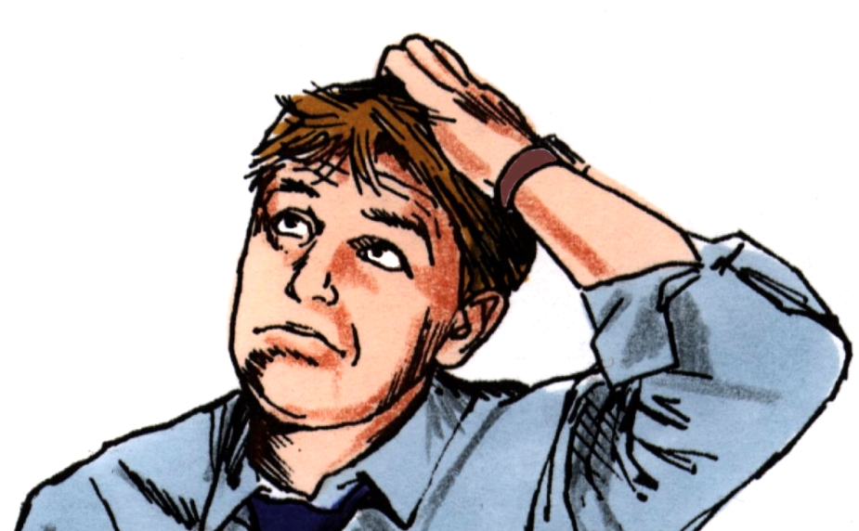
Why do bad things sometimes happen to
good people?

Slide 3
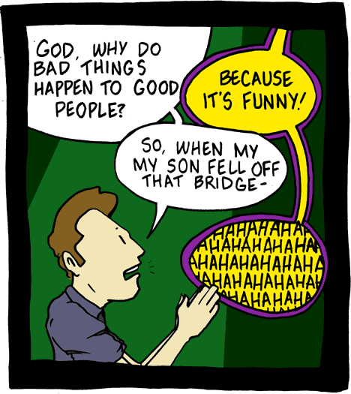
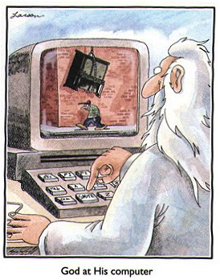
Comics have been written.

Slide 4
Books have been written.

Slide 5
Examples of Good People
Prophets
Matthew 23:31, “Therefore you are witnesses against yourselves that you are sons of those who murdered the prophets.”

Slide 6
Examples of Good People
Prophets
Luke 13:34, “O Jerusalem, Jerusalem, the one who kills the prophets and stones those who are sent to her…”

Slide 7
Examples of Good People
Prophets
Acts 7:51-53, “You stiff-necked and uncircumcised in heart and ears! You always resist the Holy Spirit; as your fathers did, so do you. Which of the prophets did your fathers not persecute? And they killed those who foretold the coming of the Just One, of whom you now have become the
betrayers and murderers, who
have received the law by the
direction of angels and have
not kept it.”

Slide 8
Examples of Good People
Stephen
Acts 7:54-60, “When they heard these things they were cut to the heart, and they gnashed at him with their teeth…Then they cried out with a loud voice, stopped their ears, and ran at him with one accord; and they cast him out of the city and stoned him…”

Slide 9
Examples of Good People
Paul
2 Corinthians 11:22-33, List of Paul’s sufferings.
2 Corinthians 4:8-9, “We are hard-pressed on every side, yet not crushed; we are perplexed, but not in despair; persecuted, but not forsaken; struck down, but not destroyed.”

Slide 10
Examples of Good People
Church in Smyrna
Revelation 2:10, “Do not fear any of those things which you are about to suffer. Indeed, the devil is about to throw some of you into prison, that you may be tested, and you will have tribulation ten days. Be faithful unto death, and I will give you the crown of life.”

Slide 11
Examples of Good People
All Christians
2 Timothy 3:12, “Yes, and all who desire to live godly in Christ Jesus will suffer persecution.”

Slide 12
Examples of Good People
Jesus Christ
Philippians 2:5-8, “Let this mind be in you which was also in Christ Jesus, who, being in the form of God, did not consider it robbery to be equal with God, but made Himself of no reputation, taking the form of a bondservant, and coming in the likeness of men. And being found in
appearance as a man, He
humbled Himself and became
obedient to the point of death,
even the death of the cross.”

Slide 13
Examples of Good People
Prophets
Stephen
Paul
Church in Smyrna
All Christians
Jesus Christ

Slide 14
What are some of the reasons?
It produces patience
James 1:2-4, “My brethren, count it all joy when you fall into various trials, knowing that the testing of your faith produces patience. But let patience have its perfect work, that you may be perfect and complete, lacking nothing.”

Slide 15
What are some of the reasons?
It produces patience
James 5:10-11, “My brethren, take the prophets, who spoke in the name of the Lord, as an example of suffering and patience. Indeed we count them blessed who endure. You have heard of the perseverance of Job and seen the end intended
by the Lord—that the Lord is very
compassionate and merciful.”

Slide 16
What are some of the reasons?
We are able to rejoice
1 Peter 1:6, “In this you greatly rejoice, though now for a little while, if need be, you have been grieved by various trials.”

Slide 17
What are some of the reasons?
It makes us pure
1 Peter 1:7, “That the genuineness of your faith, being much more precious than gold that perishes, though it is tested by fire, may be found to praise, honor, and glory at the revelation of Jesus Christ.”

Slide 18
What are some of the reasons?
Able to comfort others
2 Corinthians 1:4, “Who comforts us in all our tribulation, that we may be able to comfort those who are in any trouble, with the comfort with which we ourselves are comforted by God.”

Slide 19
What are some of the reasons?
Not to trust in ourselves
2 Corinthians 1:9-10, “Yes, we had the sentence of death in ourselves, that we should not trust in ourselves but in God who raises the dead, who delivered us from so great a death, and does deliver us; in whom we trust that He will still deliver us”

Slide 20
What are some of the reasons?
It produces patience
We are able to rejoice
To make us pure
To comfort others
Not to trust in ourselves

Slide 21
Yes, bad things can happen
to good people
1. It has happened in the past
2. We should not let it discourage us.

