Slide 1
Notes:
So far, mostly thanksgiving in this letter. And, how the word was presented.

Slide 2
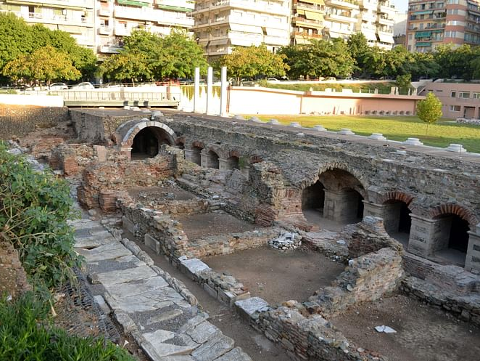
Hope, Glory, Crown, and Joy
1 Thessalonians 2:17-20
Notes:
We continue to see thankfulness. Four words used to describe the Thess.

Slide 3
¹⁷ But we, brethren, having been taken away from you for a short while—in person, not in spirit—were all the more eager with great desire to see your face.
¹⁸ For we wanted to come to you—I, Paul,more than once—and yet Satan hindered us.
¹⁹ For who is our hope or joy or crown of exultation? Is it not even you, in the presence of our Lord Jesus at His coming? ²⁰ For you are our glory and joy.

Slide 4
¹⁷ But we, brethren, having been taken away from you for a short while—in person, not in spirit—were all the more eager with great desire to see your face.
¹⁸ For we wanted to come to you—I, Paul,more than once—and yet Satan hindered us.
¹⁹ For who is our hope or joy or crown of exultation? Is it not even you, in the presence of our Lord Jesus at His coming? ²⁰ For you are our glory and joy.
Notes:
Are we eager to see each other? Eager-something we hope moves quickly. Look forward to.

Slide 5
¹⁷ But we, brethren, having been taken away from you for a short while—in person, not in spirit—were all the more eager with great desire to see your face.
¹⁸ For we wanted to come to you—I, Paul,more than once—and yet Satan hindered us.
¹⁹ For who is our hope or joy or crown of exultation? Is it not even you, in the presence of our Lord Jesus at His coming? ²⁰ For you are our glory and joy.
Notes:
Would ‘great desire’ be how we describe wanting to be with each other? We might have great desire for many things.

Slide 6
¹⁷ But we, brethren, having been taken away from you for a short while—in person, not in spirit—were all the more eager with great desire to see your face.
¹⁸ For we wanted to come to you—I, Paul,more than once—and yet Satan hindered us.
¹⁹ For who is our hope or joy or crown of exultation? Is it not even you, in the presence of our Lord Jesus at His coming? ²⁰ For you are our glory and joy.
Notes:
We understand better than ever no sub for face to face. Zoom.

Slide 7
¹⁷ But we, brethren, having been taken away from you for a short while—in person, not in spirit—were all the more eager with great desire to see your face.
¹⁸ For we wanted to come to you—I, Paul,more than once—and yet Satan hindered us.
¹⁹ For who is our hope or joy or crown of exultation? Is it not even you, in the presence of our Lord Jesus at His coming? ²⁰ For you are our glory and joy.
Notes:
*Do we believe Satan is real? Evil and a realm that we can’t fathom. *Satan doesn’t want us together. *Says something about the power of being together.

Slide 8
¹⁷ But we, brethren, having been taken away from you for a short while—in person, not in spirit—were all the more eager with great desire to see your face.
¹⁸ For we wanted to come to you—I, Paul,more than once—and yet Satan hindered us.
¹⁹ For who is our hope or joy or crown of exultation? Is it not even you, in the presence of our Lord Jesus at His coming? ²⁰ For you are our glory and joy.
Notes:
*Do we believe Satan is real? Evil and a realm that we can’t fathom. *Satan doesn’t want us together. *Says something about the power of being together.

Slide 9
¹⁷ But we, brethren, having been taken away from you for a short while—in person, not in spirit—were all the more eager with great desire to see your face.
¹⁸ For we wanted to come to you—I, Paul,more than once—and yet Satan hindered us.
¹⁹ For who is our hope or joy or crown of exultation? Is it not even you, in the presence of our Lord Jesus at His coming? ²⁰ For you are our glory and joy.
Notes:
*Expectation of future good. We should have hope/confidence in each other. *In what do we hope?

Slide 10
¹⁷ But we, brethren, having been taken away from you for a short while—in person, not in spirit—were all the more eager with great desire to see your face.
¹⁸ For we wanted to come to you—I, Paul,more than once—and yet Satan hindered us.
¹⁹ For who is our hope or joy or crown of exultation? Is it not even you, in the presence of our Lord Jesus at His coming? ²⁰ For you are our glory and joy.
Notes:
*Joy-to be glad, rejoice. Do we have joy w each other? What brings us joy?

Slide 11
¹⁷ But we, brethren, having been taken away from you for a short while—in person, not in spirit—were all the more eager with great desire to see your face.
¹⁸ For we wanted to come to you—I, Paul,more than once—and yet Satan hindered us.
¹⁹ For who is our hope or joy or crown of exultation? Is it not even you, in the presence of our Lord Jesus at His coming? ²⁰ For you are our glory and joy.
Notes:
*Exaltation (rejoicing,boasting). Reference to the wreath for victory. Trophy. Is that how we think of each other? A prize.

Slide 12
¹⁷ But we, brethren, having been taken away from you for a short while—in person, not in spirit—were all the more eager with great desire to see your face.
¹⁸ For we wanted to come to you—I, Paul,more than once—and yet Satan hindered us.
¹⁹ For who is our hope or joy or crown of exultation? Is it not even you, in the presence of our Lord Jesus at His coming? ²⁰ For you are our glory and joy.
Notes:
*Glory-great worth, held in high opinion. Is that true? How do we talk of each other?

Slide 13
¹⁷ But we, brethren, having been taken away from you for a short while—in person, not in spirit—were all the more eager with great desire to see your face.
¹⁸ For we wanted to come to you—I, Paul,more than once—and yet Satan hindered us.
¹⁹ For who is our hope or joy or crown of exultation? Is it not even you, in the presence of our Lord Jesus at His coming? ²⁰ For you are our glory and joy.
Notes:
*Is this how we think of each other? *Is this how the early church always was? No. Gospels, Acts, Romans…*Specific individuals are told to get along. *Could each of these words be used of how we think of each other?

Slide 14
I rejoiced greatly that I have found some of your children walking in truth, as we received a commandment from the Father.
2 John 4
For I rejoiced greatly when brethren came and testified of the truth that is in you, just as you walk in the truth. I have no greater joy than to hear that my children walk in truth.
3 John 3-4
Notes:
*See others do the right thing should give us so much joy! Opposite also, it should sadden us.

Slide 15
¹⁷ But we, brethren, having been taken away from you for a short while—in person, not in spirit—were all the more eager with great desire to see your face.
¹⁸ For we wanted to come to you—I, Paul,more than once—and yet Satan hindered us.
¹⁹ For who is our hope or joy or crown of exultation?
Is it not even you, in the presence of our Lord Jesus at His coming? ²⁰ For you are our glory and joy.
Notes:
*Is this how we think of each other? *Is this how the early church always was? No. Gospels, Acts, Romans…*Specific individuals are told to get along. *Could each of these words be used of how we think of each other?

Slide 16
and may the Lord cause you to increase and abound in love for one another, and for all people, just as we also do for you; so that He may establish your hearts without blame in holiness before our God and Father at the coming of our Lord Jesus with all His saints.
1 Thessalonians 3:13

Slide 17
For this we say to you by the word of the Lord, that we who are alive and remain until the coming of the Lord, will not precede those who have fallen asleep.
1 Thessalonians 4:15

Slide 18
Now may the God of peace Himself sanctify you entirely; and may your spirit and soul and body be preserved complete, without blame at the coming of our Lord Jesus Christ.
1 Thessalonians 5:23

Slide 19
Now we request you, brethren, with regard to the coming of our Lord Jesus Christ and our gathering together to Him, that you not be quickly shaken from your composure or be disturbed either by a spirit or a message or a letter as if from us, to the effect that the day of the Lord has come.
2 Thessalonians 2:1

Slide 20
¹⁷ But we, brethren, having been taken away from you for a short while—in person, not in spirit—were all the more eager with great desire to see your face.
¹⁸ For we wanted to come to you—I, Paul,more than once—and yet Satan hindered us.
¹⁹ For who is our hope or joy or crown of exultation?
Is it not even you, in the presence of our Lord Jesus at His coming? ²⁰ For you are our glory and joy.
Notes:
*Combined with joy is the expectation of Christ’s return.

