Slide 2
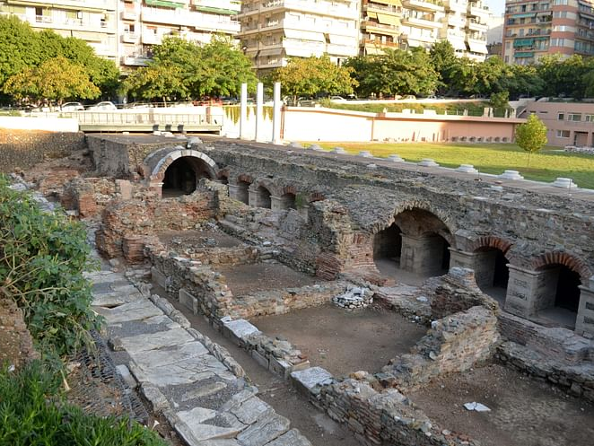
The Desire for the Thessalonians
1 Thessalonians 3:11-13
Notes:
Tonight, we look at the desire of Paul, Silas, and Timothy for the Thessalonians. Mostly been joy and thankfulness. But what do they desire for this church? It should be our desire for one another.

Slide 3
¹¹ Now may our God and Father Himself, and our Lord Jesus Christ, direct our way to you. ¹² And may the Lord make you increase and abound in love to one another and to all, just as we do to you, ¹³ so that He may establish your hearts blameless in holiness before our God and Father at the coming of our Lord Jesus Christ with all His saints.
Notes:
First, this sounds like a prayer.

Slide 4
And this I pray, that your love may abound still more and more in knowledge and all discernment, that you may approve the things that are excellent, that you may be sincere and without offense till the day of Christ, being filled with the fruits of righteousness which are by Jesus Christ, to the glory and praise of God.
Philippians 1:9-11
Notes:
This connects to hope, joy, crown, and glory.

Slide 5
For this reason we also, since the day we heard it, do not cease to pray for you, and to ask that you may be filled with the knowledge of His will in all wisdom and spiritual understanding; that you may walk worthy of the Lord, fully pleasing Him, being fruitful in every good work and increasing in the knowledge of God; strengthened with all might, according to His glorious power, for all patience and longsuffering with joy; giving thanks to the Father who has qualified us to be partakers of the inheritance of the saints in the light.
Colossians 1:9-12
Notes:
This connects to hope, joy, crown, and glory.

Slide 6
¹¹ Now may our God and Father Himself, and our Lord Jesus Christ, direct our way to you. ¹² And may the Lord make you increase and abound in love to one another and to all, just as we do to you, ¹³ so that He may establish your hearts blameless in holiness before our God and Father at the coming of our Lord Jesus Christ with all His saints.
Notes:
First, this sounds like a prayer.

Slide 7
¹¹ Now may our God and Father Himself, and our Lord Jesus Christ, direct our way to you. ¹² And may the Lord make you increase and abound in love to one another and to all, just as we do to you, ¹³ so that He may establish your hearts blameless in holiness before our God and Father at the coming of our Lord Jesus Christ with all His saints.
Notes:
The first desire is that they would be able to be together. Connects with the previous section. Satan hindered Paul. We should want to be together. Is that our prayer? That we would be able to be together?

Slide 8
¹¹ Now may our God and Father Himself, and our Lord Jesus Christ, direct our way to you. ¹² And may the Lord make you increase and abound in love to one another and to all, just as we do to you, ¹³ so that He may establish your hearts blameless in holiness before our God and Father at the coming of our Lord Jesus Christ with all His saints.
Notes:
Second desire is that the Lord would make them increase and abound. Growth is not entirely up to us.

Slide 9
¹¹ Now may our God and Father Himself, and our Lord Jesus Christ, direct our way to you. ¹² And may the Lord make you increase and abound in love to one another and to all, just as we do to you, ¹³ so that He may establish your hearts blameless in holiness before our God and Father at the coming of our Lord Jesus Christ with all His saints.
Notes:
Second desire is that the Lord would make them increase and abound. Growth is not entirely up to us.

Slide 10
being confident of this very thing, that He who has begun a good work in you will complete it until the day of Jesus Christ
Philippians 1:6
Notes:
God is involved in our growth and wants us to grow.

Slide 11
Therefore, my beloved, as you have always obeyed, not as in my presence only, but now much more in my absence, work out your own salvation with fear and trembling;
Philippians 2:12
Notes:
How many times have we heard this verse quoted and it stops there.

Slide 12
Therefore, my beloved, as you have always obeyed, not as in my presence only, but now much more in my absence, work out your own salvation with fear and trembling;
for it is God who works in you both to will and to do for His good pleasure.
Philippians 2:12-13
Notes:
It is God who works in you. We work, but God works within us.

Slide 13
¹¹ Now may our God and Father Himself, and our Lord Jesus Christ, direct our way to you. ¹² And may the Lord make you increase and abound in love to one another and to all, just as we do to you, ¹³ so that He may establish your hearts blameless in holiness before our God and Father at the coming of our Lord Jesus Christ with all His saints.
Notes:
Second desire is that the Lord would make them increase and abound. Growth is not entirely up to us.

Slide 14
¹¹ Now may our God and Father Himself, and our Lord Jesus Christ, direct our way to you. ¹² And may the Lord make you increase and abound in love to one another and to all, just as we do to you, ¹³ so that He may establish your hearts blameless in holiness before our God and Father at the coming of our Lord Jesus Christ with all His saints.
Notes:
Though the outer man is decaying, the inner man is being renewed. We are to be growing daily. We’re either progressing or declining.

Slide 15
But also for this very reason, giving all diligence, add to your faith virtue, to virtue knowledge, virtue knowledge, to knowledge self-control, to self-control perseverance, to perseverance godliness, to godliness brotherly kindness, and to brotherly kindness love. For if these things are yours and abound, you will be neither barren nor unfruitful in the knowledge of our Lord Jesus Christ.
2 Peter 1:5-8
Notes:
It is God who works in you. We work, but God works within us.

Slide 16
¹¹ Now may our God and Father Himself, and our Lord Jesus Christ, direct our way to you. ¹² And may the Lord make you increase and abound in love to one another and to all, just as we do to you, ¹³ so that He may establish your hearts blameless in holiness before our God and Father at the coming of our Lord Jesus Christ with all His saints.
Notes:
The desire is for a specific area of increase—love for one another. So many ‘love one another’ verses.

Slide 17
But concerning brotherly love you have no need that I should write to you, for you yourselves are taught by God to love one another; and indeed you do so toward all the brethren who are in all Macedonia. But we urge you, brethren, that you increase more and more. 1 Thessalonians 4:9-10
Notes:
Apparently, they were quite good at loving one another. But there was still room for growth. Fascinating! Larry Bird kept practicing. Why not stop? Always get better.

Slide 18
¹¹ Now may our God and Father Himself, and our Lord Jesus Christ, direct our way to you. ¹² And may the Lord make you increase and abound in love to one another and to all, just as we do to you, ¹³ so that He may establish your hearts blameless in holiness before our God and Father at the coming of our Lord Jesus Christ with all His saints.
Notes:
The desire is for a specific area of increase—love for one another. So many ‘love one another’ verses.

Slide 19
¹¹ Now may our God and Father Himself, and our Lord Jesus Christ, direct our way to you. ¹² And may the Lord make you increase and abound in love to one another and to all, just as we do to you, ¹³ so that He may establish your hearts blameless in holiness before our God and Father at the coming of our Lord Jesus Christ with all His saints.
Notes:
The one another passages are in reference primarily to Christians. But now, this is expanded. It could be ‘all Christians’ I think more likely all people. Maybe we are good at loving one another, but what about all people?

Slide 20
¹¹ Now may our God and Father Himself, and our Lord Jesus Christ, direct our way to you. ¹² And may the Lord make you increase and abound in love to one another and to all, just as we do to you, ¹³ so that He may establish your hearts blameless in holiness before our God and Father at the coming of our Lord Jesus Christ with all His saints.
Notes:
So that. Why do we want to increase and abound?

Slide 21
¹¹ Now may our God and Father Himself, and our Lord Jesus Christ, direct our way to you. ¹² And may the Lord make you increase and abound in love to one another and to all, just as we do to you, ¹³ so that He may establish your hearts blameless in holiness before our God and Father at the coming of our Lord Jesus Christ with all His saints.
Notes:
Blameless=to not be able to find fault. The only way for that to occur is to be in Christ. Like being justified.

Slide 22
¹¹ Now may our God and Father Himself, and our Lord Jesus Christ, direct our way to you. ¹² And may the Lord make you increase and abound in love to one another and to all, just as we do to you, ¹³ so that He may establish your hearts blameless in holiness before our God and Father at the coming of our Lord Jesus Christ with all His saints.
Notes:
Blameless=to not be able to find fault. The only way for that to occur is to be in Christ. Like being justified.

Slide 23
¹¹ Now may our God and Father Himself, and our Lord Jesus Christ, direct our way to you. ¹² And may the Lord make you increase and abound in love to one another and to all, just as we do to you, ¹³ so that He may establish your hearts blameless in holiness before our God and Father at the coming of our Lord Jesus Christ with all His saints.
Notes:
Holiness is more than just doing a nice thing for somebody. It is eternal life now. Our lives look like Heaven.

Slide 24
¹¹ Now may our God and Father Himself, and our Lord Jesus Christ, direct our way to you. ¹² And may the Lord make you increase and abound in love to one another and to all, just as we do to you, ¹³ so that He may establish your hearts blameless in holiness before our God and Father at the coming of our Lord Jesus Christ with all His saints.
Notes:
We again return to the big theme of Thessalonians. This is actually the third time so far. So much of this is about preparation for this event! Do we really believe in this and long for this. Do we think about our lives as preparing for the great event we anticipate?

