Slide 2
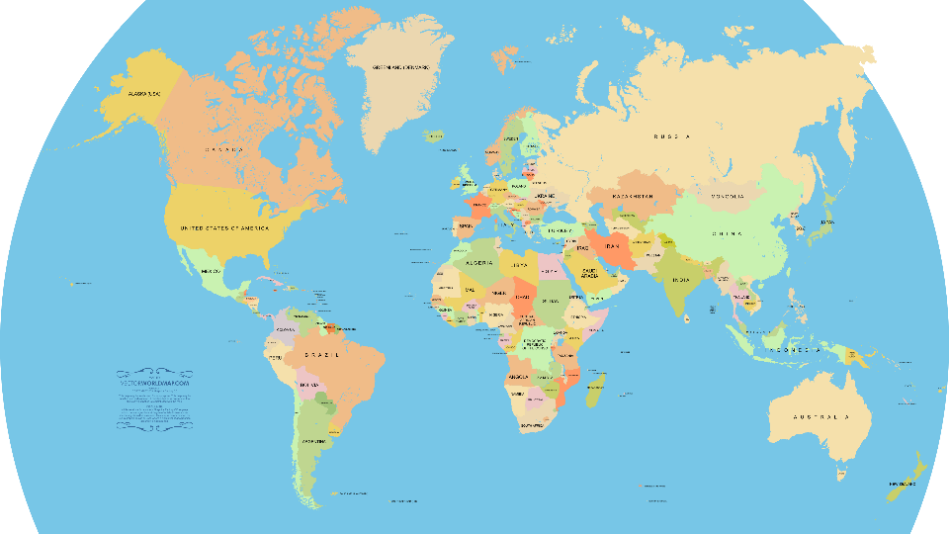

Slide 3
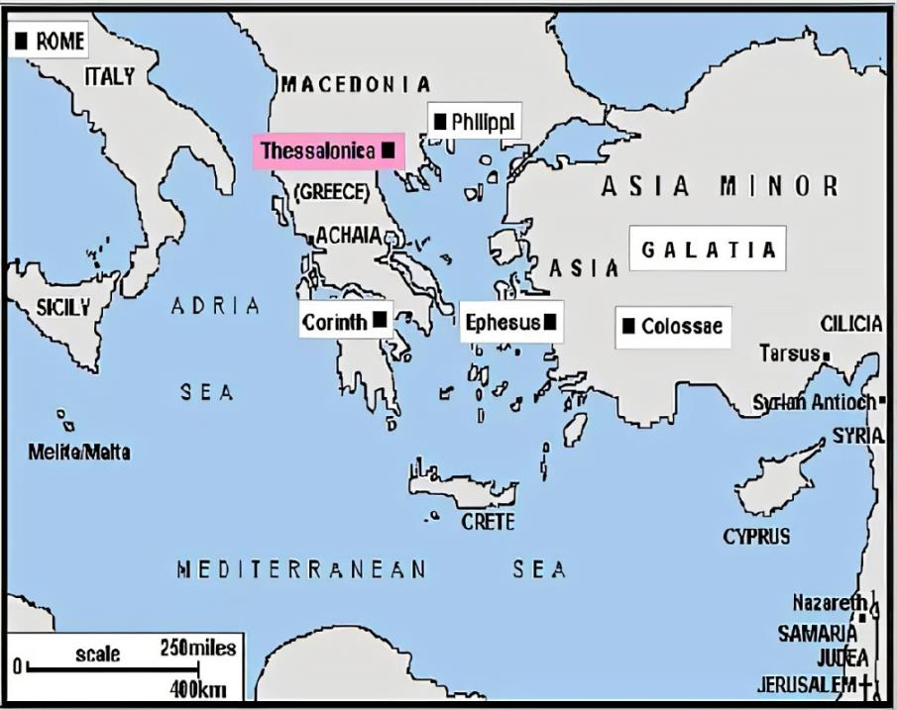

Slide 4
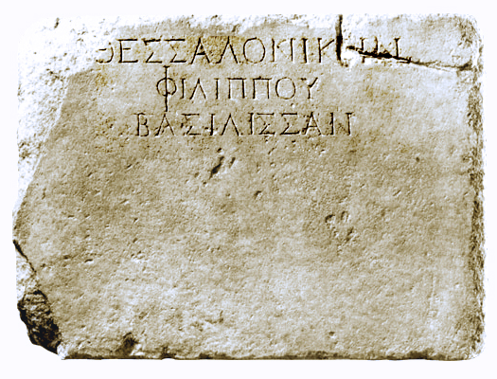

Slide 5
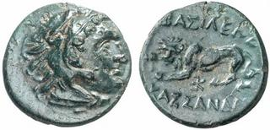

Slide 6
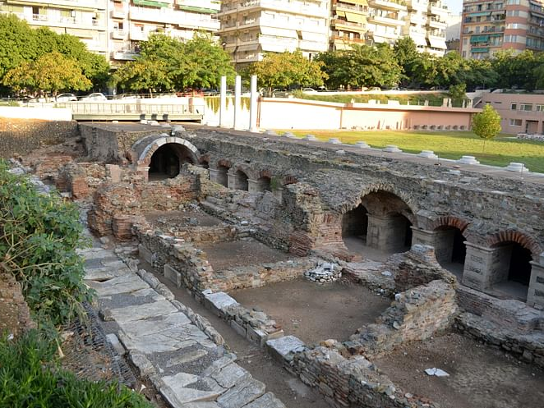

Slide 7
1 Thessalonians 1:1
Paul, Silvanus, and Timothy,
To the church of the Thessalonians in God the Father and the Lord Jesus Christ:
Grace to you and peace.
2 Thessalonians 1:1
Paul, Silvanus, and Timothy,
To the church of the Thessalonians in God our Father and the Lord Jesus Christ:

Slide 8
1 Thessalonians 2:18
because we wanted to come to you—I, Paul, again and again—but Satan hindered us.
2 Thessalonians 3:17
I, Paul, write this greeting with my own hand. This is the sign of genuineness in every letter of mine; it is the way I write.

Slide 9
1 Thessalonians 2:17
But we, brethren, having been taken away from you for a short time in presence, not in heart, endeavored more eagerly to see your face with great desire.
1 Thessalonians 3:1-2
Therefore, when we could no longer endure it, we thought it good to be left in Athens alone, and sent Timothy, our brother and minister of God, and our fellow laborer in the gospel of Christ, to establish you and encourage you concerning your faith

Slide 10
2 Thessalonians 2:15
So then, brothers, stand firm and hold to the traditions that you were taught by us, either by our spoken word or by our letter.

Slide 11
1 Thessalonians 1:2
We give thanks to God always for all of you, making mention of you in our prayers

Slide 12
1 Thessalonians 1:3
constantly bearing in mind your work of faith and labor of love and steadfastness of hope in our Lord Jesus Christ in the presence of our God and Father

Slide 13
1 Thessalonians 1:6
You also became imitators of us and of the Lord, having received the word in much tribulation with the joy of the Holy Spirit

Slide 14
1 Thessalonians 1:7-8
so that you became an example to all the believers in Macedonia and in Achaia. For the word of the Lord has sounded forth from you, not only in Macedonia and Achaia, but also in every place your faith toward God has gone forth, so that we have no need to say anything.

Slide 15
1 Thessalonians 1:9
For they themselves report about us what kind of a reception we had with you, and how you turned to God from idols to serve a living and true God

Slide 16
1 Thessalonians 1:10
and to wait for His Son from heaven, whom He raised from the dead, that is Jesus, who rescues us from the wrath to come.

