Slide 2
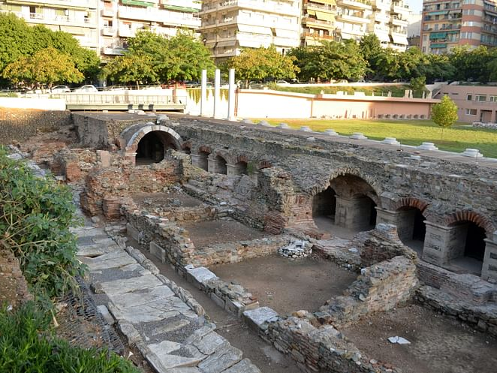
The Actions of the Thessalonians
1 Thessalonians 2:13-17

Slide 3
¹³ And we also thank God constantly for this, that when you received the word of God, which you heard from us,
you accepted it not as the word of men but as what it really is, the word of God, which is at work in you believers.
¹⁴ For you, brothers, became imitators of the churches of God in Christ Jesus that are in Judea.
For you suffered the same things from your own countrymen as they did from the Jews, ¹⁵ who killed both the Lord Jesus and the prophets, and drove us out, and displease God and oppose all mankind ¹⁶ by hindering us from speaking to the Gentiles that they might be saved—so as always to fill up the measure of their sins. But wrath has come upon them at last!

Slide 4
So then faith comes by hearing,
and hearing by the word of God.
Romans 10:17

Slide 5
¹³ And we also thank God constantly for this, that when you received the word of God, which you heard from us,
you accepted it not as the word of men but as what it really is, the word of God, which is at work in you believers.
¹⁴ For you, brothers, became imitators of the churches of God in Christ Jesus that are in Judea.
For you suffered the same things from your own countrymen as they did from the Jews, ¹⁵ who killed both the Lord Jesus and the prophets, and drove us out, and displease God and oppose all mankind ¹⁶ by hindering us from speaking to the Gentiles that they might be saved—so as always to fill up the measure of their sins. But wrath has come upon them at last!

Slide 6
And some of them were persuaded; and a great multitude of the devout Greeks, and not a few of the leading women, joined Paul and Silas.
But the Jews who were not persuaded, becoming envious, took some of the evil men from the marketplace, and gathering a mob, set all the city in an uproar and attacked the house of Jason, and sought to bring them out to the people.
Acts 17:4-5

Slide 7
¹³ And we also thank God constantly for this, that when you received the word of God, which you heard from us,
you accepted it not as the word of men but as what it really is, the word of God, which is at work in you believers.
¹⁴ For you, brothers, became imitators of the churches of God in Christ Jesus that are in Judea.
For you suffered the same things from your own countrymen as they did from the Jews, ¹⁵ who killed both the Lord Jesus and the prophets, and drove us out, and displease God and oppose all mankind ¹⁶ by hindering us from speaking to the Gentiles that they might be saved—so as always to fill up the measure of their sins. But wrath has come upon them at last!

Slide 8
But as we have been approved by God to be entrusted with the gospel, even so we speak, not as pleasing men, but God who tests our hearts.
1 Thessalonians 2:4
But I make known to you, brethren, that the gospel which was preached by me is not according to man. For I neither received it from man, nor was I taught it, but it came through the revelation of Jesus Christ.
Galatians 1:11-12

Slide 9
¹³ And we also thank God constantly for this, that when you received the word of God, which you heard from us,
you accepted it not as the word of men but as what it really is, the word of God, which is at work in you believers.
¹⁴ For you, brothers, became imitators of the churches of God in Christ Jesus that are in Judea.
For you suffered the same things from your own countrymen as they did from the Jews, ¹⁵ who killed both the Lord Jesus and the prophets, and drove us out, and displease God and oppose all mankind ¹⁶ by hindering us from speaking to the Gentiles that they might be saved—so as always to fill up the measure of their sins. But wrath has come upon them at last!

Slide 10
So shall My word be that goes forth from My mouth; It shall not return to Me void, But it shall accomplish what I please, And it shall prosper in the thing for which I sent it.
Isaiah 55:11

Slide 11
¹³ And we also thank God constantly for this, that when you received the word of God, which you heard from us,
you accepted it not as the word of men but as what it really is, the word of God, which is at work in you believers.
¹⁴ For you, brothers, became imitators of the churches of God in Christ Jesus that are in Judea.
For you suffered the same things from your own countrymen as they did from the Jews, ¹⁵ who killed both the Lord Jesus and the prophets, and drove us out, and displease God and oppose all mankind ¹⁶ by hindering us from speaking to the Gentiles that they might be saved—so as always to fill up the measure of their sins. But wrath has come upon them at last!

Slide 12
Imitate me, just as I also imitate Christ.
1 Corinthians 11:1
Therefore be imitators of God as dear children.
Ephesians 5:1
And we desire that each one of you show the same diligence to the full assurance of hope until the end, that you do not become sluggish, but imitate those who through faith and patience inherit the promises.
Hebrews 6:12

Slide 13
¹³ And we also thank God constantly for this, that when you received the word of God, which you heard from us,
you accepted it not as the word of men but as what it really is, the word of God, which is at work in you believers.
¹⁴ For you, brothers, became imitators of the churches of God in Christ Jesus that are in Judea.
For you suffered the same things from your own countrymen as they did from the Jews, ¹⁵ who killed both the Lord Jesus and the prophets, and drove us out, and displease God and oppose all mankind ¹⁶ by hindering us from speaking to the Gentiles that they might be saved—so as always to fill up the measure of their sins. But wrath has come upon them at last!

Slide 14
And He began to teach them that the Son of Man must suffer many things, and be rejected by the elders and chief priests and scribes, and be killed, and after three days rise again.
Mark 8:31
But those things which God foretold by the mouth of all His prophets, that the Christ would suffer, He has thus fulfilled.
Acts 3:18

Slide 15
So they departed from the presence of the council, rejoicing that they were counted worthy to suffer shame for His name.
Acts 5:41
but rejoice to the extent that you partake of Christ’s sufferings, that when His glory is revealed, you may also be glad with exceeding joy.
1 Peter 4:13

Slide 16
¹³ And we also thank God constantly for this, that when you received the word of God, which you heard from us,
you accepted it not as the word of men but as what it really is, the word of God, which is at work in you believers.
¹⁴ For you, brothers, became imitators of the churches of God in Christ Jesus that are in Judea.
For you suffered the same things from your own countrymen as they did from the Jews, ¹⁵ who killed both the Lord Jesus and the prophets, and drove us out, and displease God and oppose all mankind ¹⁶ by hindering us from speaking to the Gentiles that they might be saved—so as always to fill up the measure of their sins. But wrath has come upon them at last!

