Slide 2
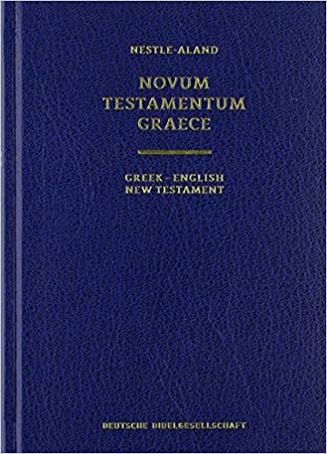
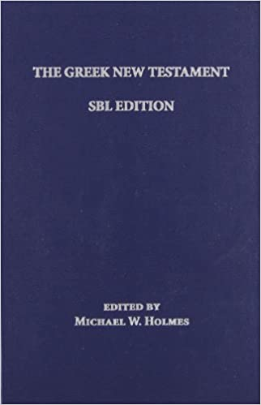
Tyndale House
NA 28
UBS 5
SBL

Slide 4
KJV (1611)
And he is the propitiation for our sins: and not for ours only, but also for the sins of the whole world.
RV (1885)
ASV (1901)
NASB (1971)
RSV (1952)
NKJV (1982)
NRSV (1989)
ESV (2001)

Slide 5
KJV (1611)
and he is the propitiation for our sins; and not for ours only, but also for the whole world.
RV (1885)
ASV (1901)
NASB (1971)
RSV (1952)
NKJV (1982)
NRSV (1989)
ESV (2001)

Slide 6
KJV (1611)
RV (1885)
and he is the propitiation for our sins; and not for ours only, but also for the whole world.
ASV (1901)
NASB (1971)
RSV (1952)
NKJV (1982)
NRSV (1989)
ESV (2001)

Slide 7
KJV (1611)
RV (1885)
ASV (1901)
and he is the expiation for our sins, and not for ours only but also for the sins of the whole world.
NASB (1971)
RSV (1952)
NKJV (1982)
NRSV (1989)
ESV (2001)

Slide 8
KJV (1611)
RV (1885)
ASV (1901)
and He Himself is the propitiation for our sins; and not for ours only, but also for the sins of the whole world.
NASB (1971)
RSV (1952)
NKJV (1982)
NRSV (1989)
ESV (2001)

Slide 9
KJV (1611)
RV (1885)
ASV (1901)
NASB (1971)
RSV (1952)
NKJV (1982)
NRSV (1989)
ESV (2001)

Slide 10
KJV (1611)
RV (1885)
ASV (1901)
NASB (1971)
RSV (1952)
And He Himself is the propitiation for our sins, and not for ours only but also for the whole world.
NKJV (1982)
NRSV (1989)
ESV (2001)

Slide 11
KJV (1611)
RV (1885)
ASV (1901)
NASB (1971)
RSV (1952)
NKJV (1982)
NRSV (1989)
ESV (2001)
He is the propitiation for our sins, and not for ours only but also for the sins of the whole world.

Slide 13
When he served as a sacrifice for our sins, he solved the sin problem for good—not only ours, but the whole world’s.
The Message

Slide 14
He is God’s way of dealing with our sins, not only ours but the sins of the whole world.
Common English Bible

Slide 15
Jesus is the way our sins are taken away. And he is the way all people can have their sins taken away too.
Easy-to-Read Version

Slide 16
And Christ himself is the means by which our sins are forgiven, and not our sins only, but also the sins of everyone.
Good News Translation

Slide 18
He himself is the sacrifice that atones for our sins—and not only our sins but the sins of all the world.
New Living Translation

Slide 19
He is the atoning sacrifice for our sins, and not only for ours but also for the sins of the whole world.
New International Version

Slide 20
He himself is the atoning sacrifice^{[a]} for our sins, and not only for ours, but also for those of the whole world.
Christian Standard Bible

Slide 21
NET Bible

