Slide 2
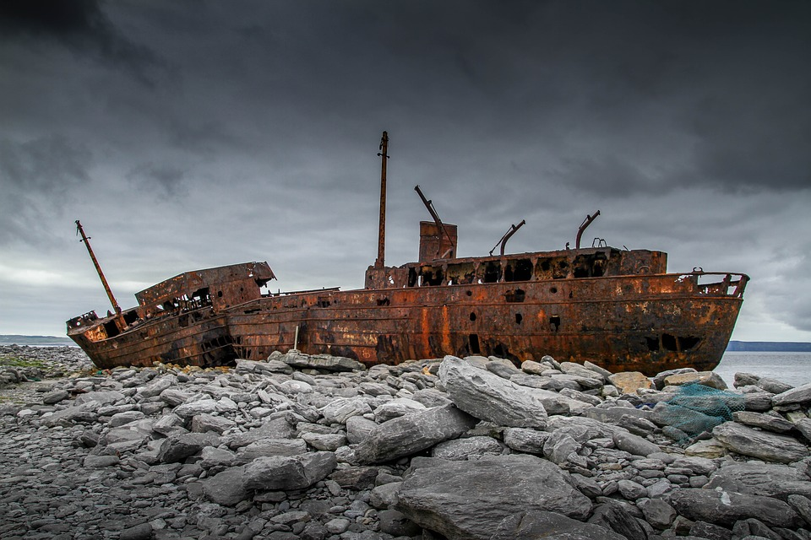
Shipwreck

Slide 3
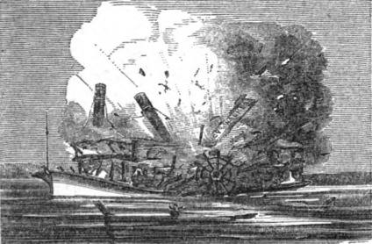

Slide 4
2 Corinthians 11:24-27
Five times I received from the Jews thirty-nine lashes. Three times I was beaten with rods, once I was stoned, three times I was shipwrecked, a night and a day I have spent adrift at sea. I have been on frequent journeys, in dangers from rivers, dangers from robbers, dangers from my countrymen, dangers from the Gentiles, dangers in the city, dangers in the wilderness, dangers at sea, dangers among false brothers; I have been in labor and hardship, through many sleepless nights, in hunger and thirst, often without food, in cold and exposure.

Slide 5
1 Timothy 1:18-20
This charge I commit to you, son Timothy, according to the prophecies previously made concerning you, that by them you may wage the good warfare, having faith and a good conscience, which some having rejected, concerning the faith have suffered shipwreck, of whom are Hymenaeus and Alexander, whom I delivered to Satan that they may learn not to blaspheme.

Slide 6
concerning the faith have suffered shipwreck (NKJV)
have suffered shipwreck in regard to the faith
(NET)
suffered shipwreck in regard to their faith
(NASB)
some have made shipwreck of their faith
(ESV)

Slide 7
They must hold the mystery of
the faith with a clear conscience.
1 Timothy 3:9

Slide 8
Now the Spirit expressly says that in later times some will depart from the faith by devoting themselves to deceitful spirits and teachings of demons.
1 Timothy 4:1

Slide 9
In pointing out these things to the brothers and sisters, you will be a good servant of Christ Jesus, constantly nourished on the words of the faith and of the good doctrine which you have been following.
1 Timothy 4:6

Slide 10
But if anyone does not provide for his relatives, and especially for members of his household, he has denied the faith and is worse than an unbeliever.
1 Timothy 5:8

Slide 11
For the love of money is a root of all kinds of evils. It is through this craving that some have wandered away from the faith and pierced themselves with many pangs.
1 Timothy 6:10

Slide 12
Fight the good fight of the faith. Take hold of the eternal life to which you were called and about which you made the good confession in the presence of many witnesses.
1 Timothy 6:12

Slide 13
which some have professed and thereby have gone astray from the faith. Grace be with you.
1 Timothy 6:21

Slide 14
1 Timothy 1:18-20
This charge I commit to you, son Timothy, according to the prophecies previously made concerning you, that by them you may wage the good warfare, having faith and a good conscience, which some having rejected, concerning the faith have suffered shipwreck, of whom are Hymenaeus and Alexander, whom I delivered to Satan that they may learn not to blaspheme.

Slide 15
1 Timothy 1:18-20
This charge I commit to you, son Timothy, according to the prophecies previously made concerning you, that by them you may wage the good warfare, having faith and a good conscience, which some having rejected, concerning the faith have suffered shipwreck, of whom are Hymenaeus and Alexander, whom I delivered to Satan that they may learn not to blaspheme.

Slide 16
2 Timothy 2:17-18
and their talk will spread like gangrene. Among them are Hymenaeus and Philetus, who have swerved from the truth, saying that the resurrection has already happened. They are upsetting the faith of some.

Slide 17
2 Timothy 4:14-15
Alexander the coppersmith did me great harm; the Lord will repay him according to his deeds.
Beware of him yourself, for he strongly opposed our message.

Slide 18
1 Timothy 1:18-20
This charge I commit to you, son Timothy, according to the prophecies previously made concerning you, that by them you may wage the good warfare, having faith and a good conscience, which some having rejected, concerning the faith have suffered shipwreck, of whom are Hymenaeus and Alexander, whom I delivered to Satan that they may learn not to blaspheme.

Slide 19
1 Timothy 1:5
The aim of our charge is love that issues from a pure heart and a good conscience and a sincere faith.

Slide 20
1 Timothy 1:18-20
This charge I commit to you, son Timothy, according to the prophecies previously made concerning you, that by them you may wage the good warfare, having faith and a good conscience, which some having rejected, concerning the faith have suffered shipwreck, of whom are Hymenaeus and Alexander, whom I delivered to Satan that they may learn not to blaspheme.

