Slide 2
Bible

Slide 3
Old Testament
New Testament

Slide 4
Pentateuch (Genesis-Deuteronomy)
History (Joshua-Esther)
Poetry and Wisdom (Psalms-Song of Solomon)
Prophets (Isaiah-Malachi)

Slide 5
Torah
Law
Nevi’im
Prophets
Ketuvim
Writings

Slide 6
Gospels (Matthew-John)
Acts
Letters of Paul to Churches (Romans-2 Thess)
Letters of Paul to Individuals (1 Tim-Philemon)
General Letters (Hebrews to Jude)
Revelation

Slide 7
Canon

Slide 8
Now He said to them, “These are My words which I spoke to you while I was still with you, that all the things that are written about Me in the Law of Moses and the Prophets and the Psalms must be fulfilled.”
Luke 24:44

Slide 9
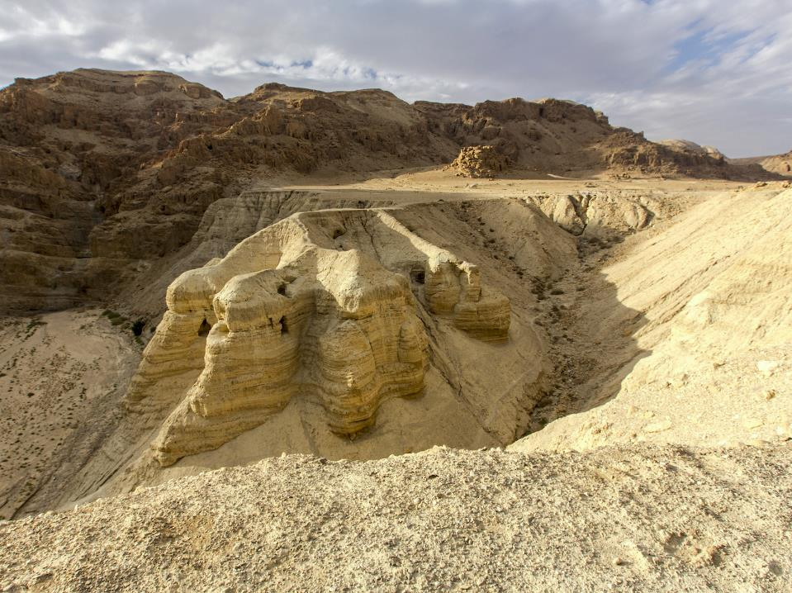

Slide 10
Gospels (Matthew-John)
Acts
Letters of Paul to Churches (Romans-1 Thess)
Letters of Paul to Individuals (1 Tim-Philemon)
General Letters (Hebrews to Jude)
Revelation

Slide 11
When this letter is read among you, have it also read in the church of the Laodiceans; and you, for your part, read my letter that is coming from Laodicea.
Colossians 4:16

Slide 13
Bryan Allan
Ryan
Alan
Brian
Allen
Brain

Slide 14
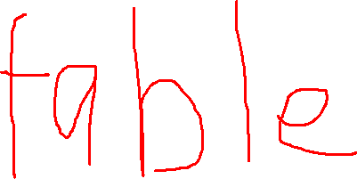

Slide 16
All Scripture is breathed out by God and profitable for teaching, for reproof, for correction, and for training in righteousness, that the man of God may be complete, equipped for every good work. 2 Timothy 3:16-17

