Slide 2
Cubits or Feet?
Formal Equivalence
Dynamic Equivalence

Slide 3
Literal
Dynamic Equivalence

Slide 4
Literal
Dynamic Equivalence
which also you antitype now saving baptism, not flesh off filth, but conscience good, demand toward God through resurrection Jesus Christ

Slide 5
Formal Equivalence
Dynamic Equivalence
NASB
Corresponding to that, baptism now saves you—not the removal of dirt from the flesh, but an appeal to God for a good conscience—through the resurrection of Jesus Christ,

Slide 6
Formal Equivalence
Dynamic Equivalence
ESV
Baptism, which corresponds to this, now saves you, not as a removal of dirt from the body but as an appeal to God for a good conscience, through the resurrection of Jesus Christ,

Slide 7
Formal Equivalence
Dynamic Equivalence
NIV
and this water symbolizes baptism that now saves you also—not the removal of dirt from the body but the pledge of a clear conscience toward God. It saves you by the resurrection of Jesus Christ,

Slide 8
Formal Equivalence
Dynamic Equivalence
NLT
And that water is a picture of baptism, which now saves you, not by removing dirt from your body, but as a response to God from a clean conscience. It is effective because of the resurrection of Jesus Christ.

Slide 9
Formal Equivalence
Dynamic Equivalence
CEV
Those flood waters were like baptism that now saves you. But baptism is more than just washing your body. It means turning to God with a clear conscience, because Jesus Christ was raised from death.

Slide 10
Corresponding to that, baptism now saves you—not the removal of dirt from the flesh, but an appeal to God for a good conscience—through the resurrection of Jesus Christ,
Those flood waters were like baptism that now saves you. But baptism is more than just washing your body. It means turning to God with a clear conscience, because Jesus Christ was raised from death.

Slide 11
Formal Equivalence
Dynamic Equivalence

Slide 12
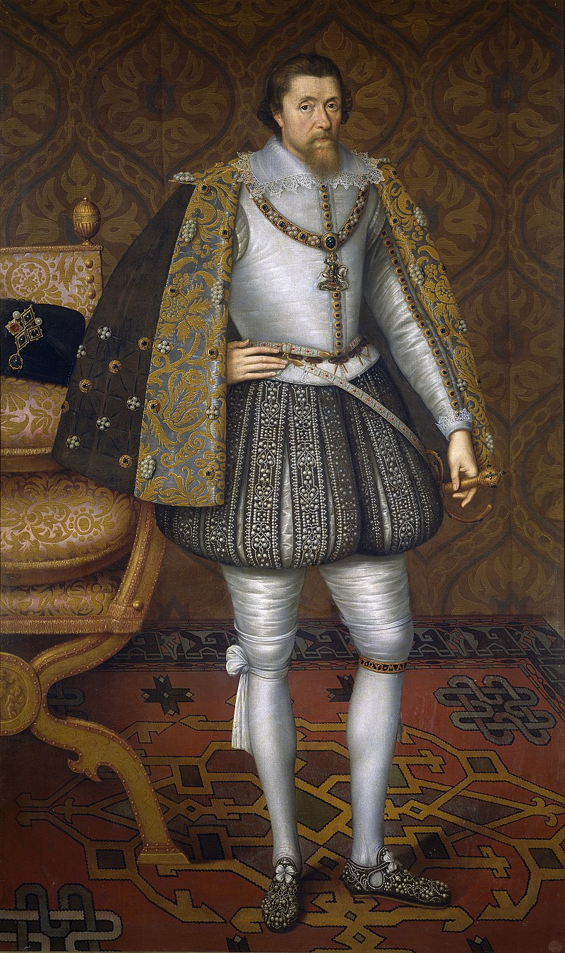
The Authorized Version of 1611
King James Version

Slide 15
Almug
Chode
Chapt
Habergeon
Hosen
Kab
Ligure
Neesed
Pilled
Ring-saked
Stacte
Strake
Trode
Wimples
Ouches
Tatches
Occurrent
Pruit
Wot

Slide 17
KJV (1611)
RV (1885)
ASV (1901)
NASB (1971)
RSV (1952)
NKJV (1982)
NRSV (1989)
ESV (2001)

