Slide 2
What is your life?

Slide 3
James 4:14
yet you do not know what tomorrow will bring. What is your life? For you are a mist that appears for a little time and then vanishes.
What is your life?

Slide 4
Job 7:6
My days are swifter than a weaver's shuttle and come to their end without hope.
What is your life?

Slide 5
Job 7:7
Remember that my life is a breath; my eye will never again see good.
What is your life?

Slide 6
Job 9:25
My days are swifter than a runner; they flee away; they see no good.
What is your life?

Slide 7
Job 9:26a
They go by like skiffs of reed
What is your life?

Slide 8
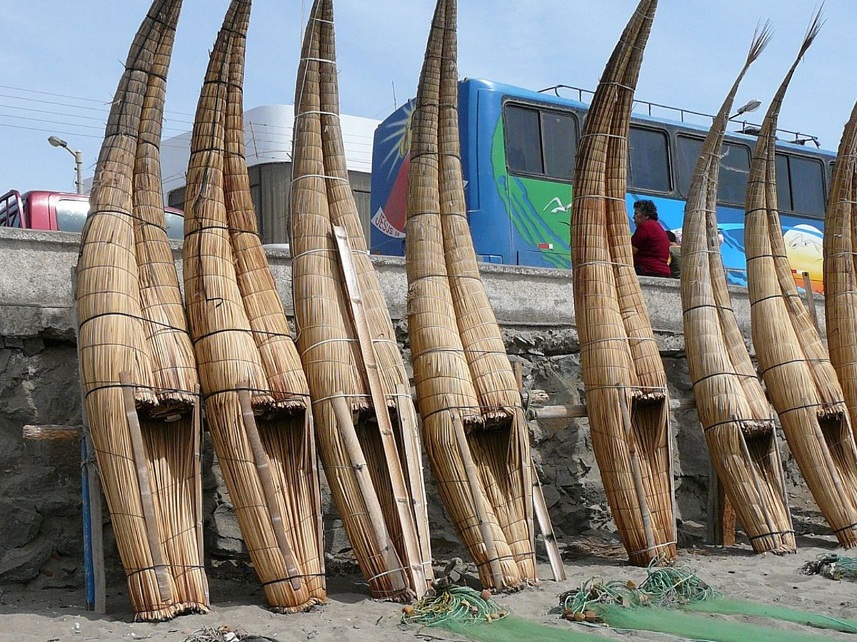

Slide 9
Job 9:26b like an eagle swooping on the prey.
What is your life?

Slide 10
Job 14:1-2 Man who is born of a woman is few of days and full of trouble. He comes out like a flower and withers;
What is your life?

Slide 11
Job 14:2b he flees like a shadow and continues not.
What is your life?

Slide 12
Psalm 39:5 Behold, you have made my days a few handbreadths, and my lifetime is as nothing before you. Surely all mankind stands as a mere breath!
What is your life?

Slide 13
Psalm 39:5 Behold, you have made my days a few handbreadths, and my lifetime is as nothing before you. Surely all mankind stands as a mere breath!
What is your life?

Slide 14
Psalm 144:4 Man is like a breath; his days are like a passing shadow.
What is your life?

Slide 15
1 Peter 1:22-25 Having purified your souls by your obedience to the truth for a sincere brotherly love, love one another earnestly from a pure heart, since you have been born again, not of perishable seed but of imperishable, through the living and abiding word of God; for
“All flesh is like grass and all its glory like the flower of grass. The grass withers, and the flower falls, but the word of the Lord remains forever.”
And this word is the good news that was preached to you.
What is your life?

