Slide 2
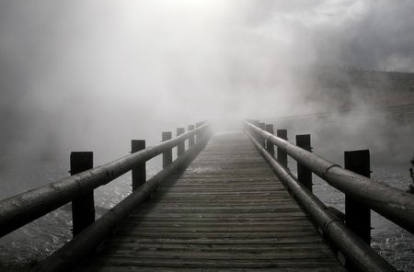

Slide 3
Wait for the Lord

Slide 4
Yet those who wait for the Lord Will gain new strength; They will mount up with wings like eagles, They will run and not get tired, They will walk and not become weary.
Isaiah 40:31

Slide 5
Smallness of Nations (40:12-17)
Weakness of Idols (40:18-20)
Shortness of Rulers (40:21-24)
Greatness of God (40:25-26)
Awareness of God (40:27-31)

Slide 6
Go up on a high mountain, Zion, messenger of good news, Raise your voice forcefully, Jerusalem, messenger of good news; Raise it up, do not fear. Say to the cities of Judah, “Here is your God!”
Isaiah 40:9

