Slide 2
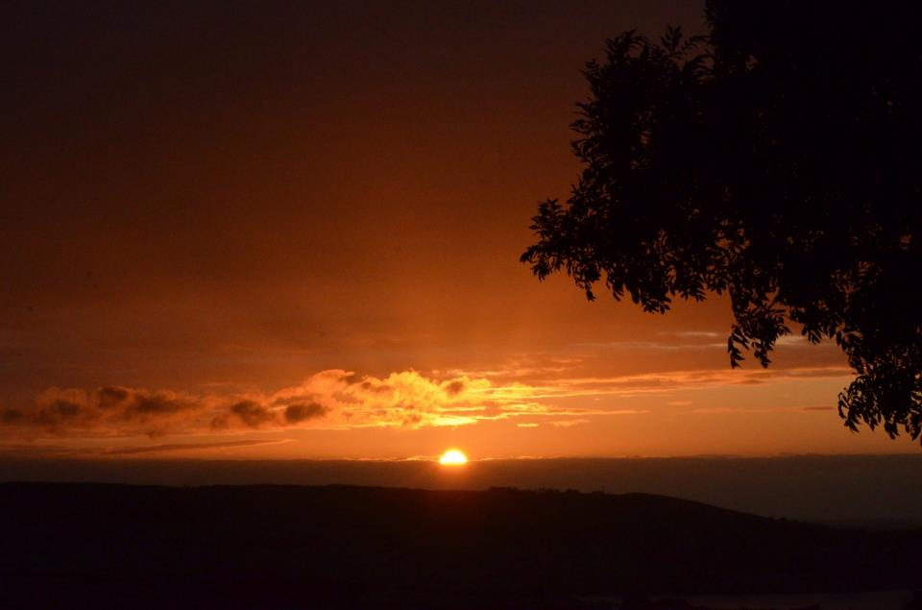
Hope

Slide 3
We give thanks to God, the Father of our Lord Jesus Christ, praying always for you, since we heard of your faith in Christ Jesus and the love which you have for all the saints; because of the hope reserved for you in heaven, of which you previously heard in the word of truth.
Colossians 1:3-5

Slide 4
Blessed be the God and Father of our Lord Jesus Christ, who according to His great mercy has caused us to be born again to a living hope through the resurrection of Jesus Christ from the dead to obtain an inheritance which is imperishable, undefiled, and will not fade away, reserved in heaven for you
1 Peter 1:3-4

Slide 6
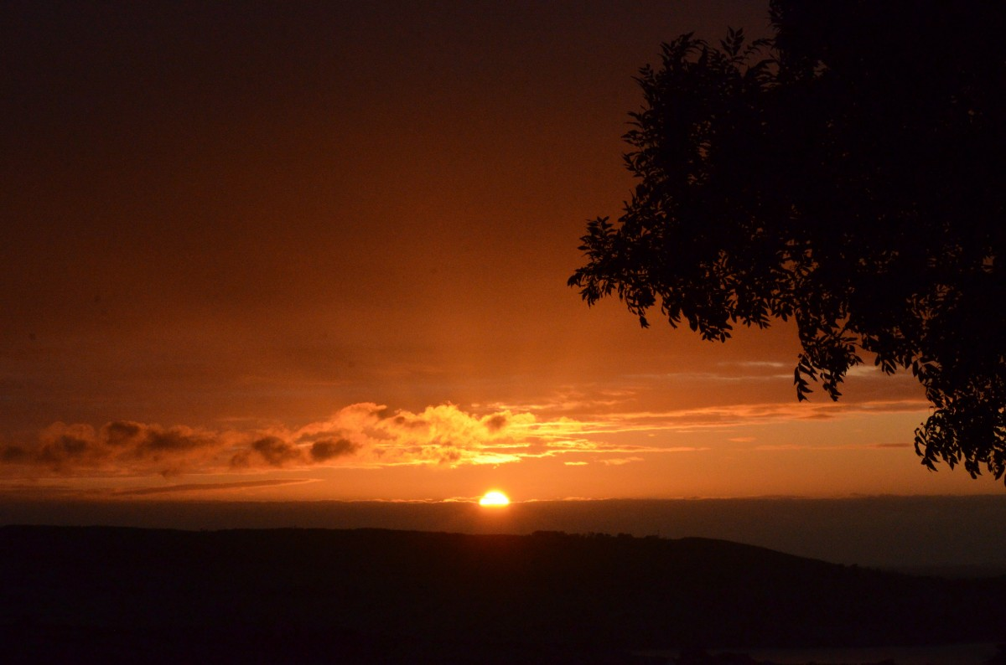
Now faith is the certainty of things hoped for, a proof of things not seen. Hebrews 11:1
But now faith, hope, and love remain, these three; but the greatest of these is love. 1 Corinthians 13:13
constantly keeping in mind your work of faith and labor of love and perseverance of hope in our Lord Jesus Christ in the presence of our God and Father 1 Thessalonians 1:3
since we heard of your faith in Christ Jesus and the love which you have for all the saints; because of the hope reserved for you in heaven, of which you previously heard in the word of truth
Colossians 1:4-5

Slide 8
constantly keeping in mind your work of faith and labor of love and perseverance of hope in our Lord Jesus Christ in the presence of our God and Father
1 Thessalonians 1:3
And we desire that each one of you demonstrate the same diligence so as to realize the full assurance of hope until the end, so that you will not be sluggish, but imitators of those who through faith and endurance inherit the promises.
Hebrews 6:11-12

Slide 9
For in hope we have been saved, but hope that is seen is not hope; for who hopes for what he already sees? But if we hope for what we do not see, through perseverance we wait eagerly for it.
Romans 8:24-25

Slide 11
And we desire that each one of you demonstrate the same diligence so as to realize the full assurance of hope until the end, so that you will not be sluggish, but imitators of those who through faith and endurance inherit the promises.
Hebrews 6:11-12

Slide 12
rejoicing in hope, persevering in tribulation,
devoted to prayer,
Romans 12:12

