Slide 2
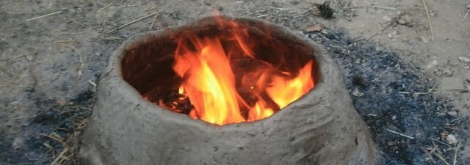
Give us this day our daily bread

Slide 3
Our Father, who is in heaven, Hallowed be Your name. Your kingdom come. Your will be done, On earth as it is in heaven.
Give us this day our daily bread.
And forgive us our debts, as we also have forgiven our debtors.
And do not lead us into temptation, but deliver us from evil.

Slide 4
Our Father, who is in heaven, Hallowed be Your name. Your kingdom come. Your will be done, On earth as it is in heaven.
Give us this day our daily bread.
And forgive us our debts, as we also have forgiven our debtors.
And do not lead us into temptation, but deliver us from evil.

Slide 5
Our Father, who is in heaven, Hallowed be Your name. Your kingdom come. Your will be done, On earth as it is in heaven.
Give us this day our daily bread.
And forgive us our debts, as we also have forgiven our debtors.
And do not lead us into temptation, but deliver us from evil.

Slide 7
Matthew 4:3-4
Now when the tempter came to Him, he said, “If You are the Son of God, command that these stones become bread.”
But He answered and said, “It is written, ‘Man shall not live by bread alone, but by every word that proceeds from the mouth of God.’ ”

Slide 8
Matthew 7:9
Or what man is there among you who, if his son asks for bread, will give him a stone?

Slide 9
Matthew 14:17-19
And they said to Him, “We have here only five loaves and two fish.”
He said, “Bring them here to Me.” Then He commanded the multitudes to sit down on the grass. And He took the five loaves and the two fish, and looking up to heaven, He blessed and broke and gave the loaves to the disciples; and the disciples gave to the multitudes.

Slide 10
Matthew 15:1-2
Then the scribes and Pharisees who were from Jerusalem came to Jesus, saying, “Why do Your disciples transgress the tradition of the elders? For they do not wash their hands when they eat bread.”

Slide 11
Matthew 16:5
Now when His disciples had come to the other side, they had forgotten to take bread.

Slide 13
Matthew 6:11
Give us this day our daily bread.

Slide 15
Matthew 6:25-34

Slide 16
1 Timothy 6:7-8
For we brought nothing into this world, and it is certain we can carry nothing out. And having food and clothing, with these we shall be content.

Slide 17
Proverbs 30:8-9
Remove falsehood and lies far from me; Give me neither poverty nor riches— Feed me with the food allotted to me; Lest I be full and deny You, And say, “Who is the Lord?” Or lest I be poor and steal, And profane the name of my God.

Slide 18
Proverbs 30:8-9
Remove falsehood and lies far from me; Give me neither poverty nor riches— Feed me with the food allotted to me; Lest I be full and deny You, And say, “Who is the Lord?” Or lest I be poor and steal, And profane the name of my God.

Slide 19
Proverbs 30:8-9
Remove falsehood and lies far from me; Give me neither poverty nor riches— Feed me with the food allotted to me; Lest I be full and deny You, And say, “Who is the Lord?” Or lest I be poor and steal, And profane the name of my God.

