Slide 2
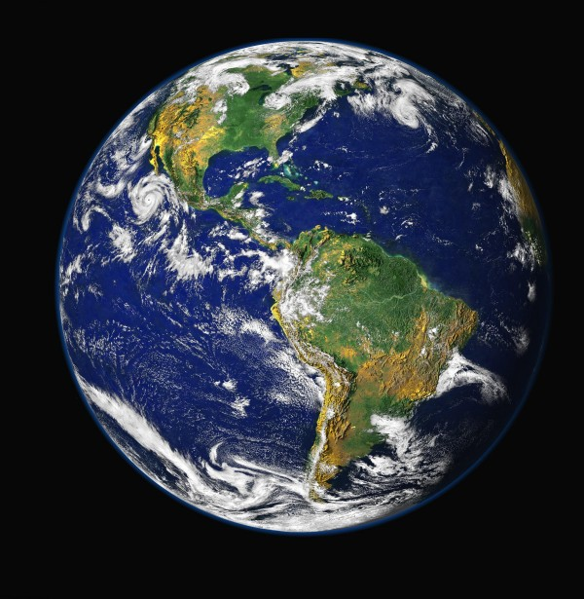
on earth as it is in heaven

Slide 3
Matthew 6:10
Your kingdom come. Your will be done, On earth as it is in heaven..

Slide 4
Matthew 6:10
Your kingdom come. Your will be done, On earth as it is in heaven..

Slide 5
Matthew 16:18-19
And I also say to you that you are Peter, and upon this rock I will build My church; and the gates of Hades will not overpower it. I will give you the keys of the kingdom of heaven; and whatever you bind on earth shall have been bound in heaven, and whatever you loose on earth shall have been loosed in heaven.

Slide 6
Colossians 1:13-14
For He rescued us from the domain of darkness, and transferred us to the kingdom of His beloved Son, in whom we have redemption, the forgiveness of sins.

Slide 7
Colossians 1:13-14
For He rescued us from the domain of darkness, and transferred us to the kingdom of His beloved Son, in whom we have redemption, the forgiveness of sins.
2 Timothy 4:18
The Lord will rescue me from every evil deed, and will bring me safely to His heavenly kingdom; to Him be the glory forever and ever. Amen.

Slide 8
Colossians 1:13-14
For He rescued us from the domain of darkness, and transferred us to the kingdom of His beloved Son, in whom we have redemption, the forgiveness of sins.
2 Timothy 4:18
The Lord will rescue me from every evil deed, and will bring me safely to His heavenly kingdom; to Him be the glory forever and ever. Amen.

Slide 9
Ephesians 2:8-9
For by grace you have been saved through faith; and this is not of yourselves, it is the gift of God; not a result of works, so that no one may boast.

Slide 10
1 Corinthians 1:18
For the word of the cross is foolishness to those who are perishing, but to us who are being saved it is the power of God.

Slide 11
Romans 13:11
Do this, knowing the time, that it is already the hour for you to awaken from sleep; for now salvation is nearer to us than when we first believed.

Slide 12
Matthew 6:10
Your kingdom come. Your will be done, On earth as it is in heaven..

Slide 13
Matthew 6:10
Your kingdom come. Your will be done, On earth as it is in heaven..

Slide 14
Matthew 26:39-44
And He went a little beyond them, and fell on His face and prayed, saying, “My Father, if it is possible, let this cup pass from Me; yet not as I will, but as You will.” And He came to the disciples and found them sleeping, and He said to Peter, “So, you men could not keep watch with Me for one hour? Keep watching and praying, so that you do not come into temptation; the spirit is willing, but the flesh is weak.” He went away again a second time and prayed, saying, “My Father, if this cup cannot pass away unless I drink from it, Your will be done.” Again He came and found them sleeping, for their eyes were heavy. And He left them again, and went away and prayed a third time, saying the same thing once more.

Slide 15
Matthew 6:10
Your kingdom come. Your will be done, On earth as it is in heaven..

Slide 16
Our Father in heaven,
Hallowed be Your name.
Your kingdom come. Your will be done, On earth as it is in heaven..

Slide 17
Our Father in heaven,
Hallowed be Your name.
Your kingdom come. Your will be done, On earth as it is in heaven..

Slide 18
Our Father in heaven,
Hallowed be Your name.
Your kingdom come. Your will be done, On earth as it is in heaven..

Slide 19
Matthew 6:33
But seek first His kingdom and His righteousness, and all these things will be provided to you.

