Slide 2
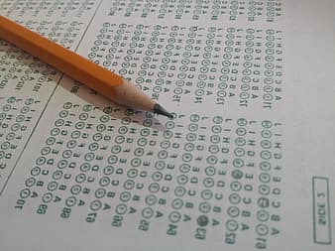
Types of Tests

Slide 3
James 1:12
Blessed is the man who remains steadfast under trial, for when he has stood the test he will receive the crown of life, which God has promised to those who love him.

Slide 5
1 Corinthians 11:27-29
Whoever, therefore, eats the bread or drinks the cup of the Lord in an unworthy manner will be guilty concerning the body and blood of the Lord. Let a person examine himself, then, and so eat of the bread and drink of the cup. For anyone who eats and drinks without discerning the body eats and drinks judgment on himself.

Slide 6
1 Corinthians 11:27-29
Whoever, therefore, eats the bread or drinks the cup of the Lord in an unworthy manner will be guilty concerning the body and blood of the Lord. Let a person examine himself, then, and so eat of the bread and drink of the cup. For anyone who eats and drinks without discerning the body eats and drinks judgment on himself.

Slide 7
1 Corinthians 10:16-17
The cup of blessing that we bless, is it not a participation in the blood of Christ? The bread that we break, is it not a participation in the body of Christ? Because there is one bread, we who are many are one body, for we all partake of the one bread.

Slide 8
1 Corinthians 11:27-29
Whoever, therefore, eats the bread or drinks the cup of the Lord in an unworthy manner will be guilty concerning the body and blood of the Lord. Let a person examine himself, then, and so eat of the bread and drink of the cup. For anyone who eats and drinks without discerning the body eats and drinks judgment on himself.

Slide 9
2 Corinthians 13:5-6
Examine yourselves, to see whether you are in the faith. Test yourselves. Or do you not realize this about yourselves, that Jesus Christ is in you?—unless indeed you fail to meet the test! I hope you will find out that we have not failed the test.

Slide 10
Lamentations 3:40
Let us test and examine our ways, and return to the Lord!

Slide 11
Psalm 119:59
When I think on my ways, I turn my feet to your testimonies.

Slide 12
1 Thessalonians 5:21-22
Test all things; hold fast what is good. Abstain from every form of evil.

Slide 13
1 John 4:1, 6
Beloved, do not believe every spirit, but test the spirits, whether they are of God; because many false prophets have gone out into the world. … We are of God. He who knows God hears us; he who is not of God does not hear us. By this we know the spirit of truth and the spirit of error.

