Slide 2
Pray, then, in this way:
‘Our Father, who is in heaven, Hallowed be Your name. Your kingdom come. Your will be done, On earth as it is in heaven. Give us this day our daily bread. And forgive us our debts,
as we also have forgiven our debtors. And do not lead us into temptation,
but deliver us from evil.’
Matthew 6:9-13

Slide 3
Pray, then, in this way:
‘Our Father, who is in heaven, Hallowed be Your name. Your kingdom come. Your will be done, On earth as it is in heaven. Give us this day our daily bread. And forgive us our debts,
as we also have forgiven our debtors. And do not lead us into temptation,
but deliver us from evil.’
Matthew 6:9-13

Slide 4
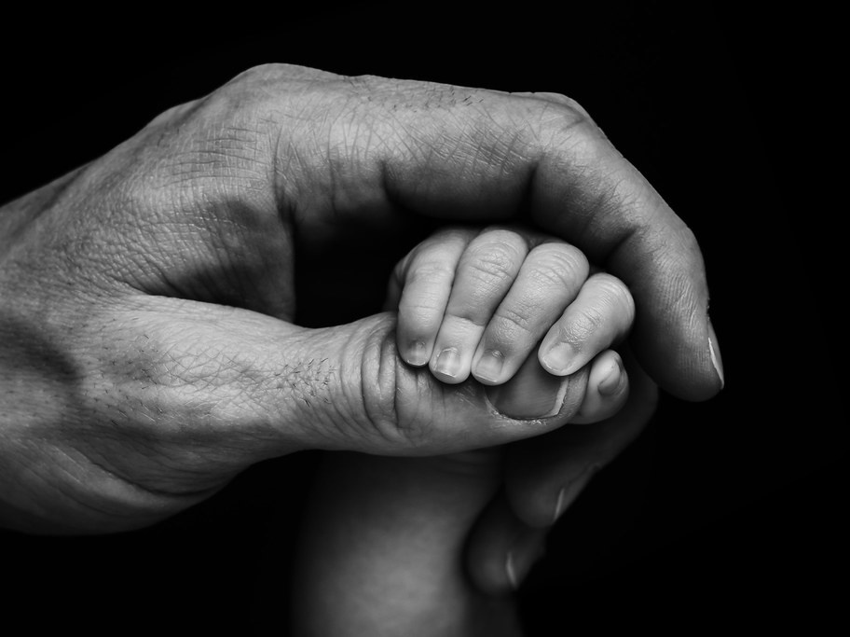
Our Father

Slide 5
Pray, then, in this way:
‘Our Father, who is in heaven, Hallowed be Your name. Your kingdom come. Your will be done, On earth as it is in heaven. Give us this day our daily bread. And forgive us our debts,
as we also have forgiven our debtors. And do not lead us into temptation,
but deliver us from evil.’
Matthew 6:9-13

Slide 6
Pray, then, in this way:
‘Our Father, who is in heaven, Hallowed be Your name. Your kingdom come. Your will be done, On earth as it is in heaven. Give us this day our daily bread. And forgive us our debts,
as we also have forgiven our debtors. And do not lead us into temptation,
but deliver us from evil.’
Matthew 6:9-13

Slide 7
Then you shall say to Pharaoh, ‘This is what the Lord says: “Israel is My son, My firstborn.”
Exodus 4:22

Slide 8
But now, Lord, You are our Father; We are the clay, and You our potter, And all of us are the work of Your hand. Isaiah 64:8

Slide 9
And He went a little beyond them, and fell on His face and prayed, saying, “My Father, if it is possible, let this cup pass from Me; yet not as I will, but as You will.”
Matthew 26:39

Slide 10
For you have not received a spirit of slavery leading to fear again, but you have received a spirit of adoption as sons and daughters by which we cry out, “Abba! Father!” Romans 8:15

Slide 11
Because you are sons, God has sent the Spirit of His Son into our hearts, crying out, “Abba! Father!” Therefore you are no longer a slave, but a son; and if a son, then an heir through God. Galatians 4:6-7

Slide 12
Pray, then, in this way:
‘Our Father, who is in heaven, Hallowed be Your name. Your kingdom come. Your will be done, On earth as it is in heaven. Give us this day our daily bread. And forgive us our debts,
as we also have forgiven our debtors. And do not lead us into temptation,
but deliver us from evil.’
Matthew 6:9-13

Slide 13
And I will make My holy name known in the midst of My people Israel; and I will not allow My holy name to be profaned anymore. But the nations will know that I am the Lord, the Holy One in Israel.
Ezekiel 39:7

