Slide 2
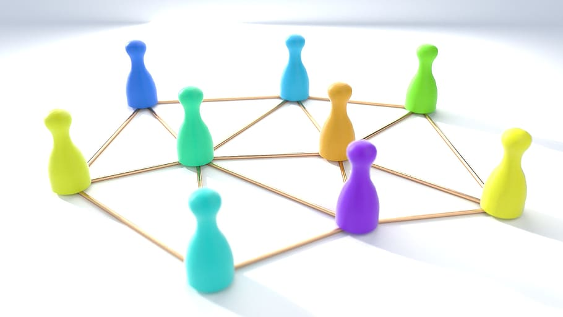
Appreciating Relationships

Slide 3
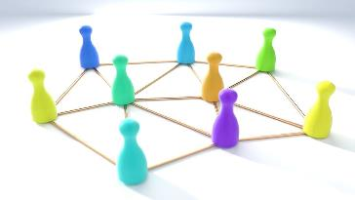
Genesis 1:26-27
Then God said, “Let Us make mankind in Our image, according to Our likeness; and let them rule over the fish of the sea and over the birds of the sky and over the livestock and over all the earth, and over every crawling thing that crawls on the earth.” So God created man in His own image, in the image of God He created him; male and female He created them.

Slide 4
Genesis 1:26-27
Then God said, “Let Us make mankind in Our image, according to Our likeness; and let them rule over the fish of the sea and over the birds of the sky and over the livestock and over all the earth, and over every crawling thing that crawls on the earth.” So God created man in His own image, in the image of God He created him; male and female He created them.

Slide 5
Genesis 2:18
Then the Lord God said, “It is not good for the man to be alone; I will make him a helper suitable for him.”

Slide 6
Genesis 3:12
The man said, “The woman whom You gave to be with me, she gave me some of the fruit of the tree, and I ate.”

Slide 8
Genesis 17:7
I will establish My covenant between Me and you and your descendants after you throughout their generations as an everlasting covenant, to be God to you and to your descendants after you.

Slide 9
Exodus 6:4-5
I also established My covenant with them, to give them the land of Canaan, the land in which they lived as strangers. Furthermore I have heard the groaning of the sons of Israel, because the Egyptians are holding them in bondage, and I have remembered My covenant.

Slide 10
Psalm 78:56
Yet they tested and provoked the Most High God, And did not keep His testimonies

Slide 11
2 Kings 17:14-15
However, they did not listen, but stiffened their neck like their fathers, who did not believe in the Lord their God. They rejected His statutes and His covenant which He made with their fathers, and His warnings which He gave them. And they followed idols and became empty, and followed the nations that surrounded them, about which the Lord had commanded them not to do as they did.

Slide 13
John 1:14
And the Word became flesh, and dwelt among us; and we saw His glory, glory as of the only Son from the Father, full of grace and truth.

Slide 14
John 1:10-12
He was in the world, and the world came into being through Him, and yet the world did not know Him. He came to His own, and His own people did not accept Him. But as many as received Him, to them He gave the right to become children of God, to those who believe in His name

Slide 16
John 14:15
If you love Me, you will keep My commandments.

Slide 17
John 17:20-23
“I am not asking on behalf of these alone, but also for those who believe in Me through their word, that they may all be one; just as You, Father, are in Me and I in You, that they also may be in Us, so that the world may believe that You sent Me. The glory which You have given Me I also have given to them, so that they may be one, just as We are one; I in them and You in Me, that they may be perfected in unity, so that the world may know that You sent Me, and You loved them, just as You loved Me.”

Slide 18
John 17:20-23
“I am not asking on behalf of these alone, but also for those who believe in Me through their word, that they may all be one; just as You, Father, are in Me and I in You, that they also may be in Us, so that the world may believe that You sent Me. The glory which You have given Me I also have given to them, so that they may be one, just as We are one; I in them and You in Me, that they may be perfected in unity, so that the world may know that You sent Me, and You loved them, just as You loved Me.”

Slide 19
John 17:20-23
“I am not asking on behalf of these alone, but also for those who believe in Me through their word, that they may all be one; just as You, Father, are in Me and I in You, that they also may be in Us, so that the world may believe that You sent Me. The glory which You have given Me I also have given to them, so that they may be one, just as We are one; I in them and You in Me, that they may be perfected in unity, so that the world may know that You sent Me, and You loved them, just as You loved Me.”

Slide 20
John 17:20-23
“I am not asking on behalf of these alone, but also for those who believe in Me through their word, that they may all be one; just as You, Father, are in Me and I in You, that they also may be in Us, so that the world may believe that You sent Me. The glory which You have given Me I also have given to them, so that they may be one, just as We are one; I in them and You in Me, that they may be perfected in unity, so that the world may know that You sent Me, and You loved them, just as You loved Me.”

Slide 21
John 17:20-23
“I am not asking on behalf of these alone, but also for those who believe in Me through their word, that they may all be one; just as You, Father, are in Me and I in You, that they also may be in Us, so that the world may believe that You sent Me. The glory which You have given Me I also have given to them, so that they may be one, just as We are one; I in them and You in Me, that they may be perfected in unity, so that the world may know that You sent Me, and You loved them, just as You loved Me.”

Slide 23
Revelation 7:9-12
After these things I looked, and behold, a great multitude which no one could count, from every nation and all the tribes, peoples, and languages, standing before the throne and before the Lamb, clothed in white robes, and palm branches were in their hands; and they cried out with a loud voice, saying, “Salvation belongs to our God who sits on the throne, and to the Lamb.” And all the angels were standing around the throne and around the elders and the four living creatures; and they fell on their faces before the throne and worshiped God, saying, “Amen, blessing, glory, wisdom, thanksgiving, honor, power, and might belong to our God forever and ever. Amen.”

