Slide 2
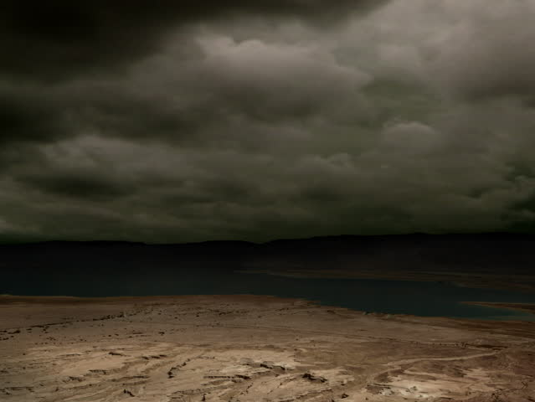
O Death…

Slide 3
1 Corinthians 15:52
in a moment, in the twinkling of an eye, at the last trumpet; for the trumpet will sound, and the dead will be raised imperishable, and we will be changed.

Slide 4
1 Corinthians 15:52
in a moment, in the twinkling of an eye, at the last trumpet; for the trumpet will sound, and the dead will be raised imperishable, and we will be changed.

Slide 5
Isaiah 29:5
But the multitude of your enemies will become like fine dust, And the multitude of the ruthless ones like the chaff which blows away; And it will happen instantly, suddenly.

Slide 6
1 Corinthians 15:52
in a moment, in the twinkling of an eye, at the last trumpet; for the trumpet will sound, and the dead will be raised imperishable, and we will be changed.

Slide 7
1 Corinthians 15:52
in a moment, in the twinkling of an eye, at the last trumpet; for the trumpet will sound, and the dead will be raised imperishable, and we will be changed.

Slide 9
1 Corinthians 15:54
When the perishable puts on the imperishable, and the mortal puts on immortality, then shall come to pass the saying that is written:
“Death is swallowed up in victory.”

Slide 10
Isaiah 25:8
He will swallow up death for all time; And the Lord God will wipe tears away from all faces, And He will remove the reproach of His people from all the earth; For the LORD has spoken.

Slide 11
1 Corinthians 15:55
“O death, where is your victory? O death, where is your sting?”

Slide 12
1 Corinthians 15:56-57
The sting of death is sin, and the power of sin is the law. But thanks be to God, who gives us the victory through our Lord Jesus Christ.

Slide 13
Revelation 21:4,7
and He will wipe away every tear from their eyes; and there will no longer be any death; there will no longer be any mourning, or crying, or pain; the first things have passed away. …The one who overcomes will inherit these things, and I will be his God and he will be My son.

Slide 14
1 Corinthians 15:58
Therefore, my beloved brothers, be steadfast, immovable, always abounding in the work of the Lord, knowing that in the Lord your labor is not in vain.

