Slide 2
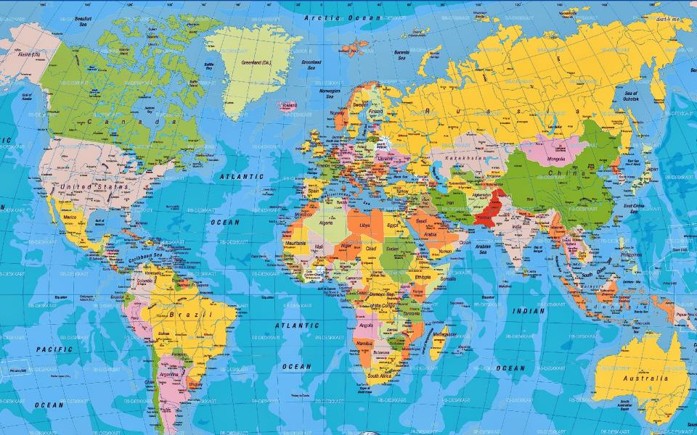
Exile Living

Slide 3
Peter, an apostle of Jesus Christ,
To those who are elect exiles of the Dispersion in Pontus, Galatia, Cappadocia, Asia, and Bithynia, 1 Peter 1:1

Slide 4
Peter, an apostle of Jesus Christ,
To those who are elect exiles of the Dispersion in Pontus, Galatia, Cappadocia, Asia, and Bithynia, 1 Peter 1:1

Slide 5
Peter, an apostle of Jesus Christ,
To those who are elect exiles of the Dispersion in Pontus, Galatia, Cappadocia, Asia, and Bithynia, 1 Peter 1:1

Slide 7
If you address as Father the One who impartially judges according to each one's work, conduct yourselves in fear during the time of your stay on earth 1 Peter 1:17

Slide 8
She who is in Babylon, chosen together with you, sends you greetings, and so does my son, Mark. 1 Peter 5:13

Slide 9
Beloved, I urge you as aliens and strangers to abstain from fleshly lusts which wage war against the soul. 1 Peter 2:11

Slide 10
Keep your behavior excellent among the Gentiles, so that in the thing in which they slander you as evildoers, they may because of your good deeds, as they observe them, glorify God in the day of visitation.
1 Peter 2:12

Slide 11
Submit yourselves for the Lord’s sake to every human institution, whether to a king as the one in authority, or to governors as sent by him for the punishment of evildoers and the praise of those who do right. For such is the will of God that by doing right you may silence the ignorance of foolish men. Act as free men, and do not use your freedom as a covering for evil, but use it as bondslaves of God.
1 Peter 2:13-16

Slide 12
Honor all people,
love the brotherhood,
fear God,
honor the king.
1 Peter 2:17

Slide 13
Honor all people,
love the brotherhood,
fear God,
honor the king.
1 Peter 2:17

Slide 14
Honor all people,
love the brotherhood,
fear God,
honor the king.
1 Peter 2:17

Slide 15
Honor all people,
love the brotherhood,
fear God,
honor the king.
1 Peter 2:17

