Slide 2
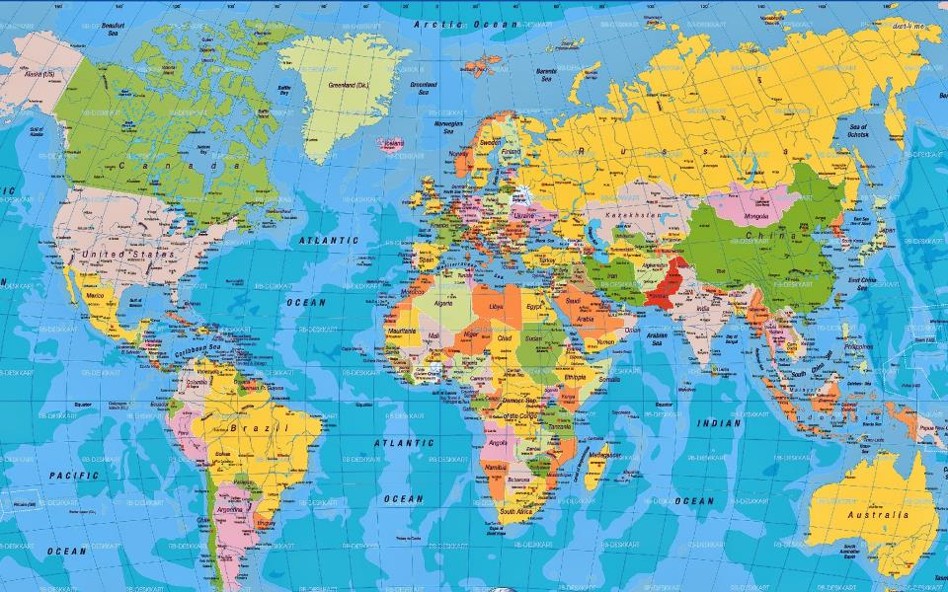
Strangers and Exiles

Slide 3
All these died in faith, without receiving the promises, but having seen them and having welcomed them from a distance, and having confessed that they were strangers and exiles on the earth. Hebrews 11:13

Slide 4
All these died in faith, without receiving the promises, but having seen them and having welcomed them from a distance, and having confessed that they were strangers and exiles on the earth. Hebrews 11:13

Slide 5
All these died in faith, without receiving the promises, but having seen them and having welcomed them from a distance, and having confessed that they were strangers and exiles on the earth. Hebrews 11:13

Slide 6
“For though, in truth, Homer has spoken many wise and divine words, he never spoke a wiser or a truer word than this: ‘For naught is sweeter than one’s native land.’” --Dio Chrysostom

Slide 7
“they do not live in their own country but sojourn in a strange land; for thus to sojourn is a reproach.” --Lucian

Slide 8
All these died in faith, without receiving the promises, but having seen them and having welcomed them from a distance, and having confessed that they were strangers and exiles on the earth. Hebrews 11:13

Slide 9
By faith Abraham, when he was called, obeyed by going out to a place which he was to receive for an inheritance; and he went out, not knowing where he was going. By faith he lived as an alien in the land of promise, as in a foreign land, dwelling in tents with Isaac and Jacob, fellow heirs of the same promise; Hebrews 11:8-9

Slide 10
Then he proceeded from there to the mountain on the east of Bethel, and pitched his tent, with Bethel on the west and Ai on the east; and there he built an altar to the Lord and called upon the name of the Lord. Genesis 12:8

Slide 11
Then Abram moved his tent and came and dwelt by the oaks of Mamre, which are in Hebron, and there he built an altar to the Lord. Genesis 13:18

Slide 12
I am a stranger and a sojourner among you… Genesis 23:4

Slide 14
But as it is, they desire a better country, that is, a heavenly one. Therefore God is not ashamed to be called their God; for He has prepared a city for them. Hebrews 11:16

Slide 15
But as it is, they desire a better country, that is, a heavenly one. Therefore God is not ashamed to be called their God; for He has prepared a city for them. Hebrews 11:16

Slide 16
But as it is, they desire a better country, that is, a heavenly one. Therefore God is not ashamed to be called their God; for He has prepared a city for them. Hebrews 11:16

Slide 17
Then I saw a new heaven and a new earth; for the first heaven and the first earth passed away, and there is no longer any sea. And I saw the holy city, new Jerusalem, coming down out of heaven from God, made ready as a bride adorned for her husband. Revelation 21:1-2

