Slide 2
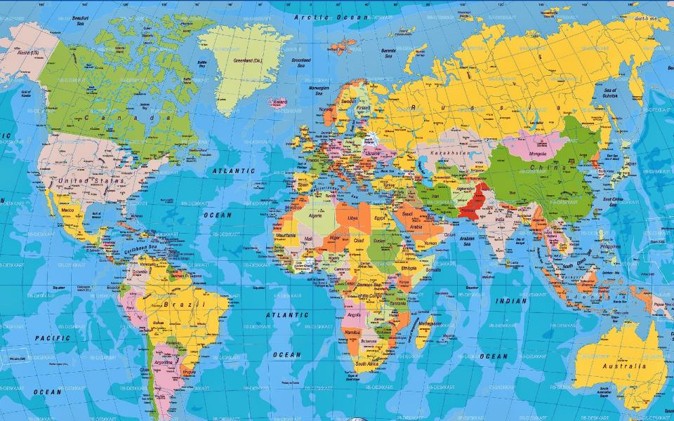
Citizenship in Heaven

Slide 3
For our citizenship is in heaven, from which also we eagerly wait for a Savior, the Lord Jesus Christ
Philippians 3:20

Slide 4
Brothers, join in imitating me, and keep your eyes on those who walk according to the example you have in us. For many, of whom I have often told you and now tell you even with tears, walk as enemies of the cross of Christ. Their end is destruction, their god is their belly, and they glory in their shame, with minds set on earthly things. Philippians 3:17-19

Slide 5
For our citizenship is in heaven, from which also we eagerly wait for a Savior, the Lord Jesus Christ
Philippians 3:20

Slide 6
Therefore God also has highly exalted Him and given Him the name which is above every name, that at the name of Jesus every knee should bow, of those in heaven, and of those on earth, and of those under the earth, and that every tongue should confess that Jesus Christ is Lord, to the glory of God the Father. Philippians 2:9-11

Slide 7
who will transform the body of our humble state into conformity with the body of His glory, by the exertion of the power that He has even to subject all things to Himself. Philippians 3:21

Slide 8
Therefore, my beloved brethren whom I long to see, my joy and crown, in this way stand firm in the Lord, my beloved. Philippians 4:1

Slide 9
After these things I looked, and behold, a great multitude which no one could count, from every nation and all tribes and peoples and tongues, standing before the throne and before the Lamb, clothed in white robes, and palm branches were in their hands; and they cry out with a loud voice, saying,
“Salvation to our God who sits on the throne, and to the Lamb.”
Revelation 7:9-10

