Slide 1


Slide 2

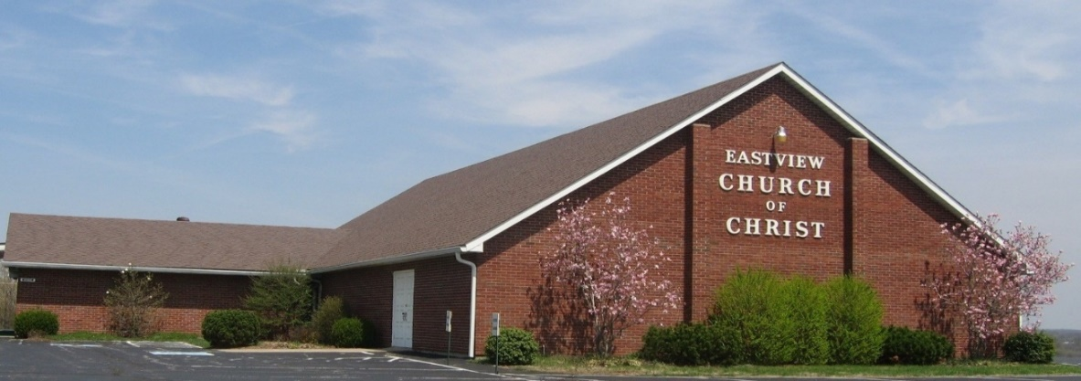
“I was glad when they said to me, ‘Let us go to the house of the Lord.’”
- Psalm 122:1

Slide 3


Slide 4
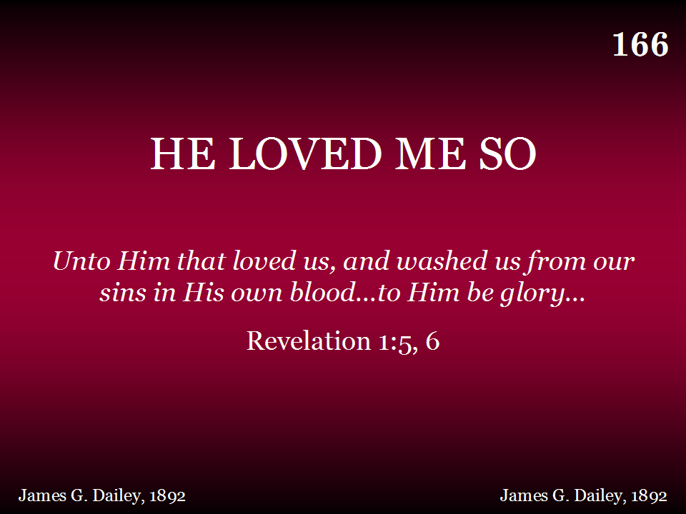
166 - He Loved Me So - Title

Slide 5
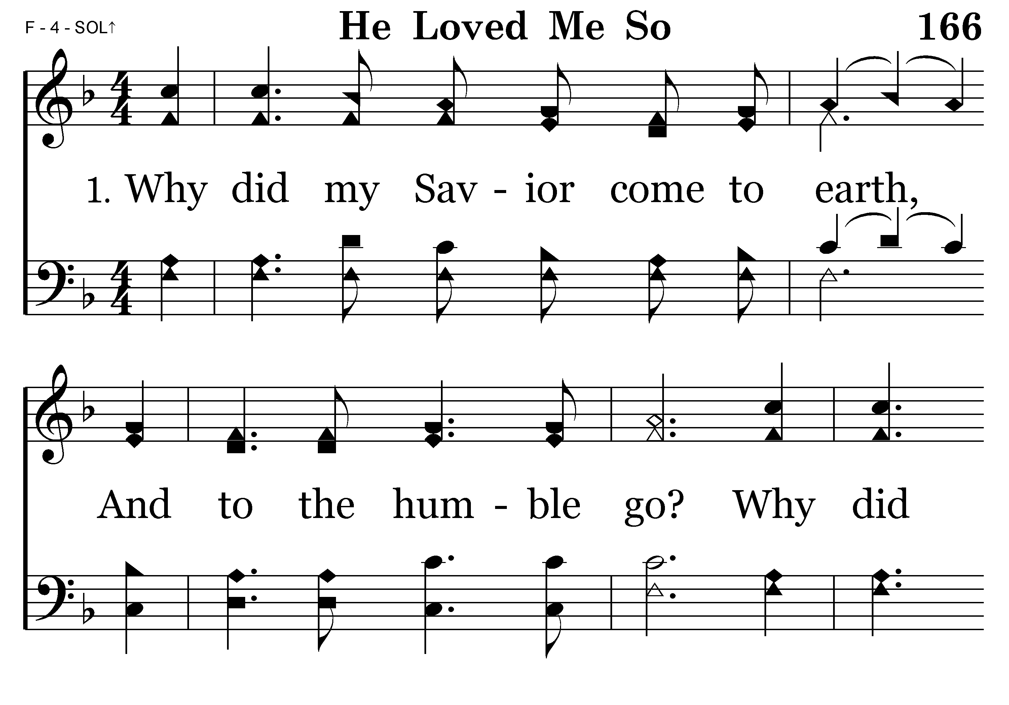
166 - He Loved Me So - 1.1

Slide 6
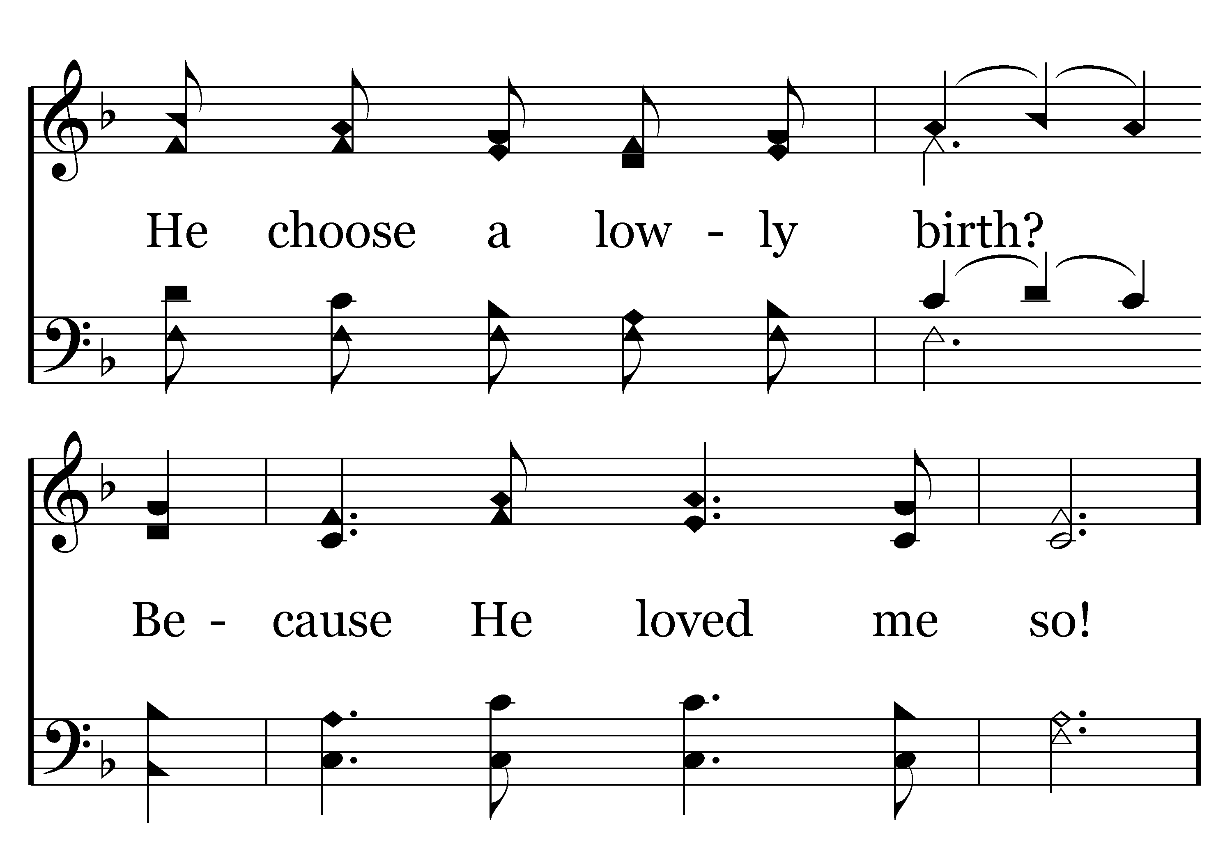
166 - He Loved Me So - 1.2

Slide 7
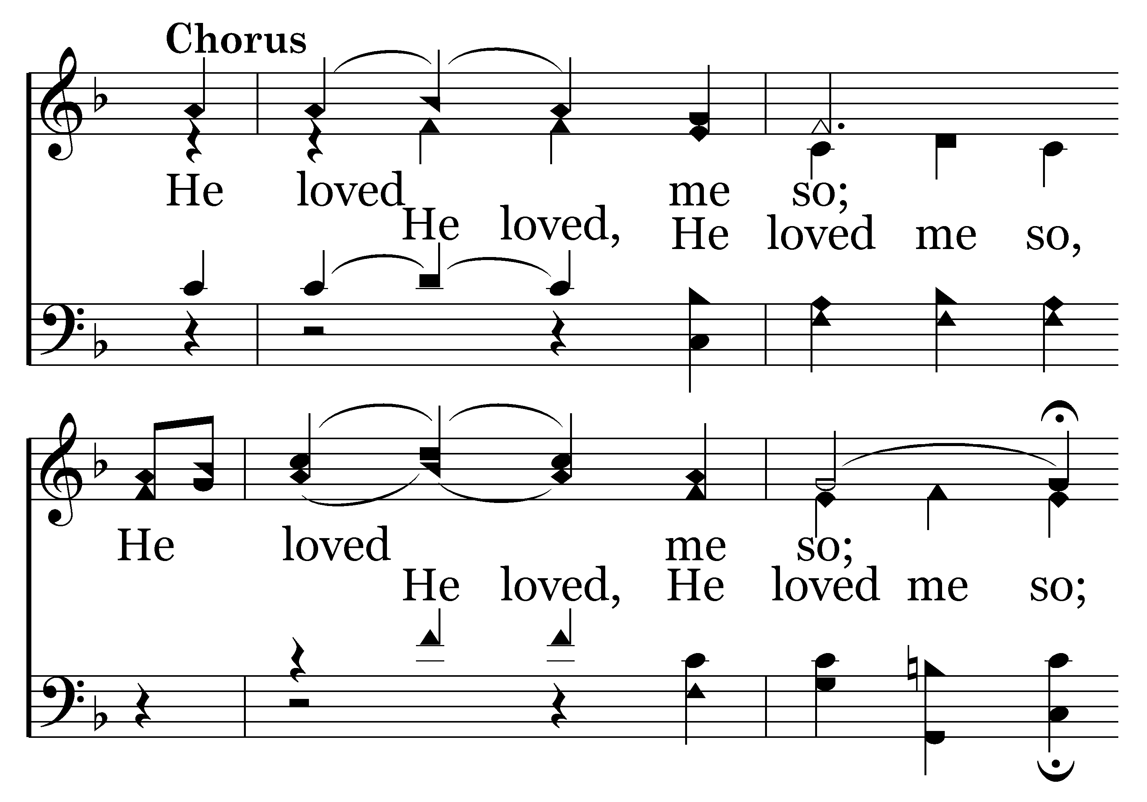
166 - He Loved Me So - C.1

Slide 8
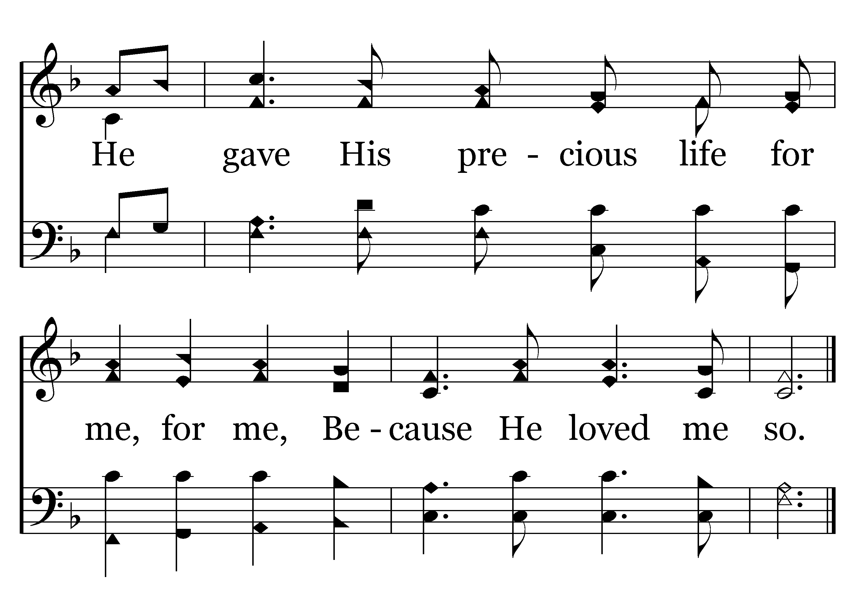
166 - He Loved Me So - C.2
End of Verse 1

Slide 9
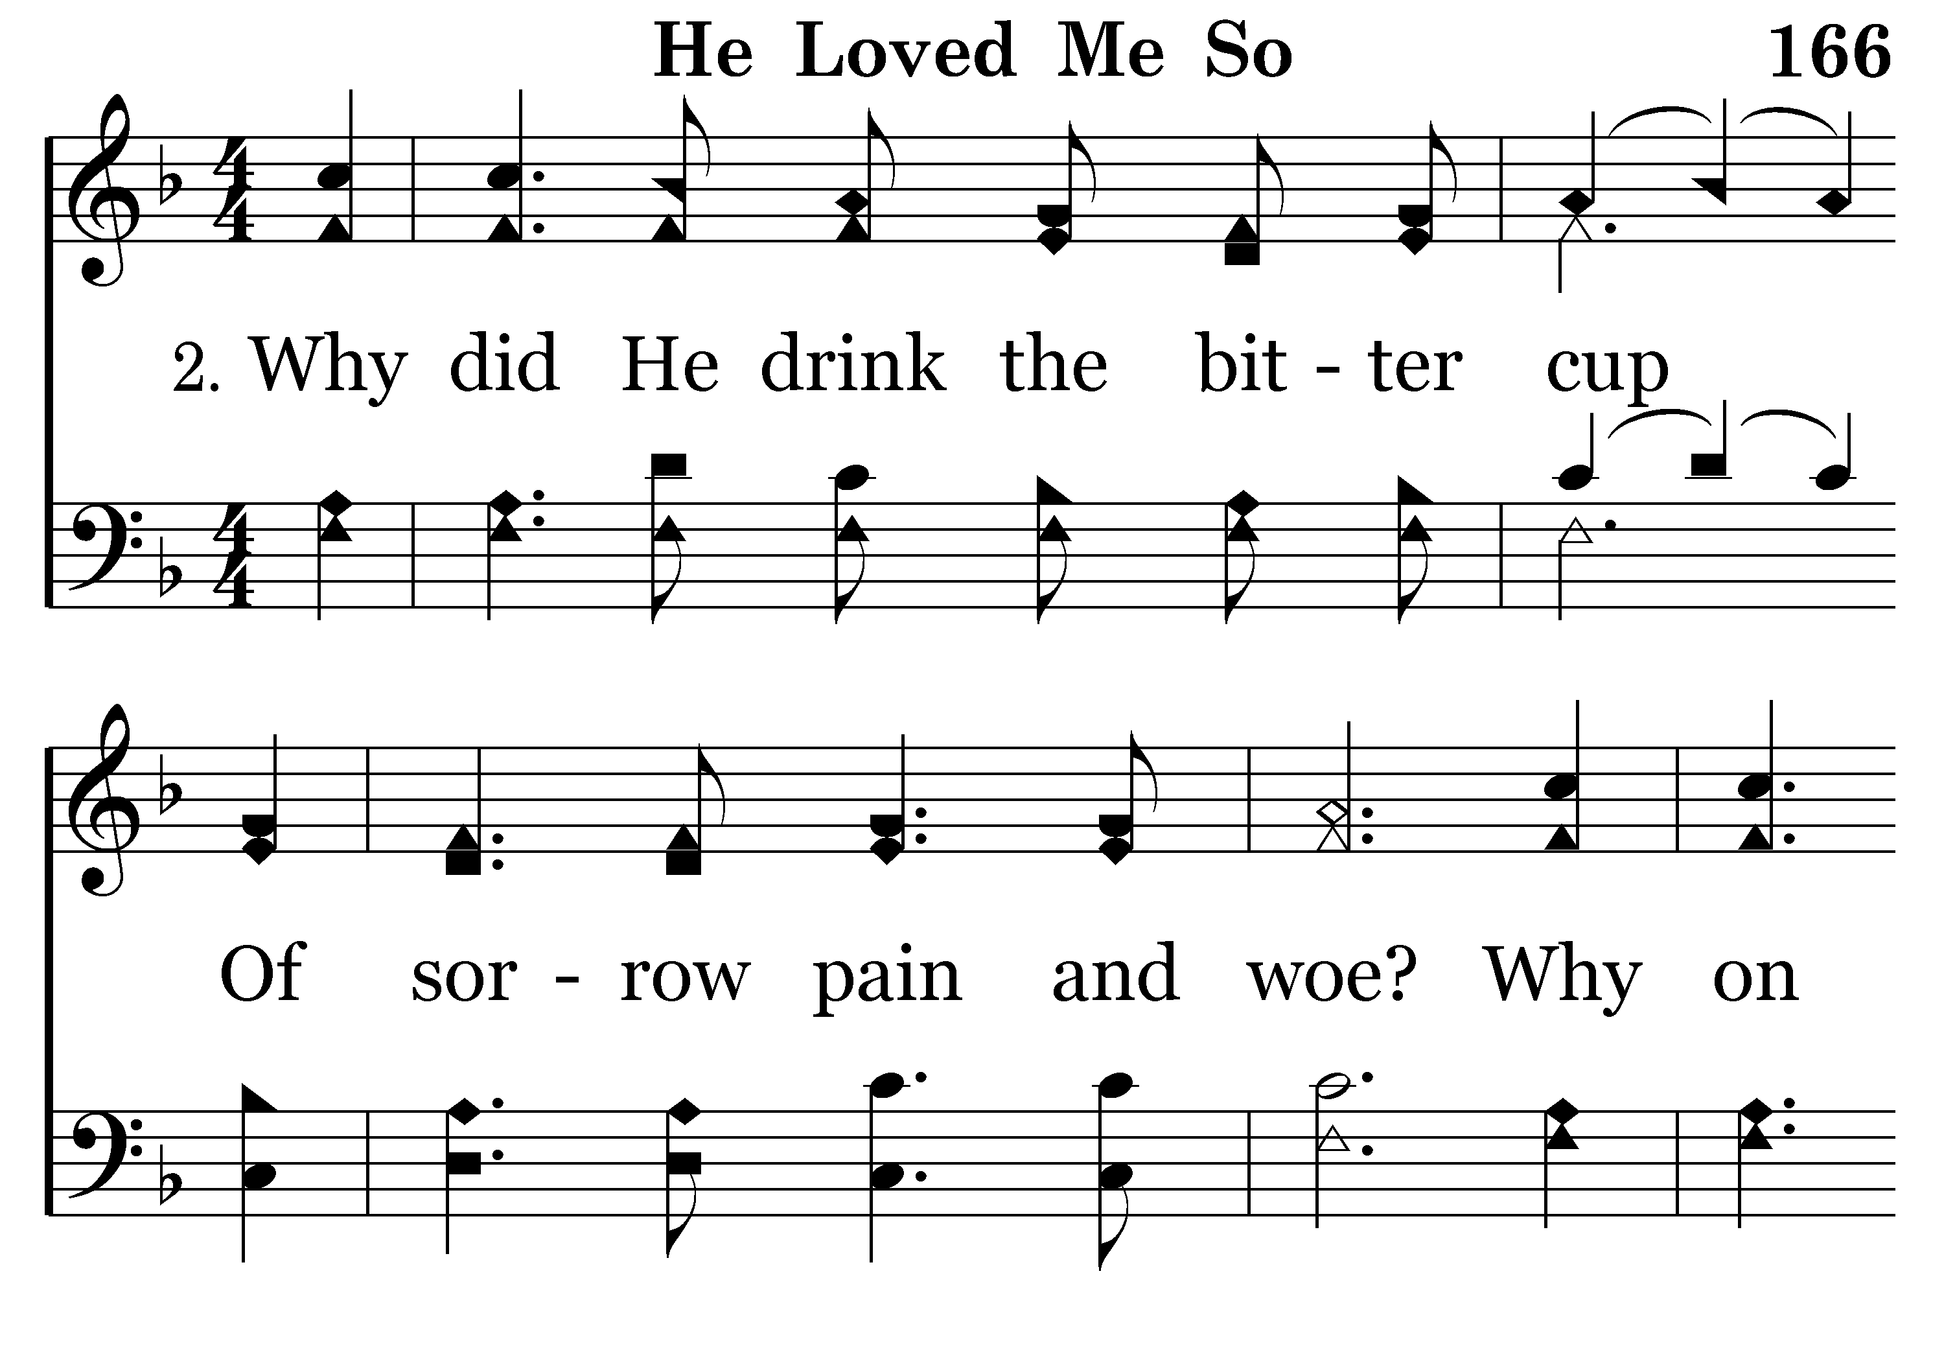
166 - He Loved Me So - 2.1

Slide 10
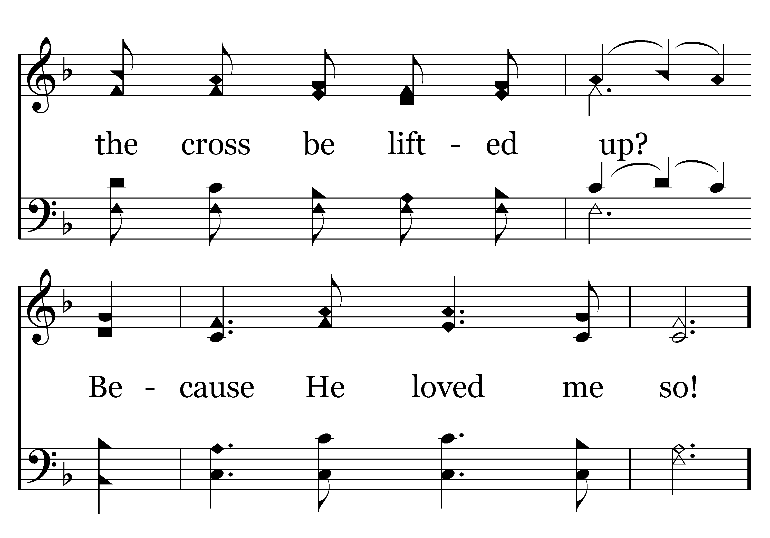
166 - He Loved Me So - 2.2

Slide 11
166 - He Loved Me So - C.1

Slide 12
166 - He Loved Me So - C.2
End of Verse 2

Slide 13
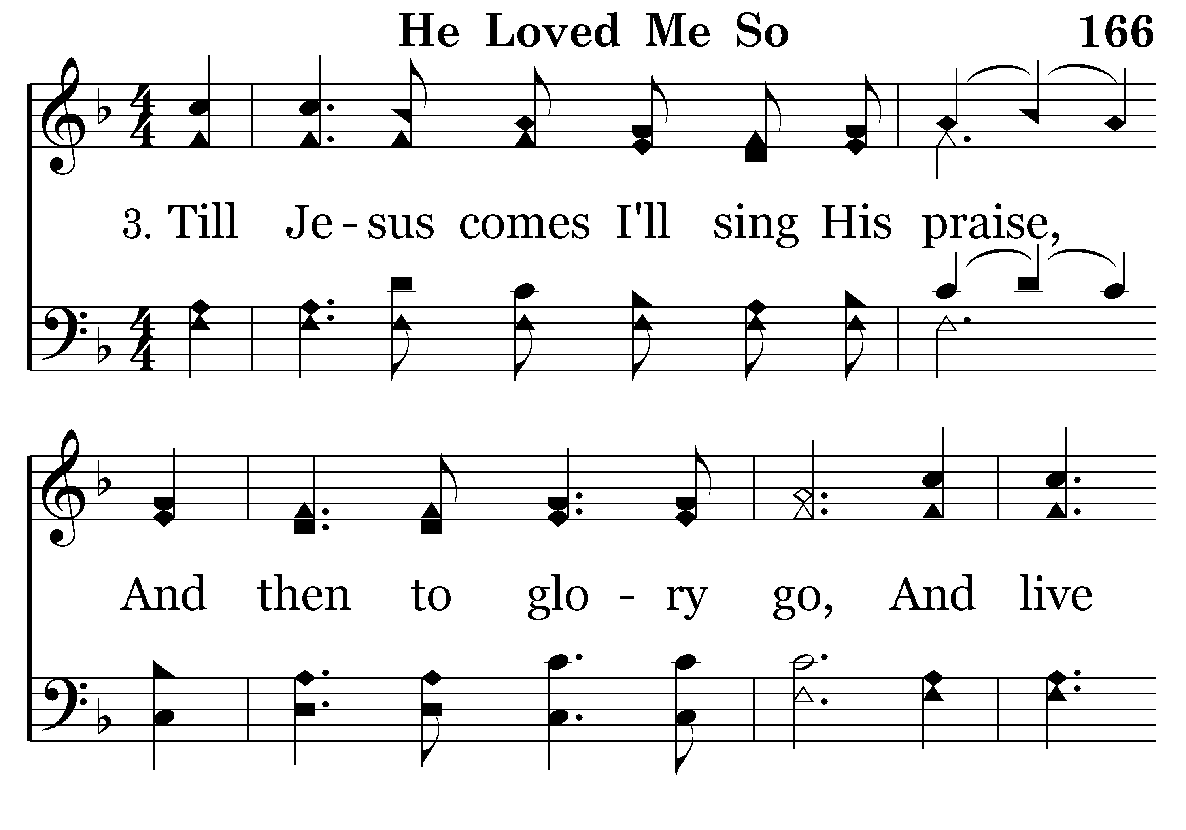
166 - He Loved Me So - 3.1

Slide 14
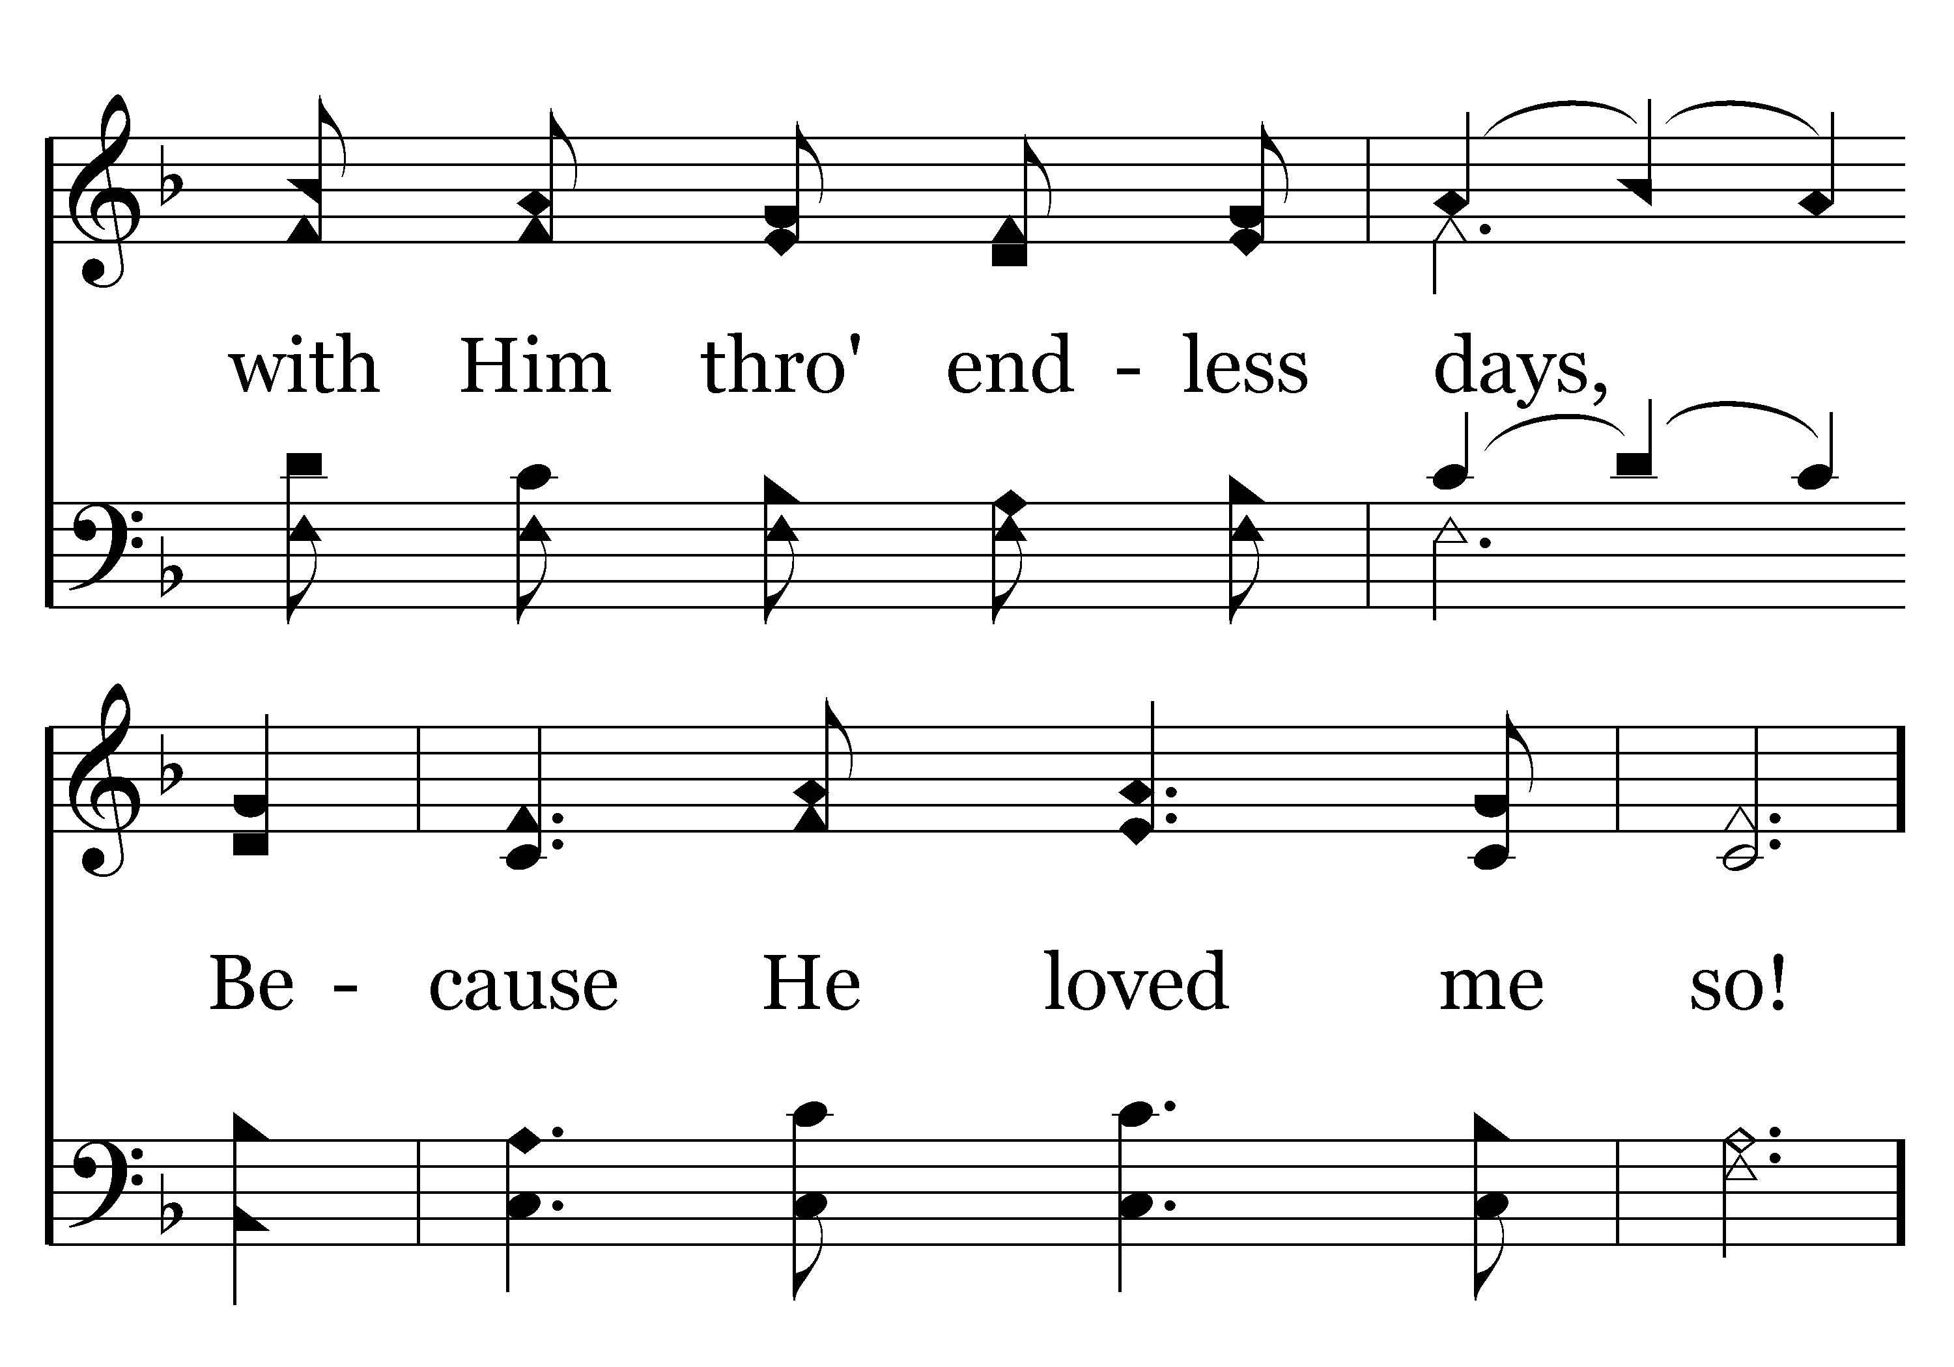
166 - He Loved Me So - 3.2

Slide 15
166 - He Loved Me So - C.1

Slide 16
166 - He Loved Me So - C.2
End of Song

Slide 17
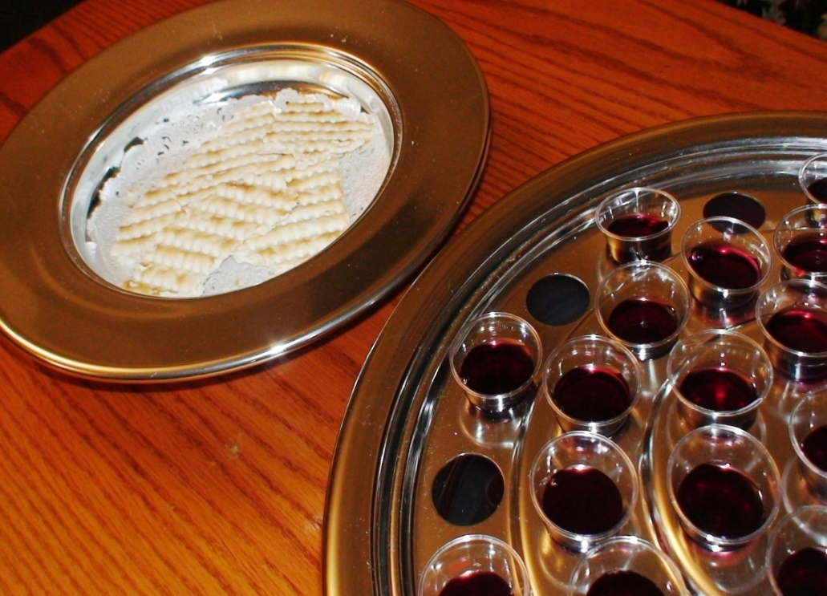
The Communion
“The cup of blessing that we bless, is it not a participation in the blood of Christ? The bread that we break, is it not a participation in the body of Christ? Because there is one bread, we who are many are one body, for we all partake of the one bread.”
1 Corinthians 9:16-17

Slide 18
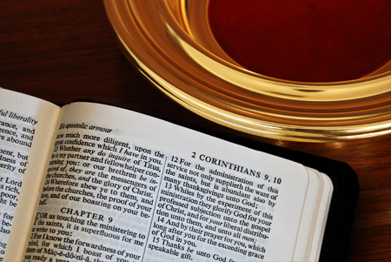
The Giving
“You will be enriched in every way to be generous in every way, which through us will produce thanksgiving to God. For the ministry of this service is not only supplying the needs of the saints but is also overflowing in many thanksgivings to God”.
2 Corinthians 9:11-12

Slide 19
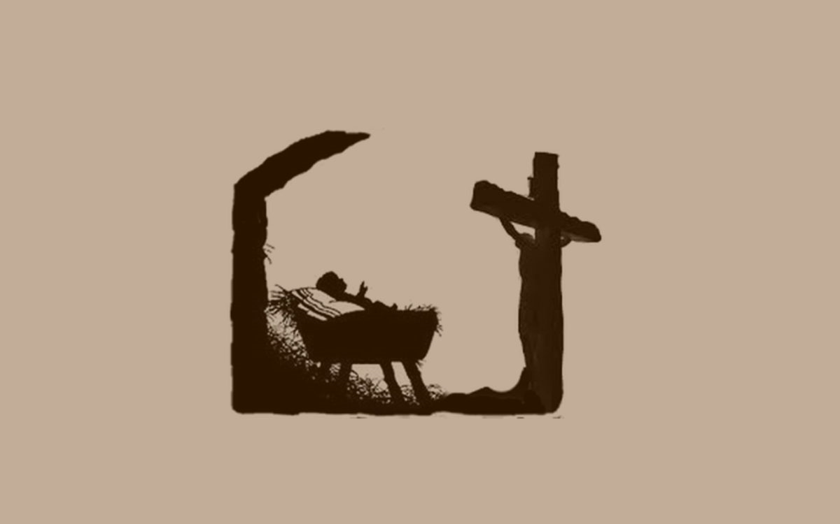
Reading Luke 1:46-55

Slide 20
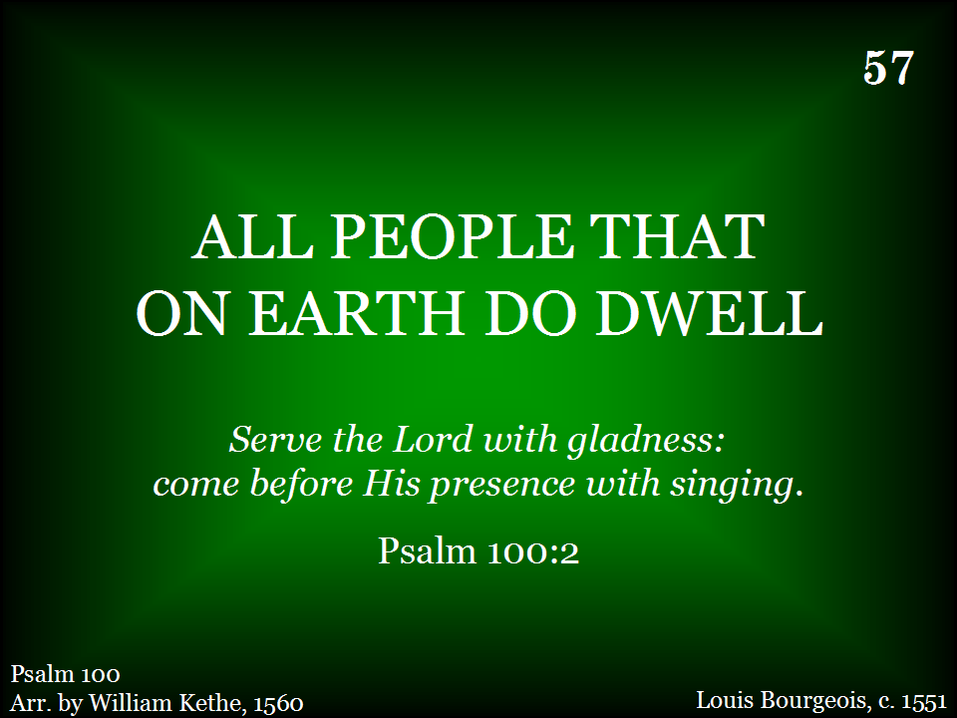
057 - All People That On Earth Do Dwell - Title

Slide 21
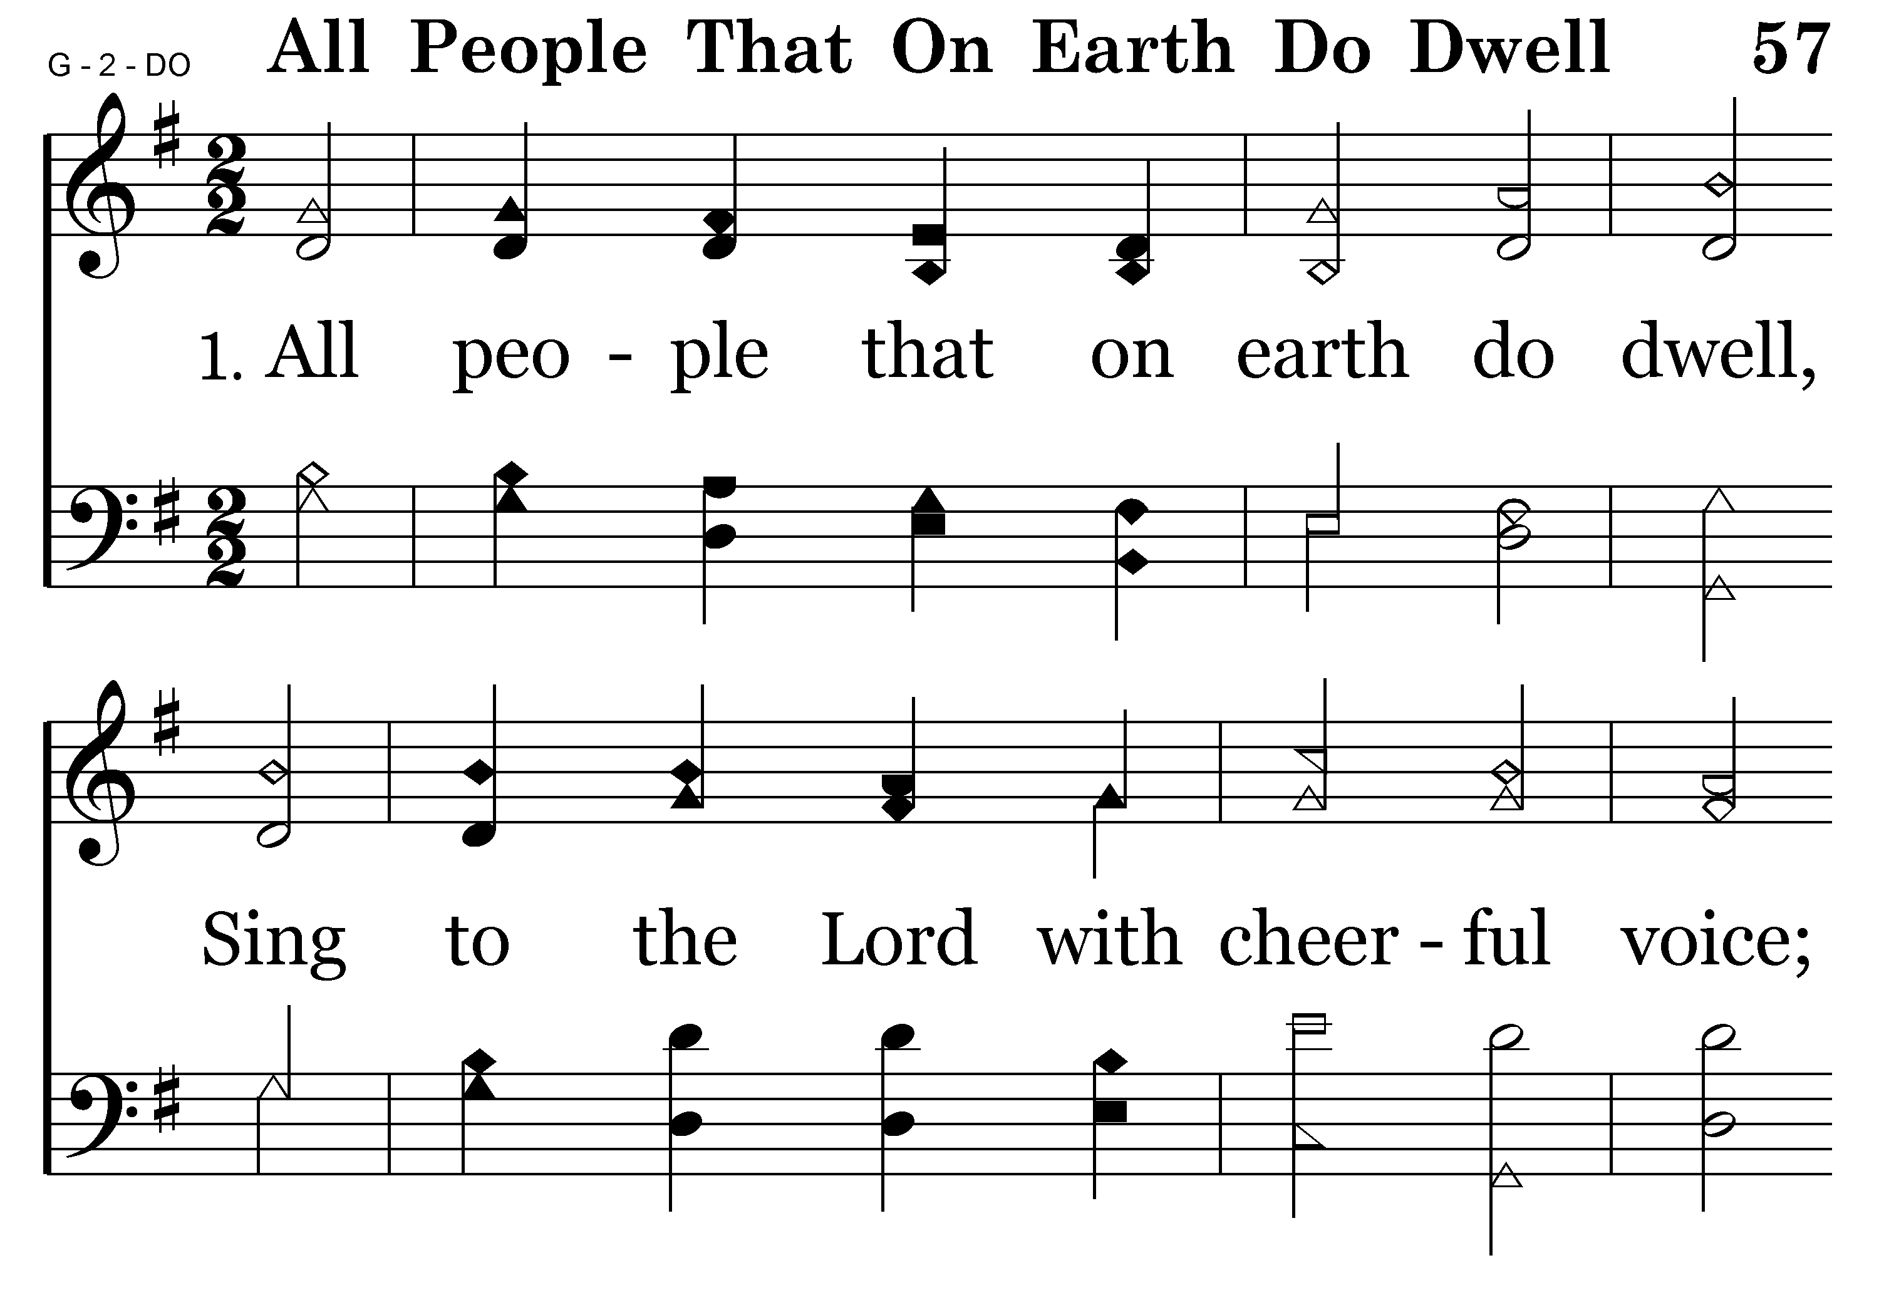
057 - All People That On Earth Do Dwell - 1.1

Slide 22
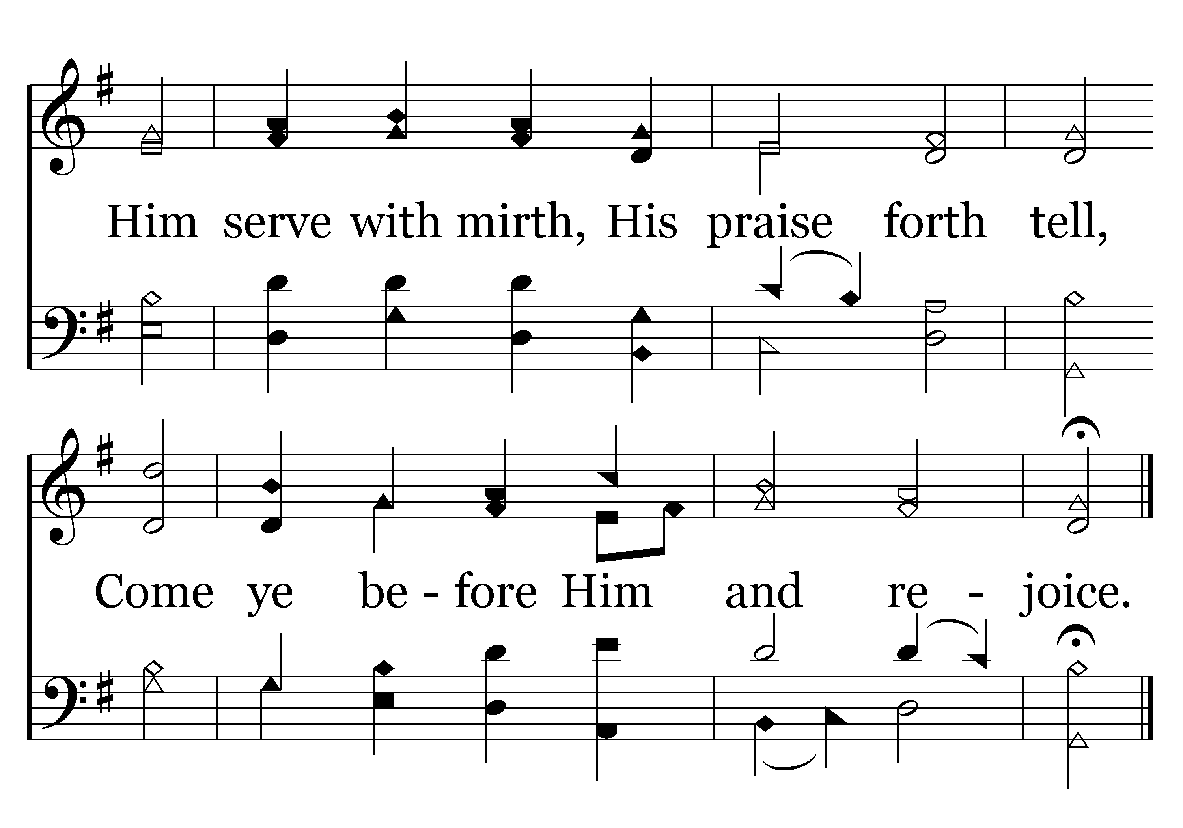
057 - All People That On Earth Do Dwell - 1.2
End of Verse 1

Slide 23
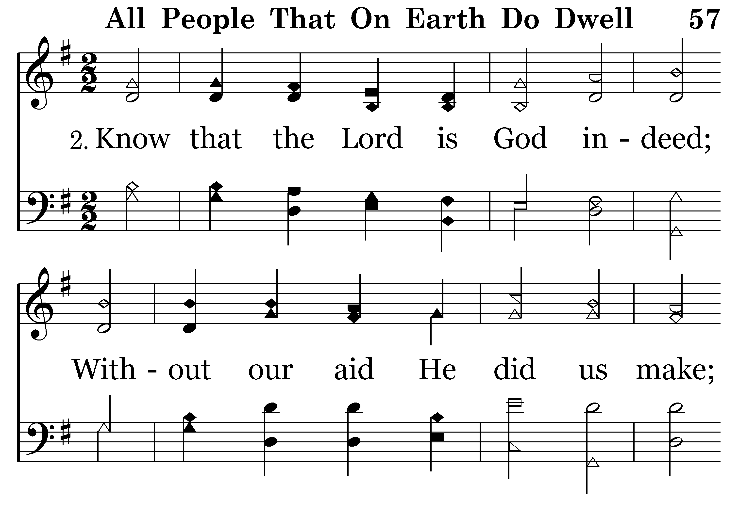
057 - All People That On Earth Do Dwell - 2.1

Slide 24
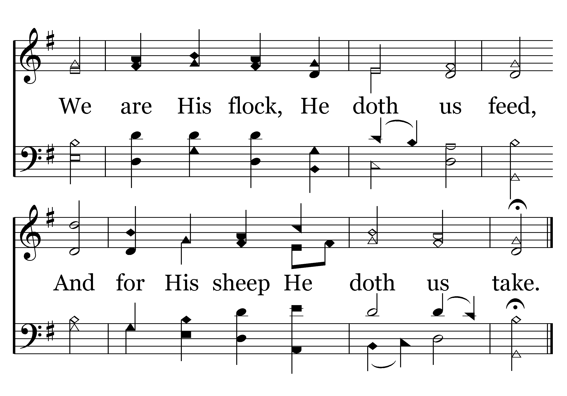
057 - All People That On Earth Do Dwell - 2.2
End of Verse 2

Slide 25
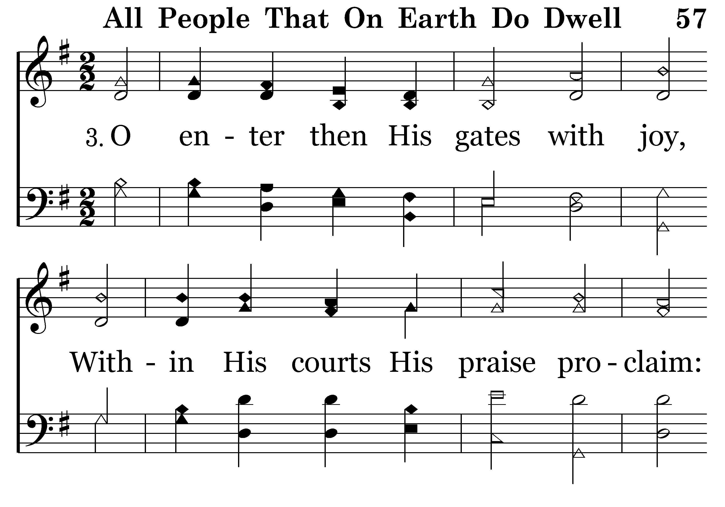
057 - All People That On Earth Do Dwell - 3.1

Slide 26
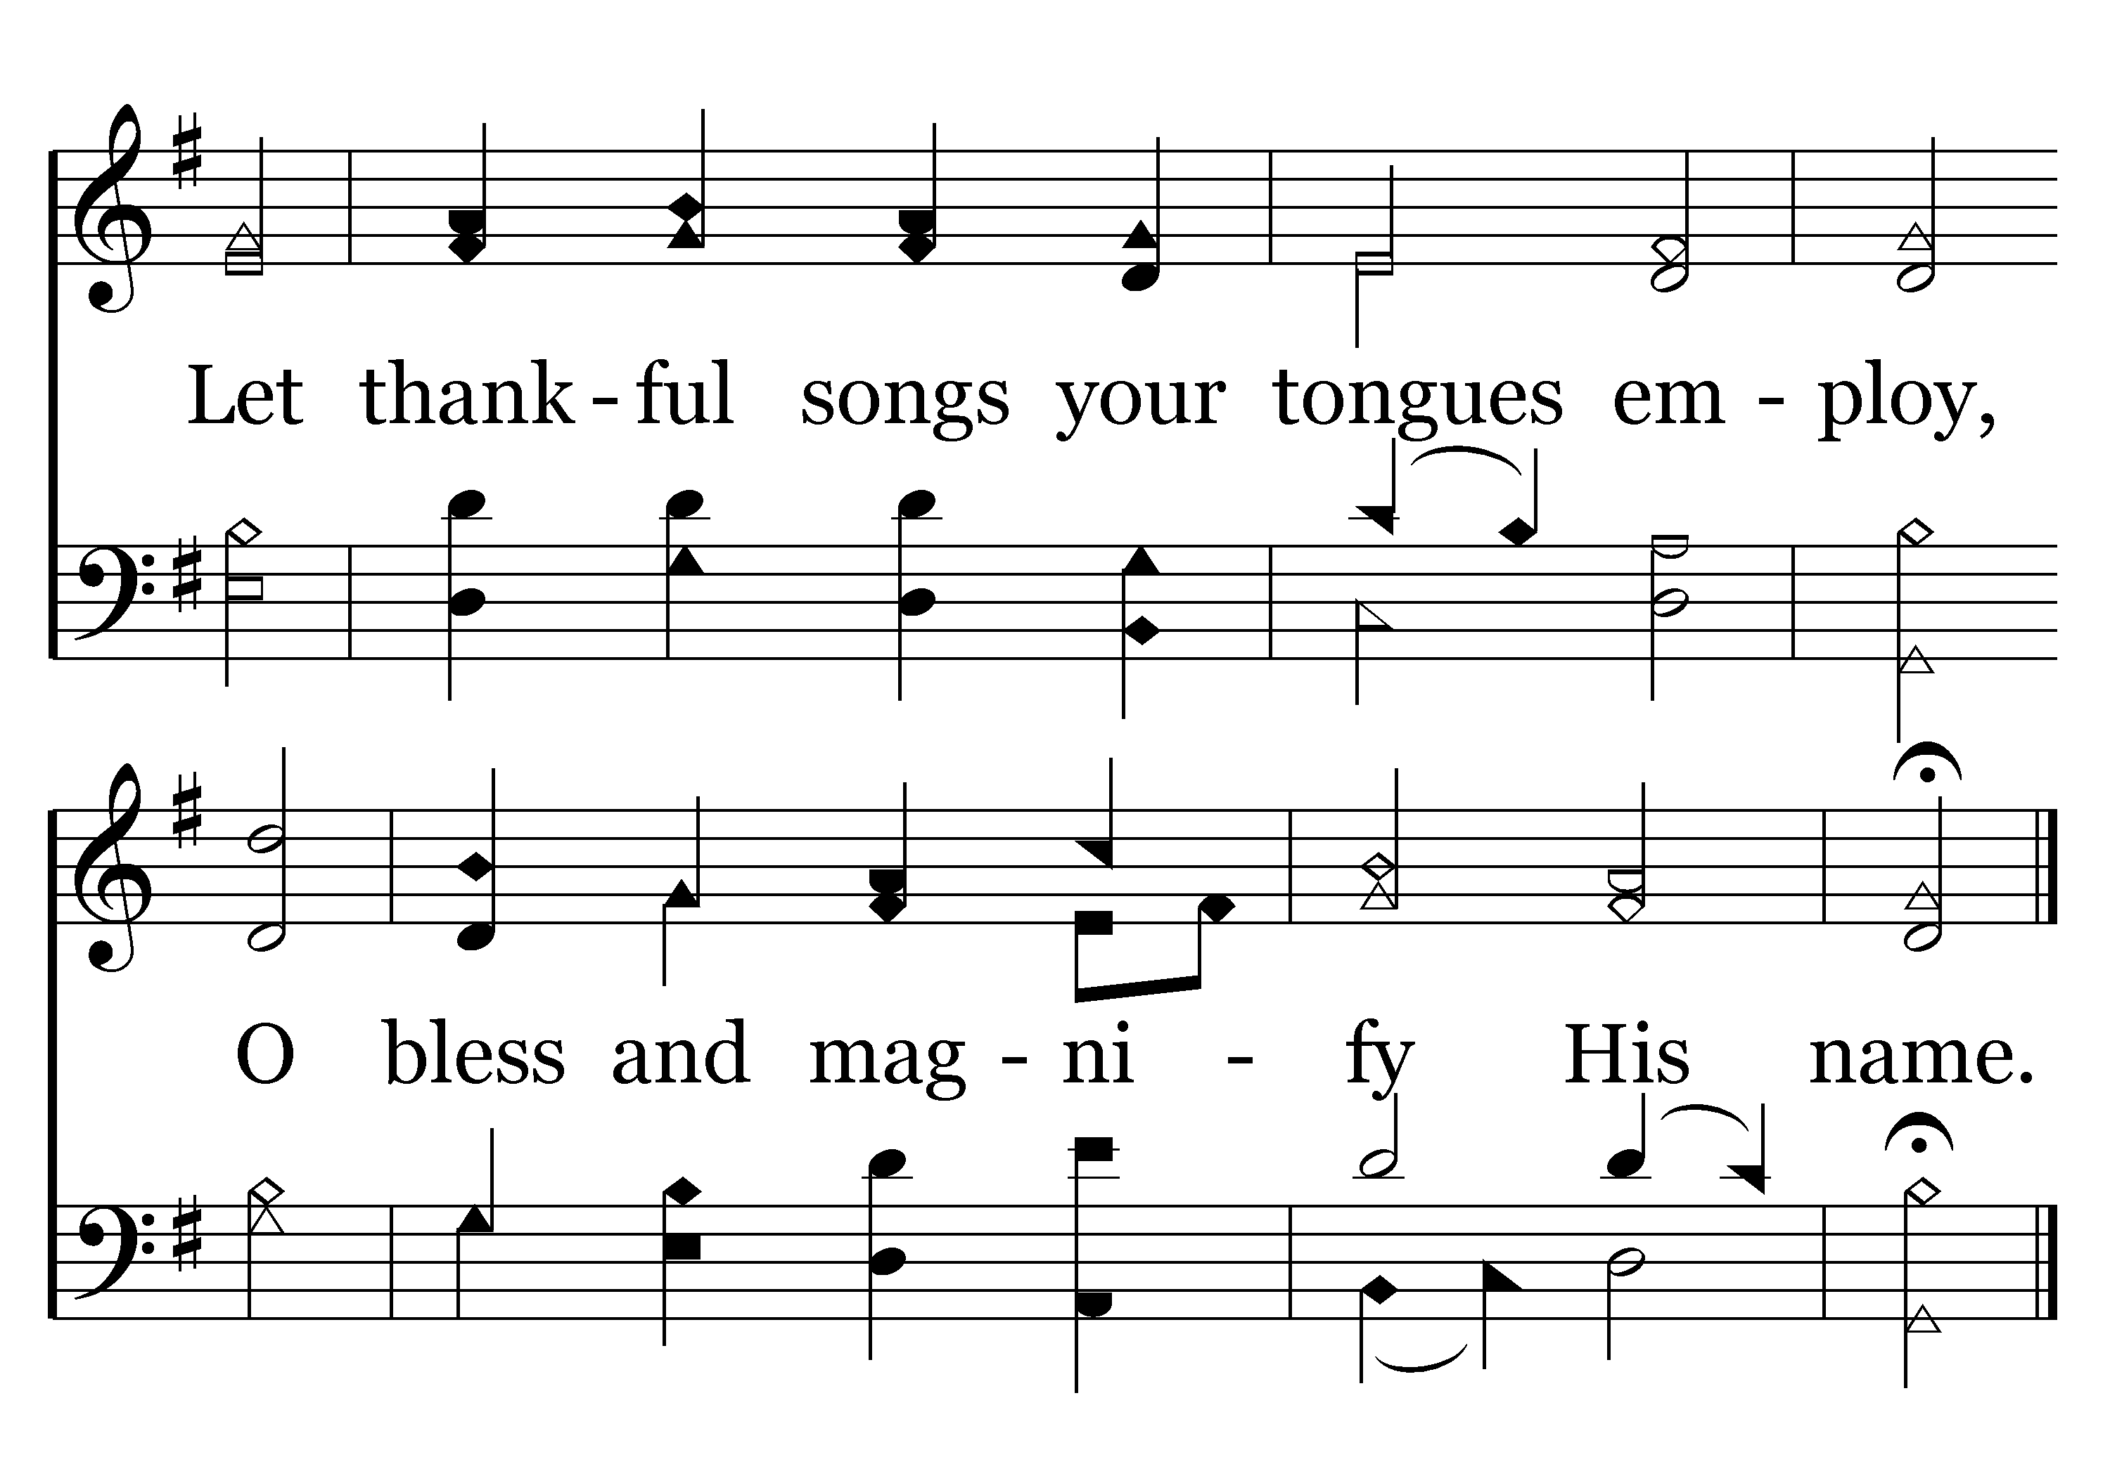
057 - All People That On Earth Do Dwell - 3.2
End of Verse 3

Slide 27
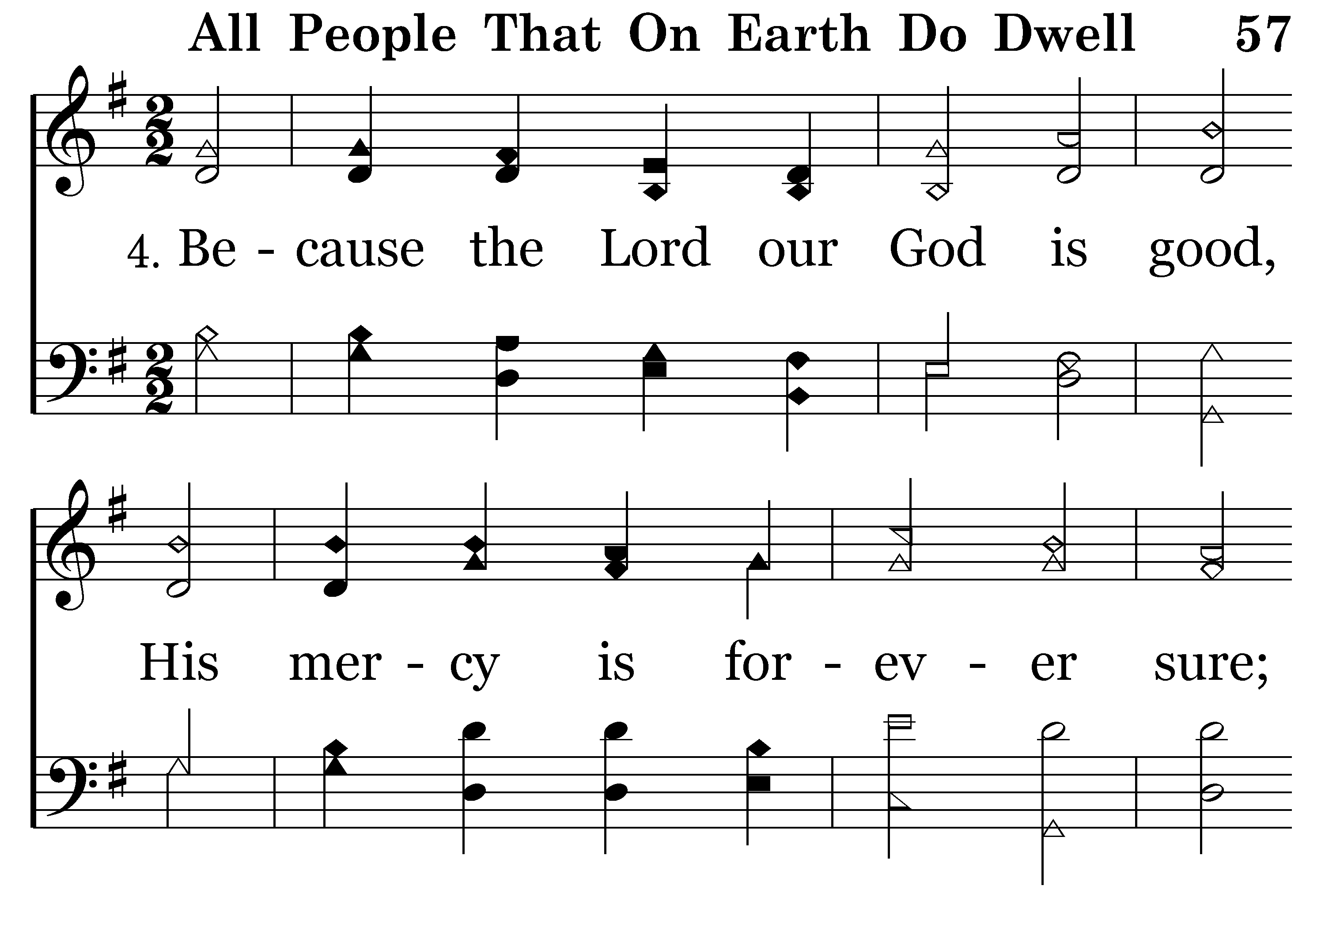
057 - All People That On Earth Do Dwell - 4.1

Slide 28
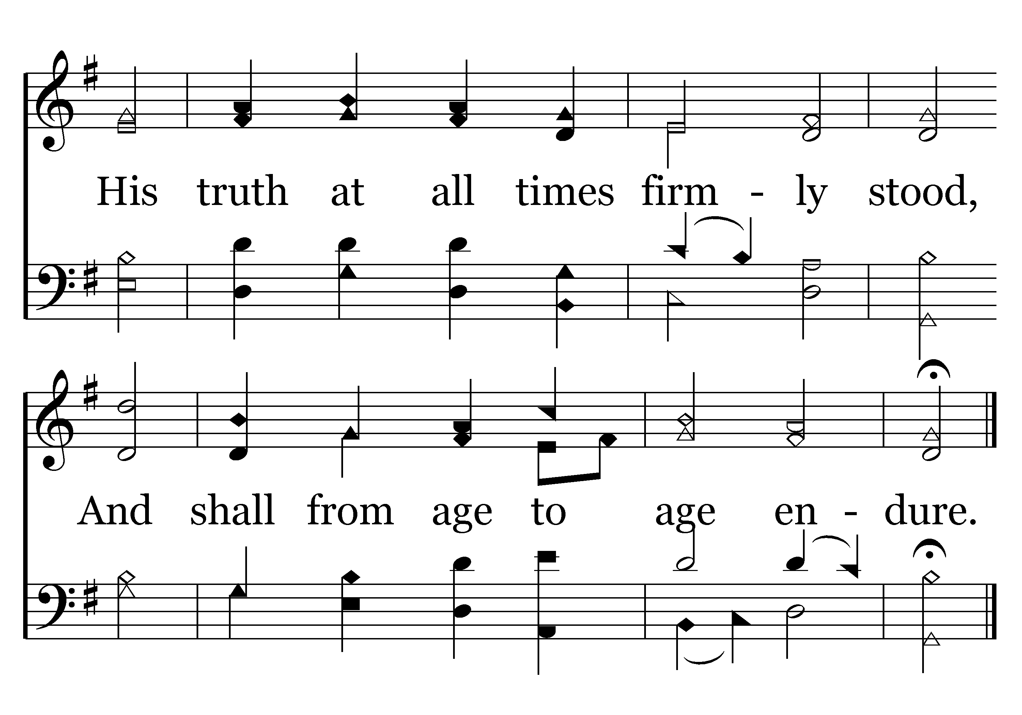
057 - All People That On Earth Do Dwell - 4.2
End of Song

Slide 29
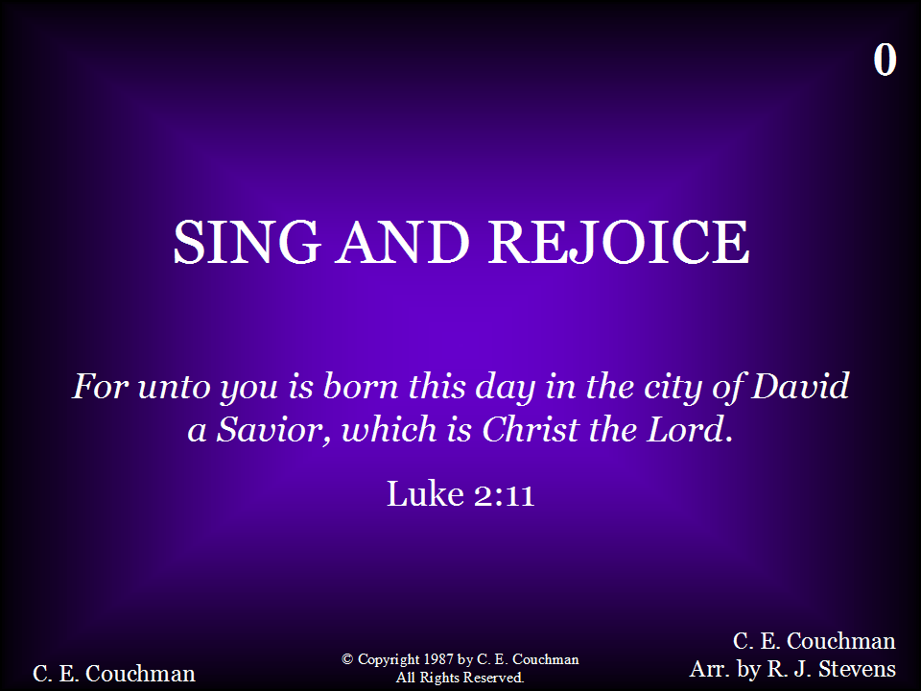
000 - Sing and Rejoice in the Savior's Birth - Title

Slide 30
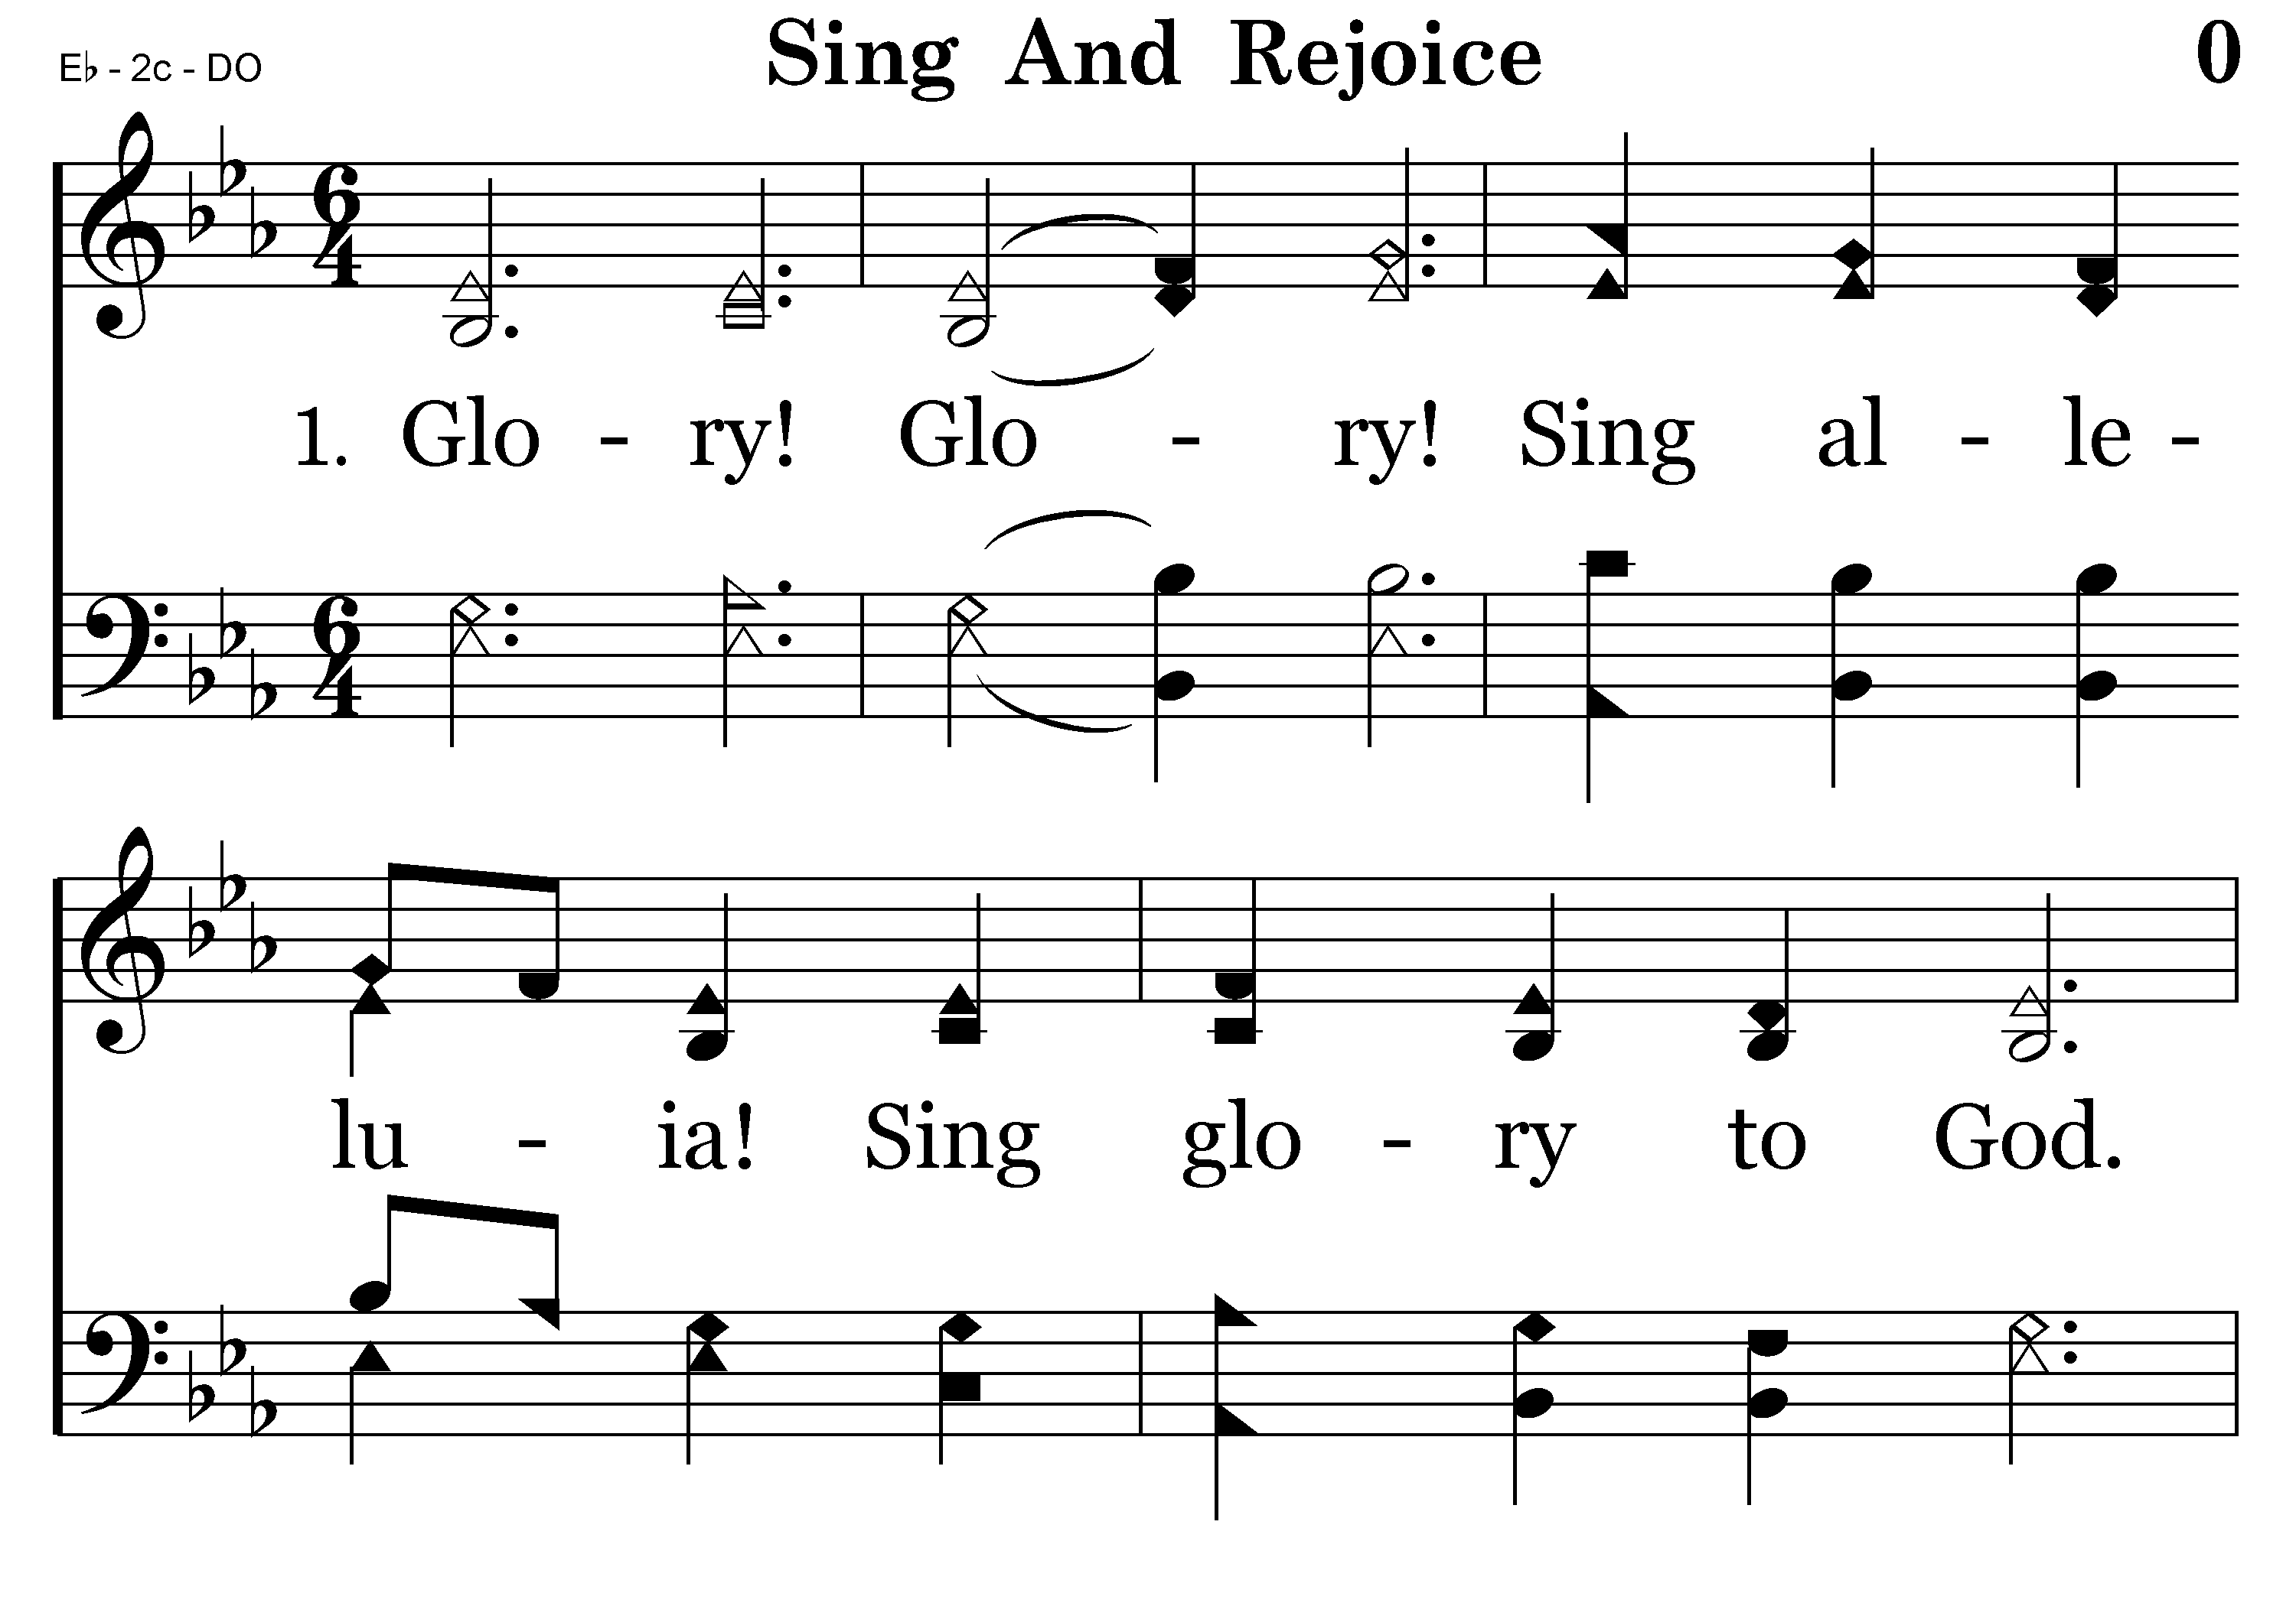
000 - Sing and Rejoice in the Savior's Birth - 1.1

Slide 31
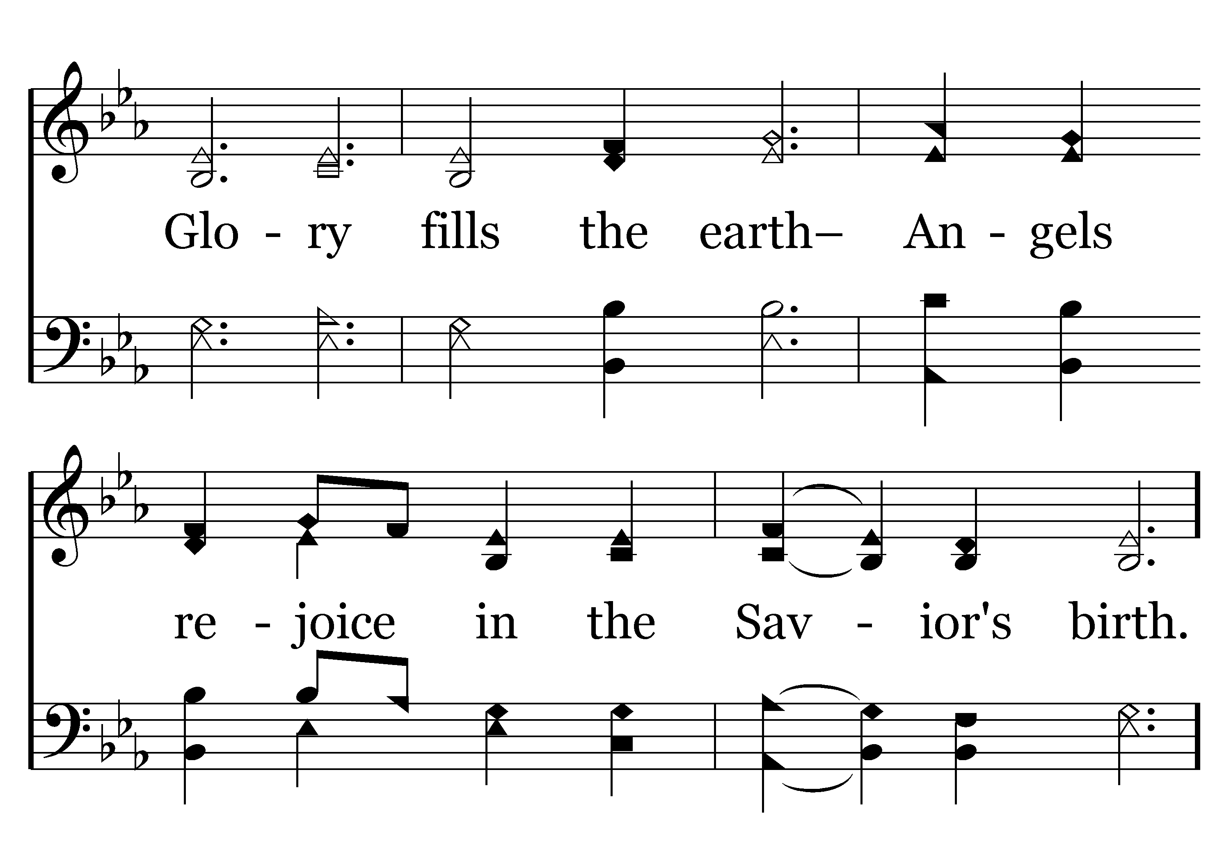
000 - Sing and Rejoice in the Savior's Birth - 1.2

Slide 32
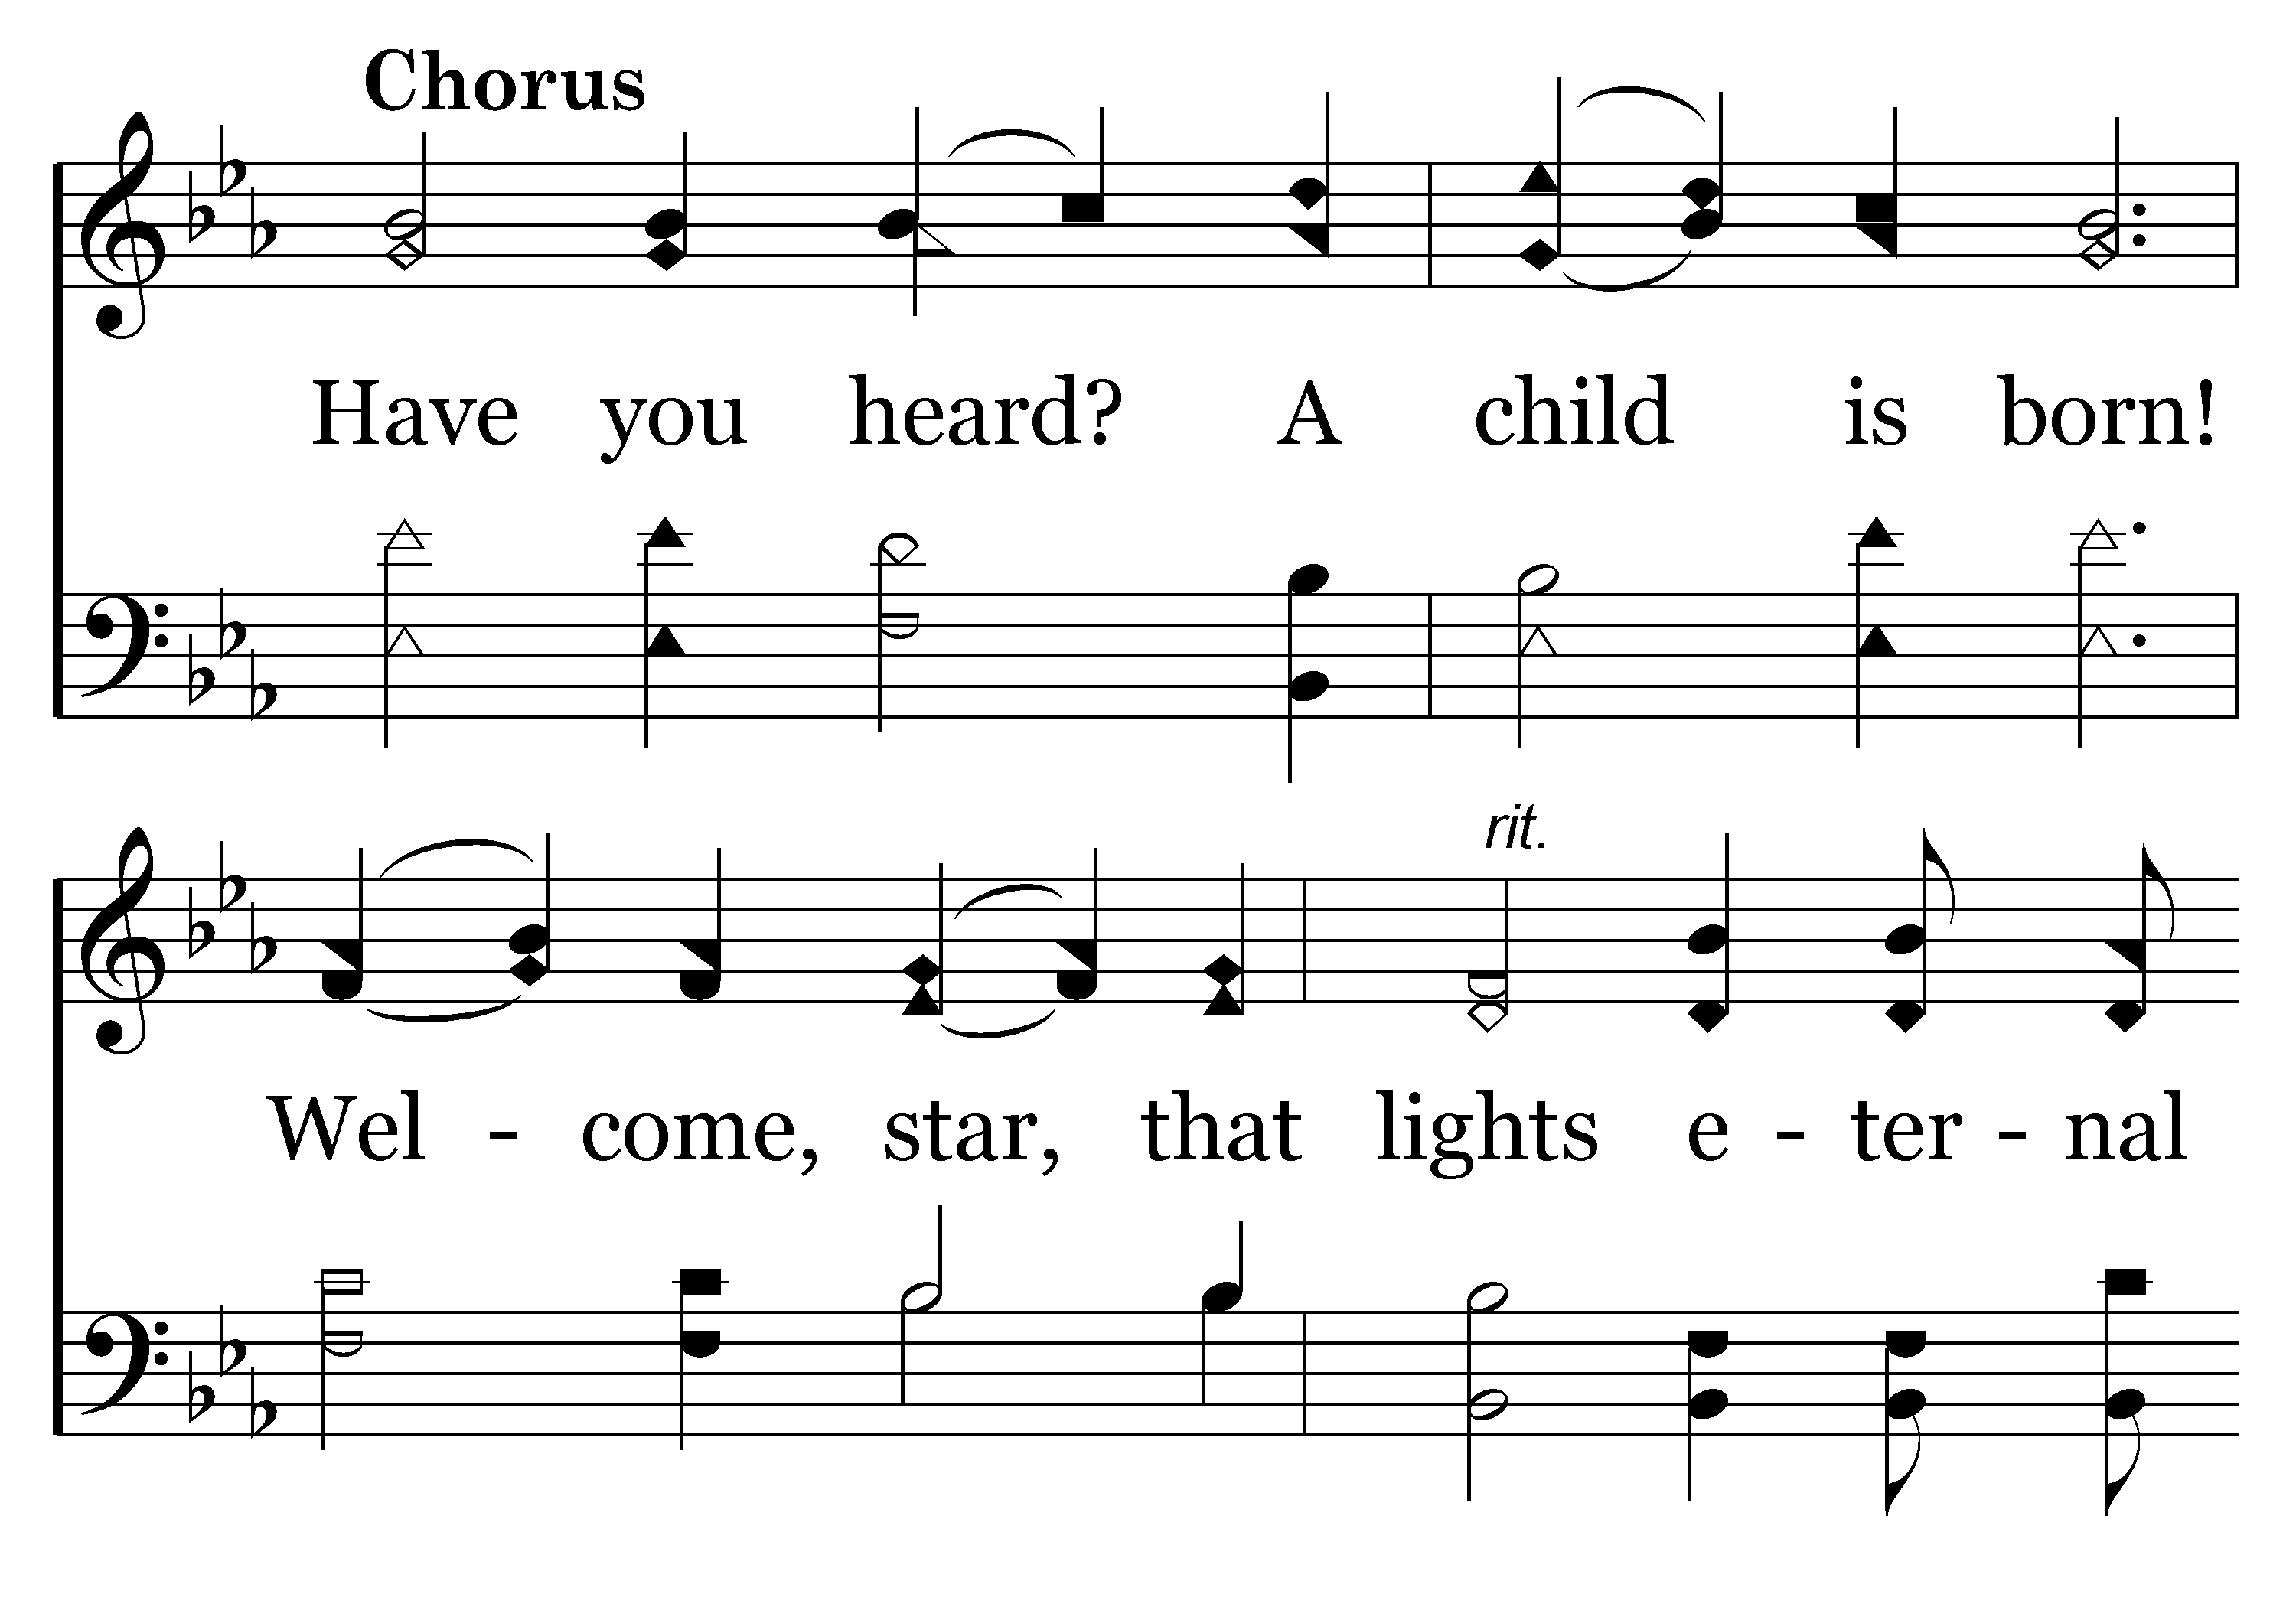
000 - Sing and Rejoice in the Savior's Birth - C.1

Slide 33
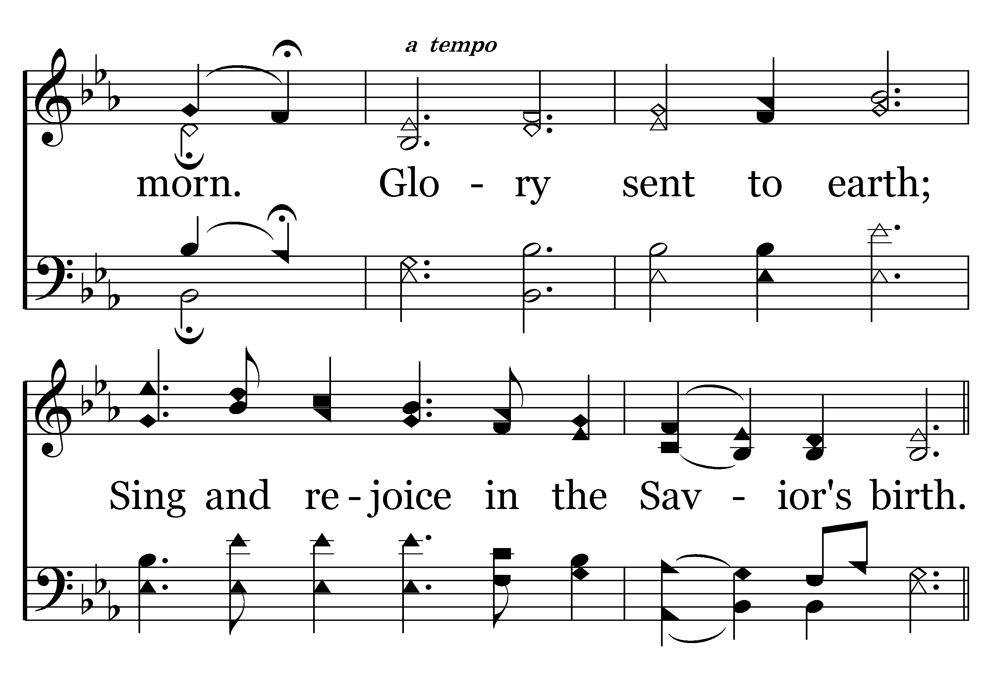
000 - Sing and Rejoice in the Savior's Birth - C.2
End of Verse 1

Slide 34
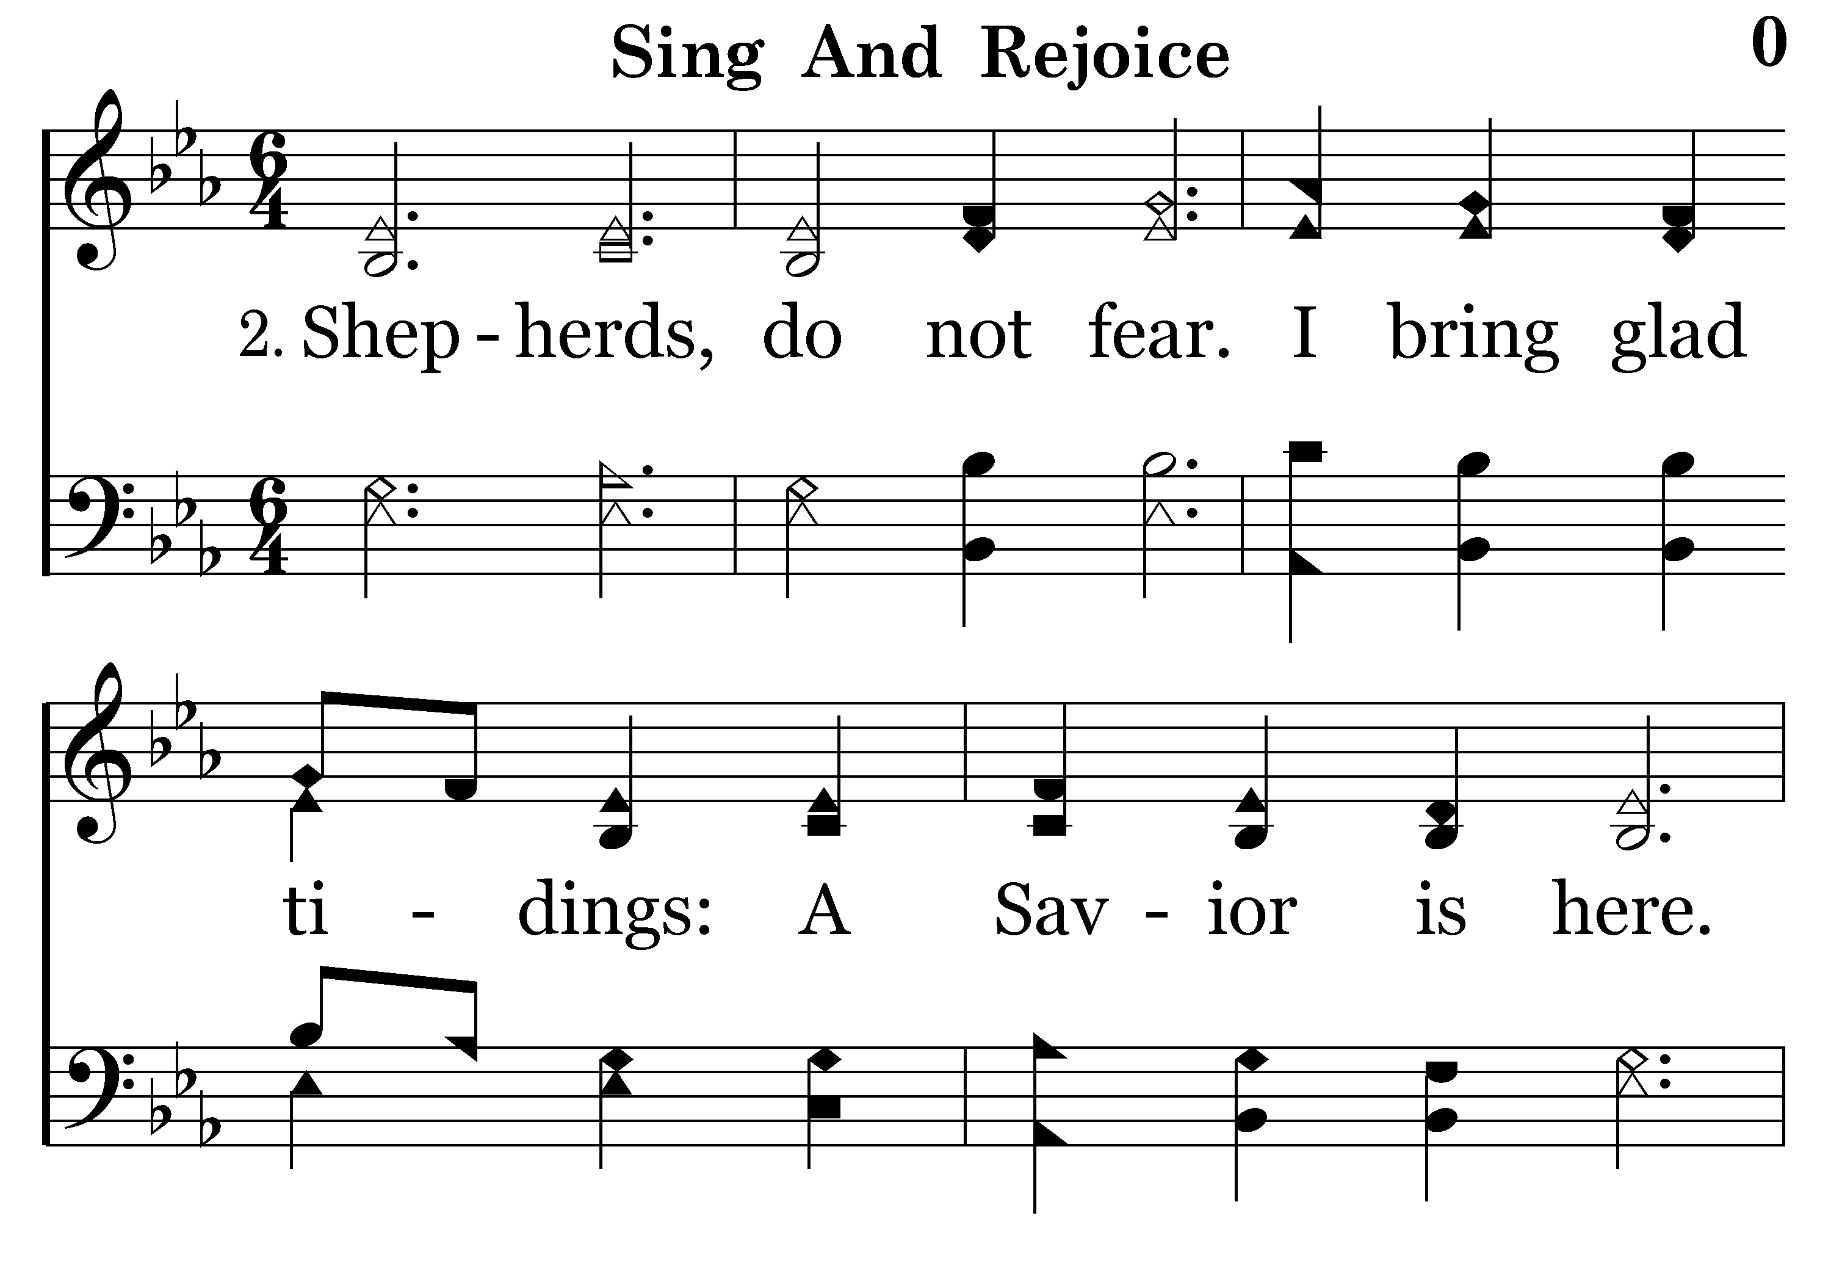
000 - Sing and Rejoice in the Savior's Birth - 2.1

Slide 35
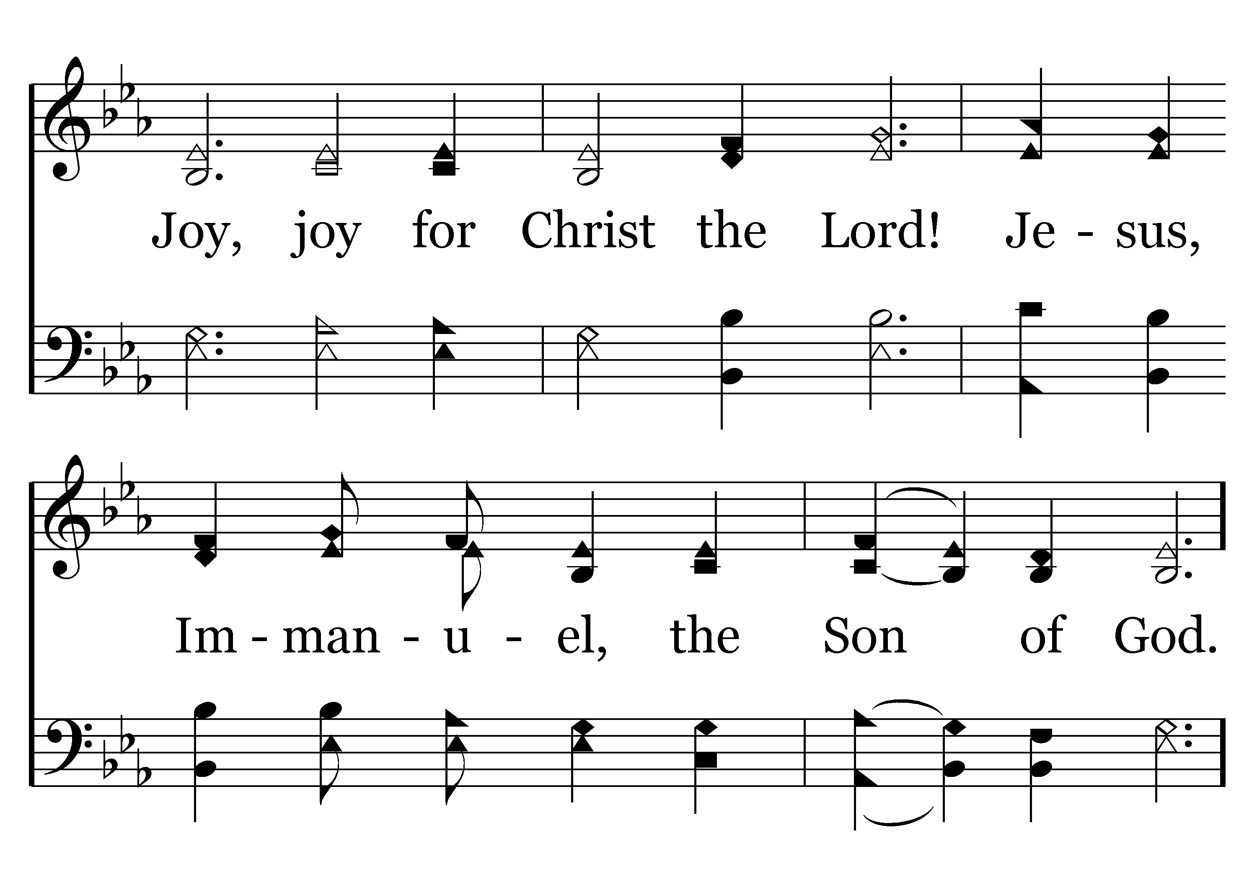
000 - Sing and Rejoice in the Savior's Birth - 2.2

Slide 36
000 - Sing and Rejoice in the Savior's Birth - C.1

Slide 37
000 - Sing and Rejoice in the Savior's Birth - C.2
End of Verse 2

Slide 38
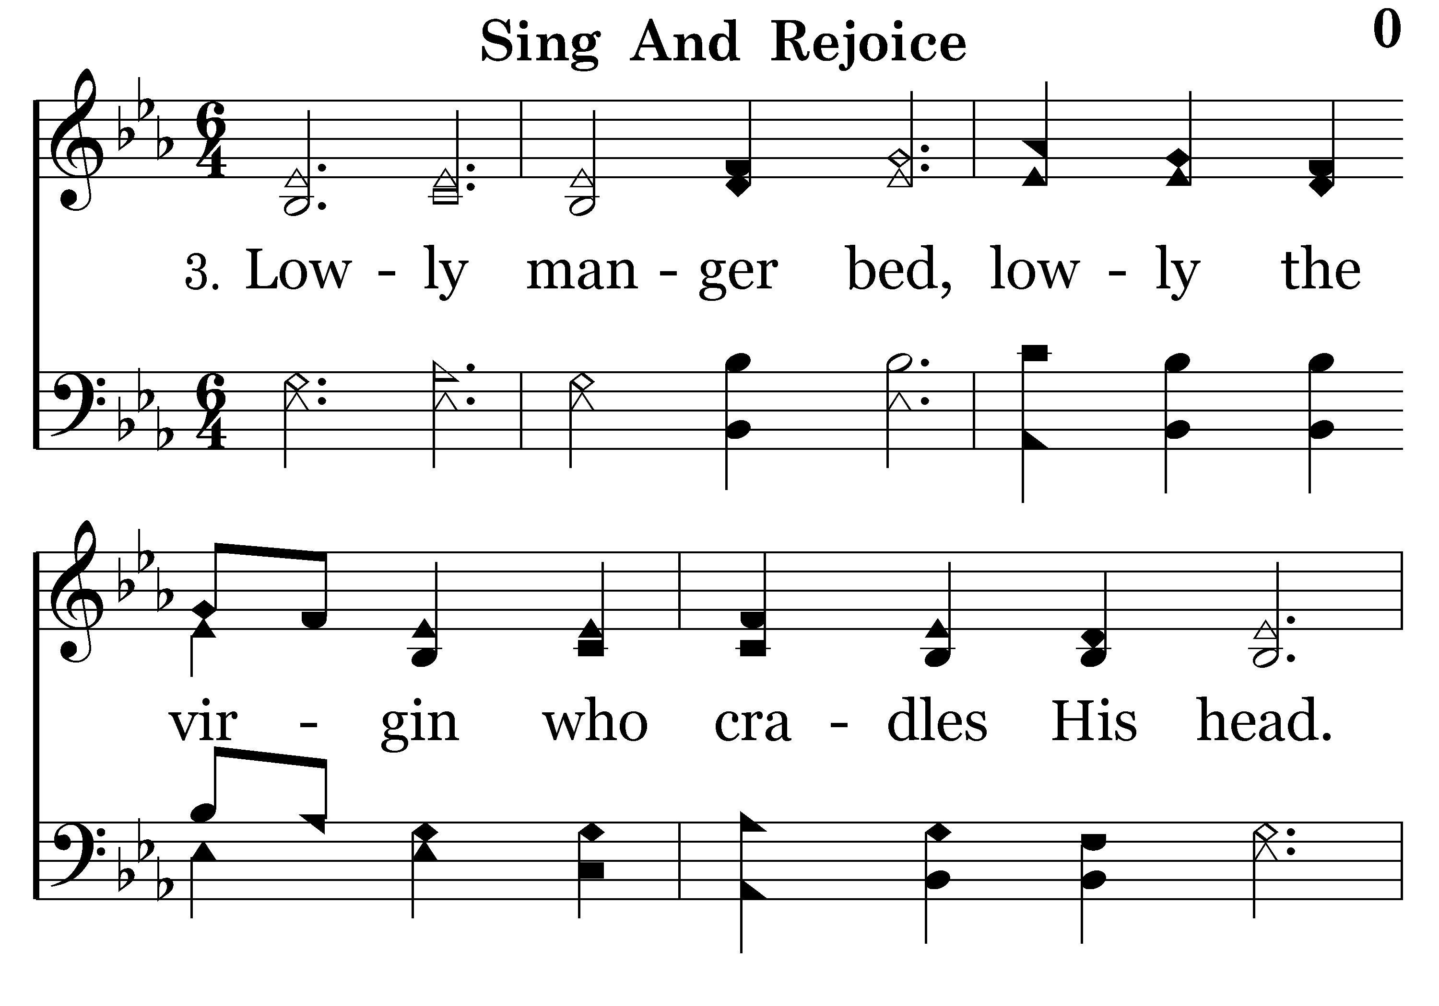
000 - Sing and Rejoice in the Savior's Birth - 3.1

Slide 39
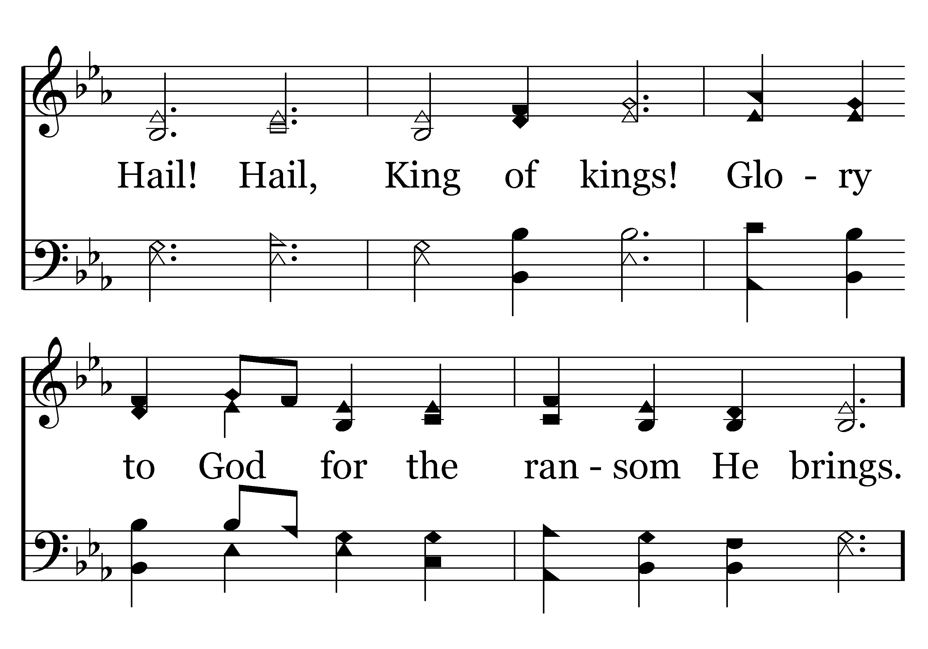
000 - Sing and Rejoice in the Savior's Birth - 3.2

Slide 40
000 - Sing and Rejoice in the Savior's Birth - C.1

Slide 41
000 - Sing and Rejoice in the Savior's Birth - C.2

Slide 42
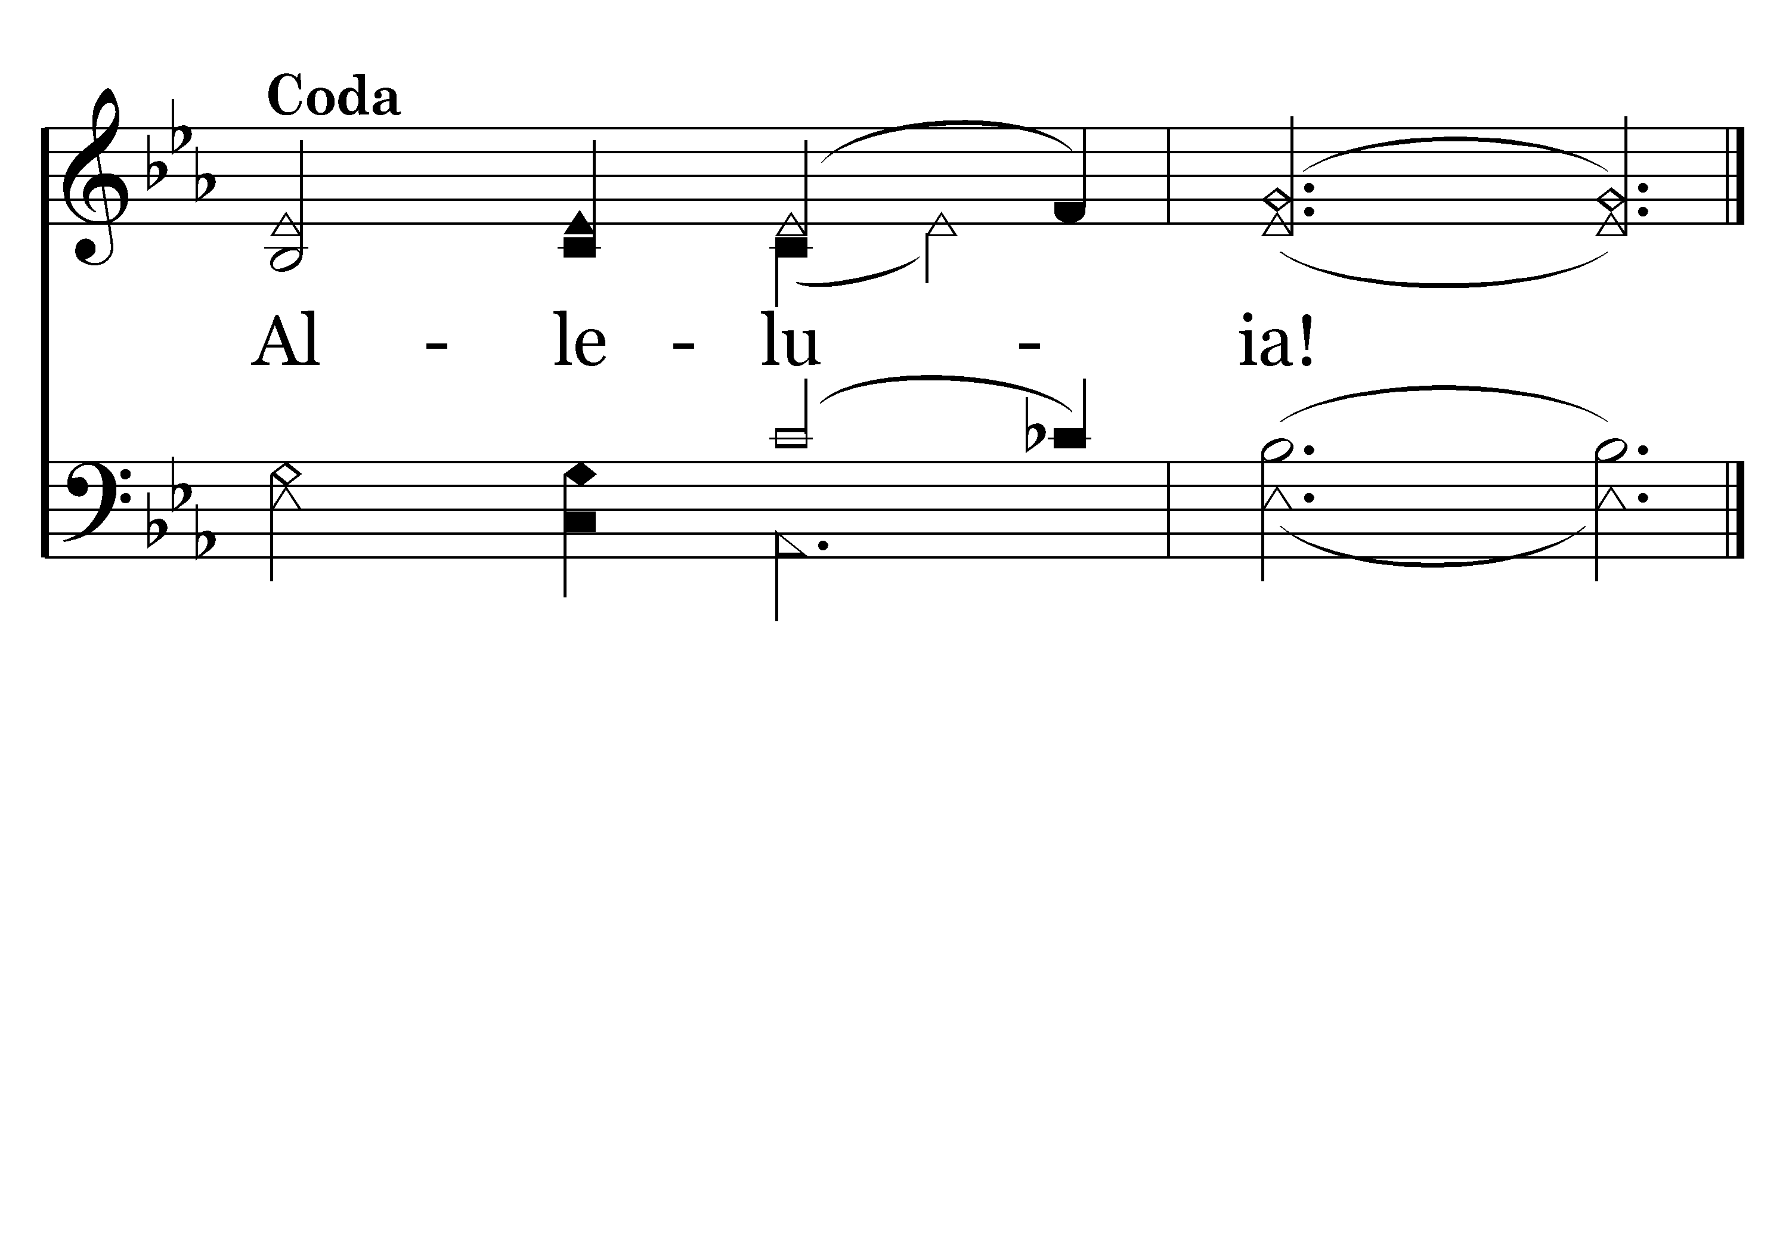
000 - Sing and Rejoice in the Savior's Birth - D.1
End of Song

Slide 43
Prayer of thanks for relationship with God

Slide 44
Phil 2:6-11, Christ’s Spirit of humility

Slide 45
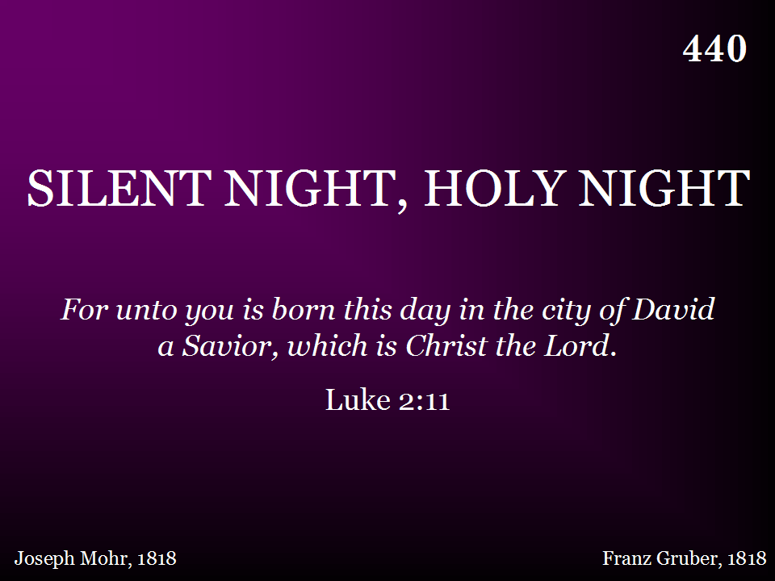
440 - Silent Night, Holy Night - Title

Slide 46
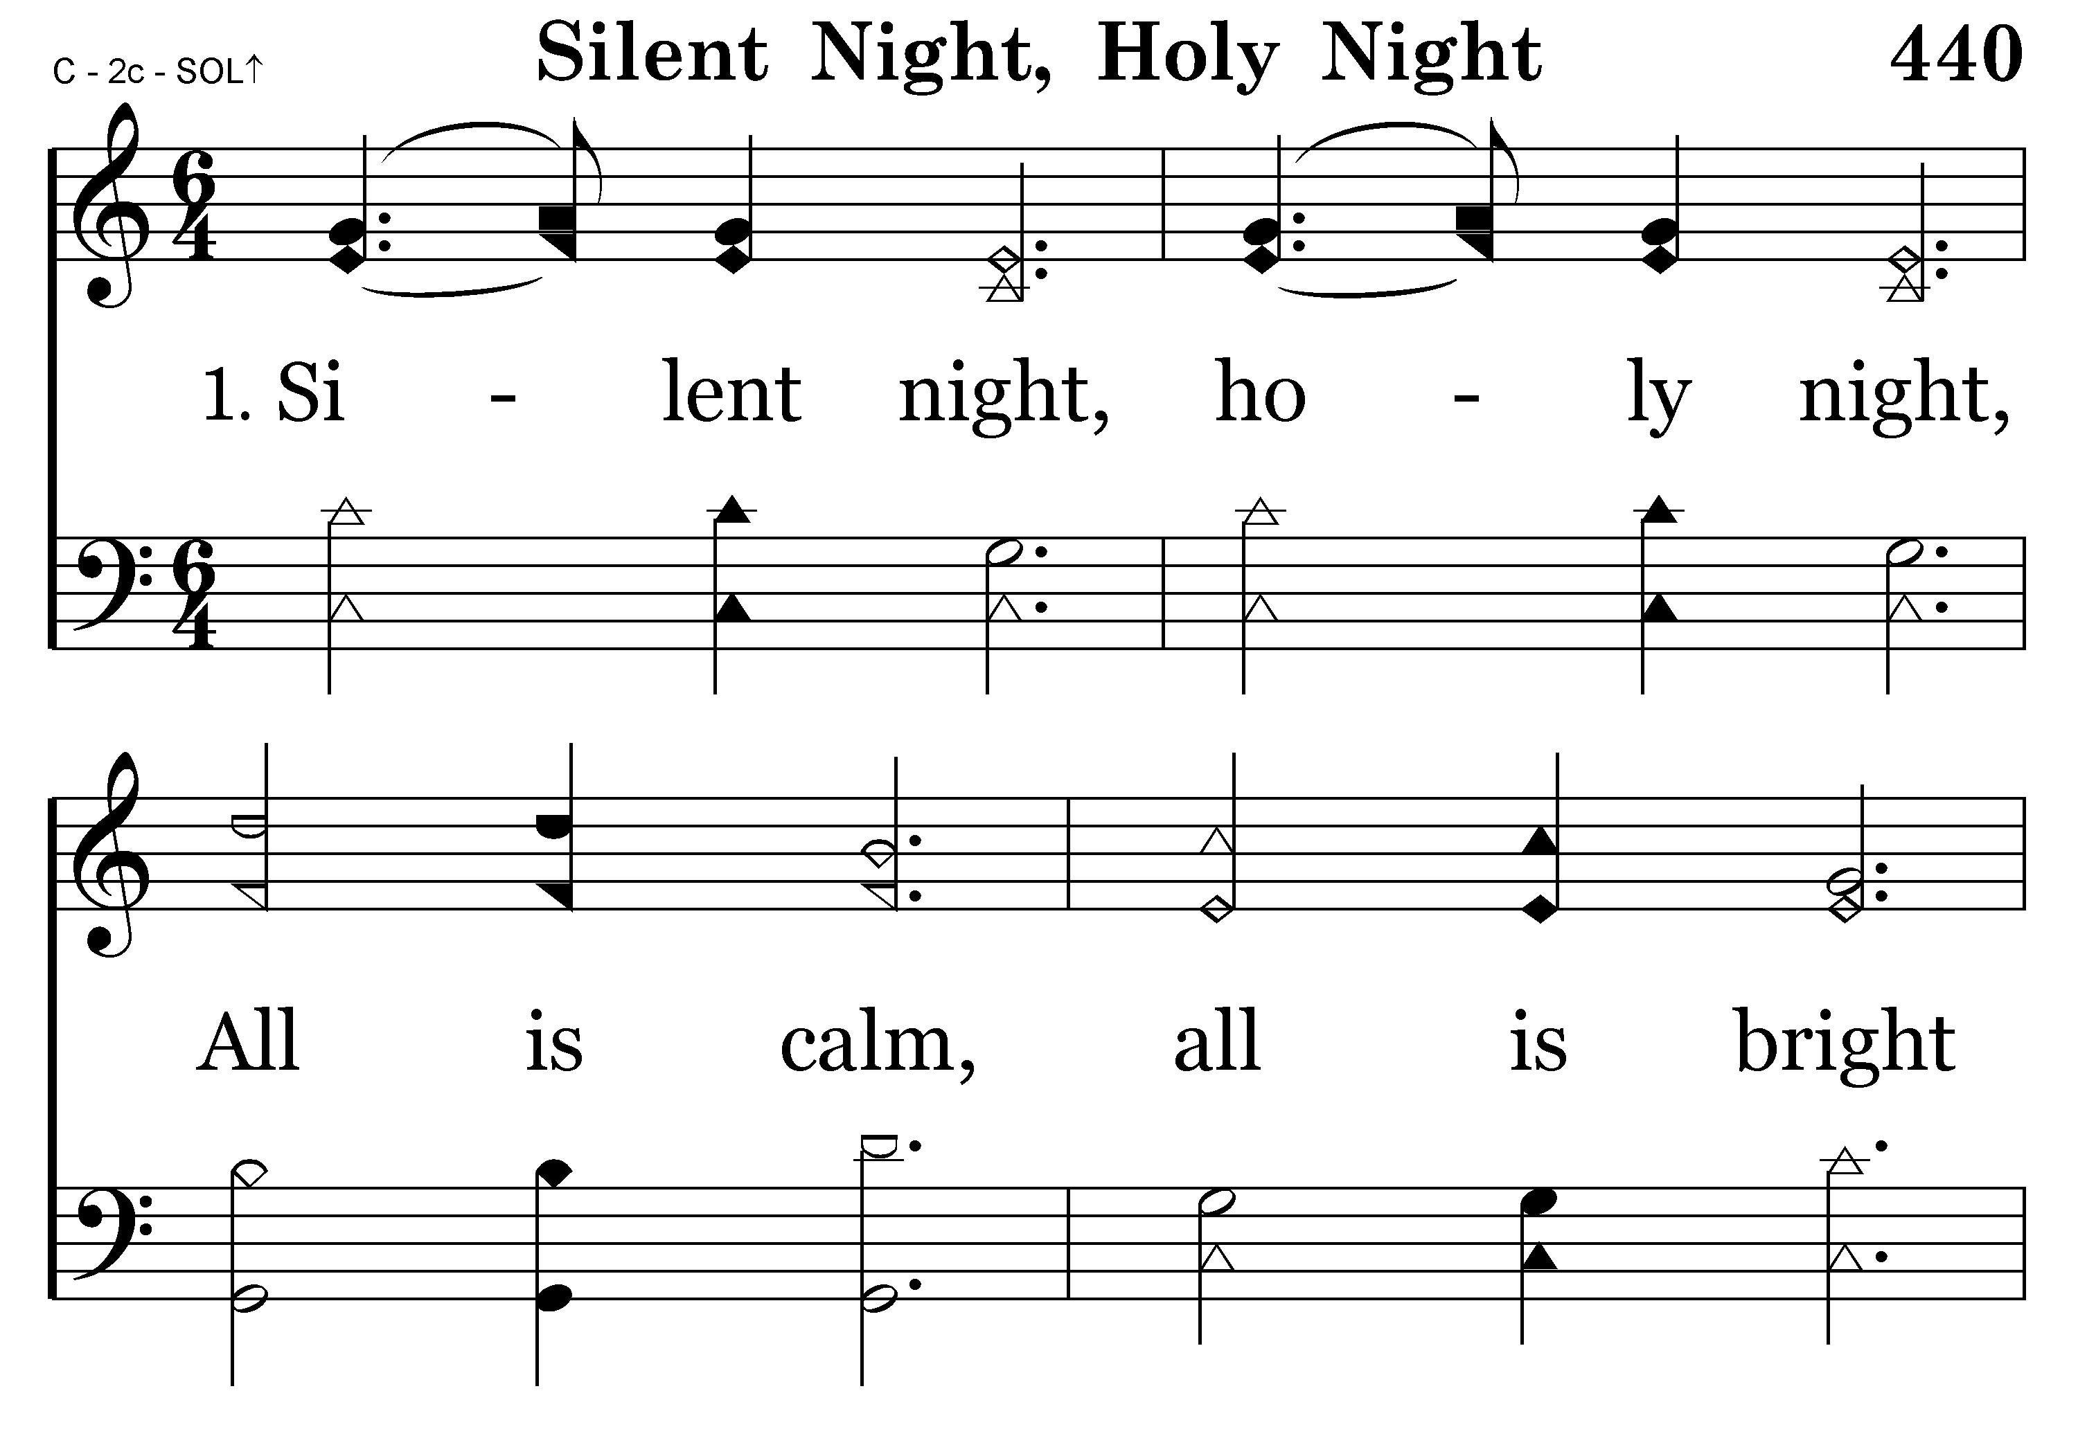
440 - Silent Night, Holy Night - 1.1

Slide 47
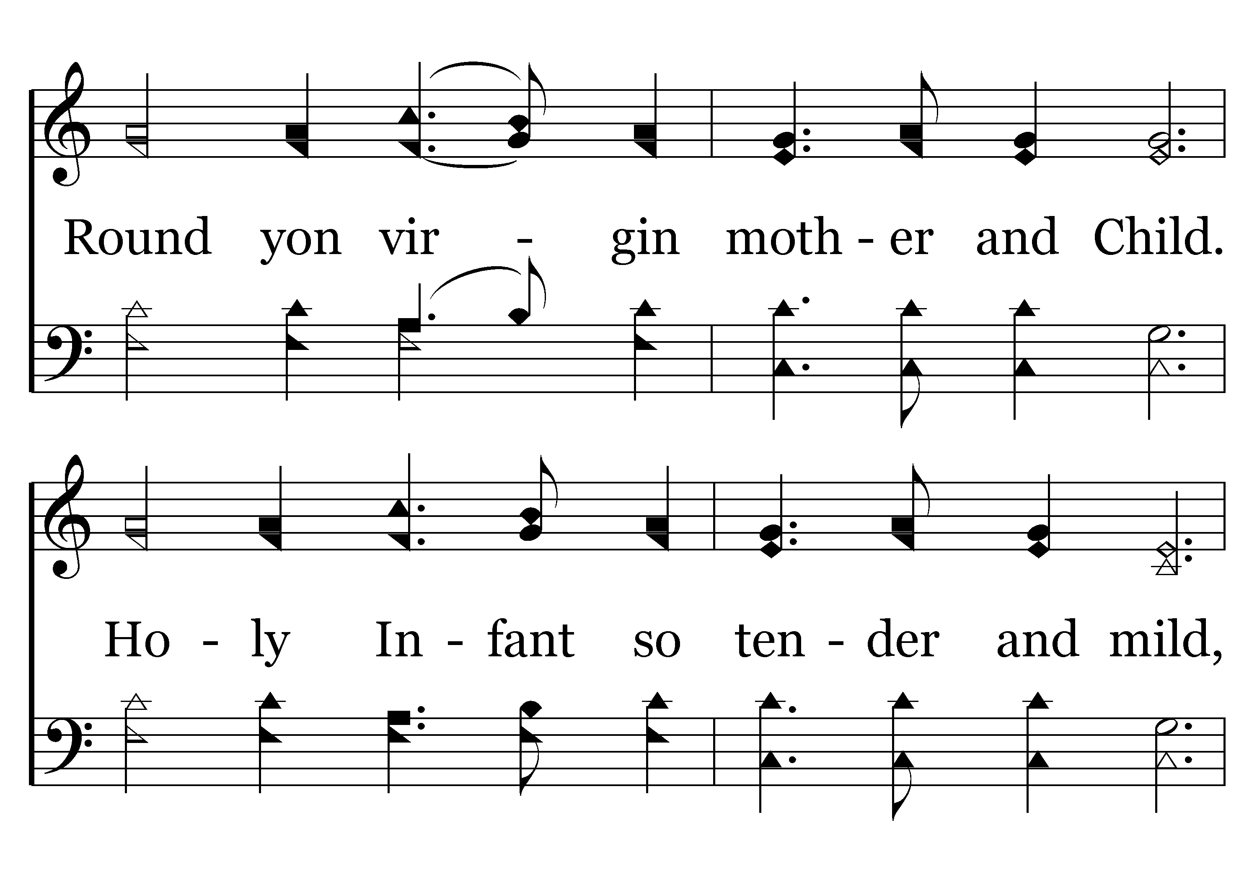
440 - Silent Night, Holy Night - 1.2

Slide 48
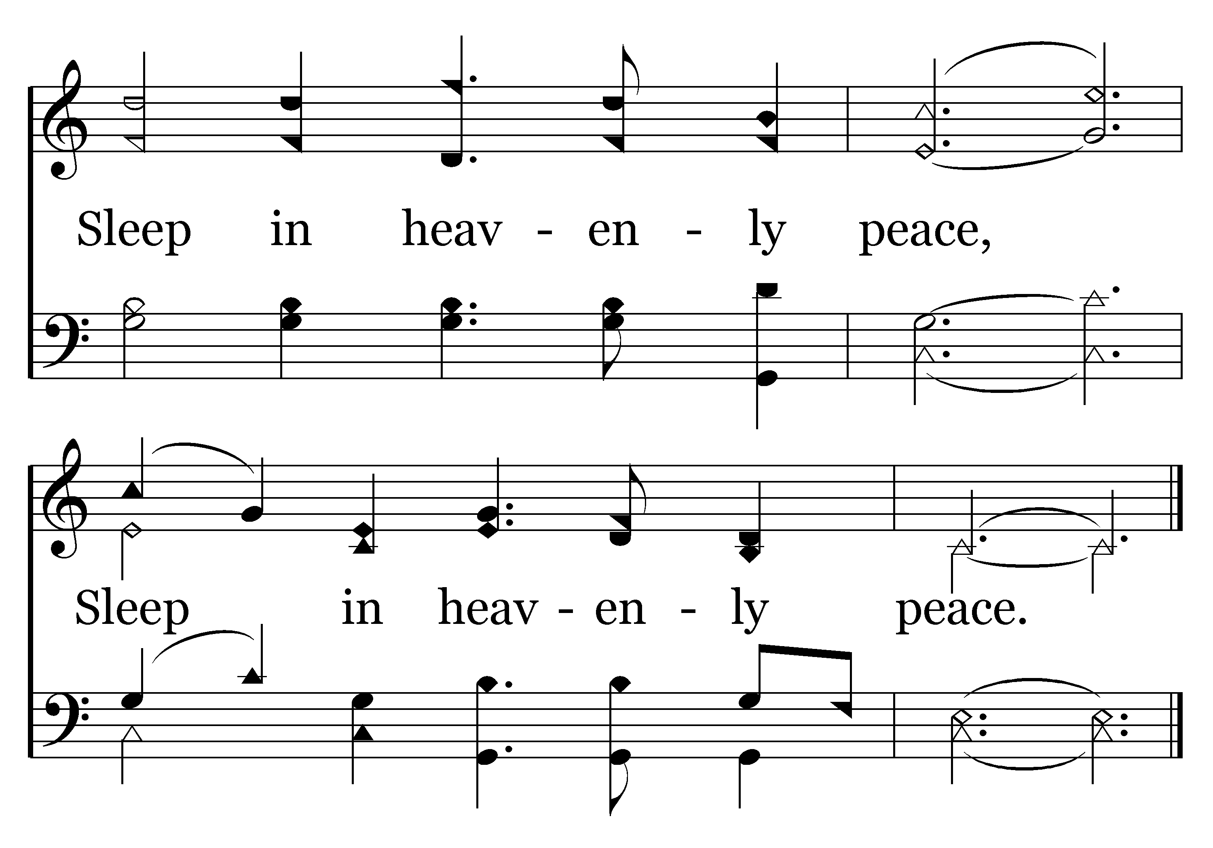
440 - Silent Night, Holy Night - 1.3
End of Verse 1

Slide 49
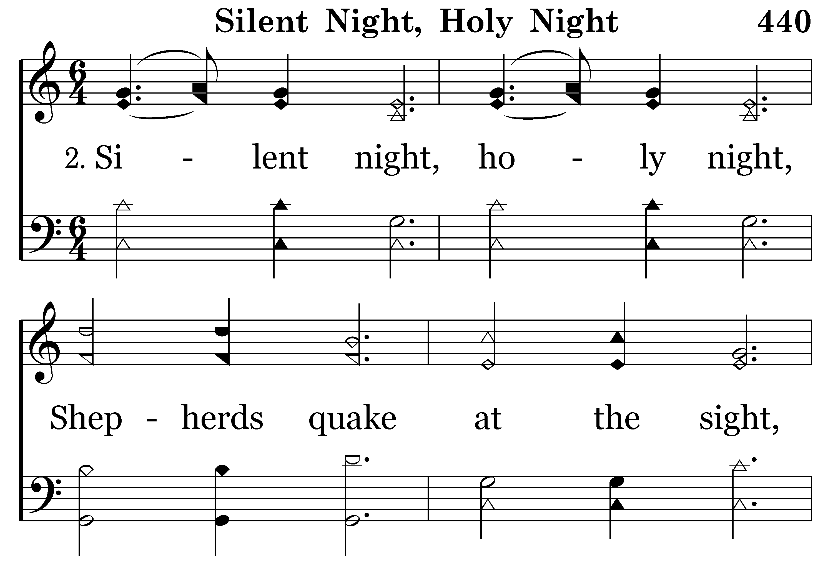
440 - Silent Night, Holy Night - 2.1

Slide 50
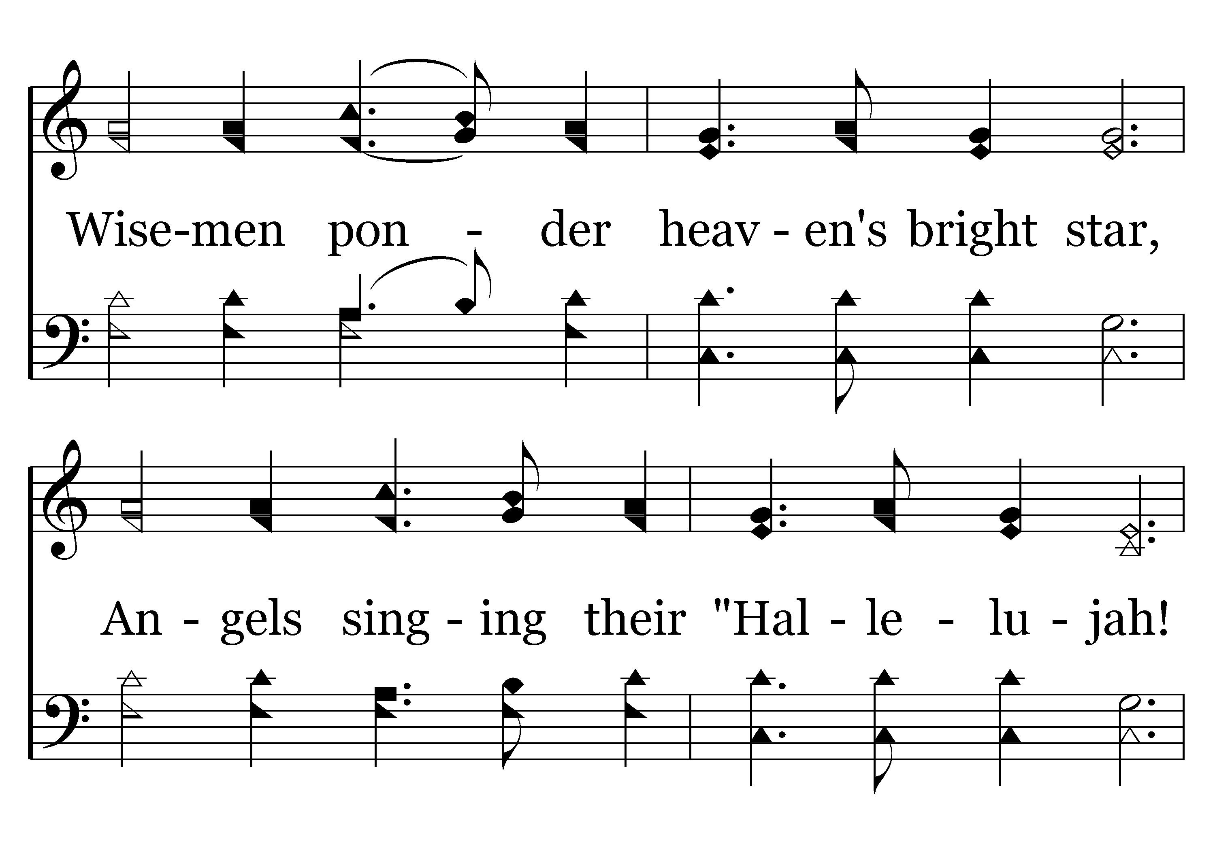
440 - Silent Night, Holy Night - 2.2

Slide 51
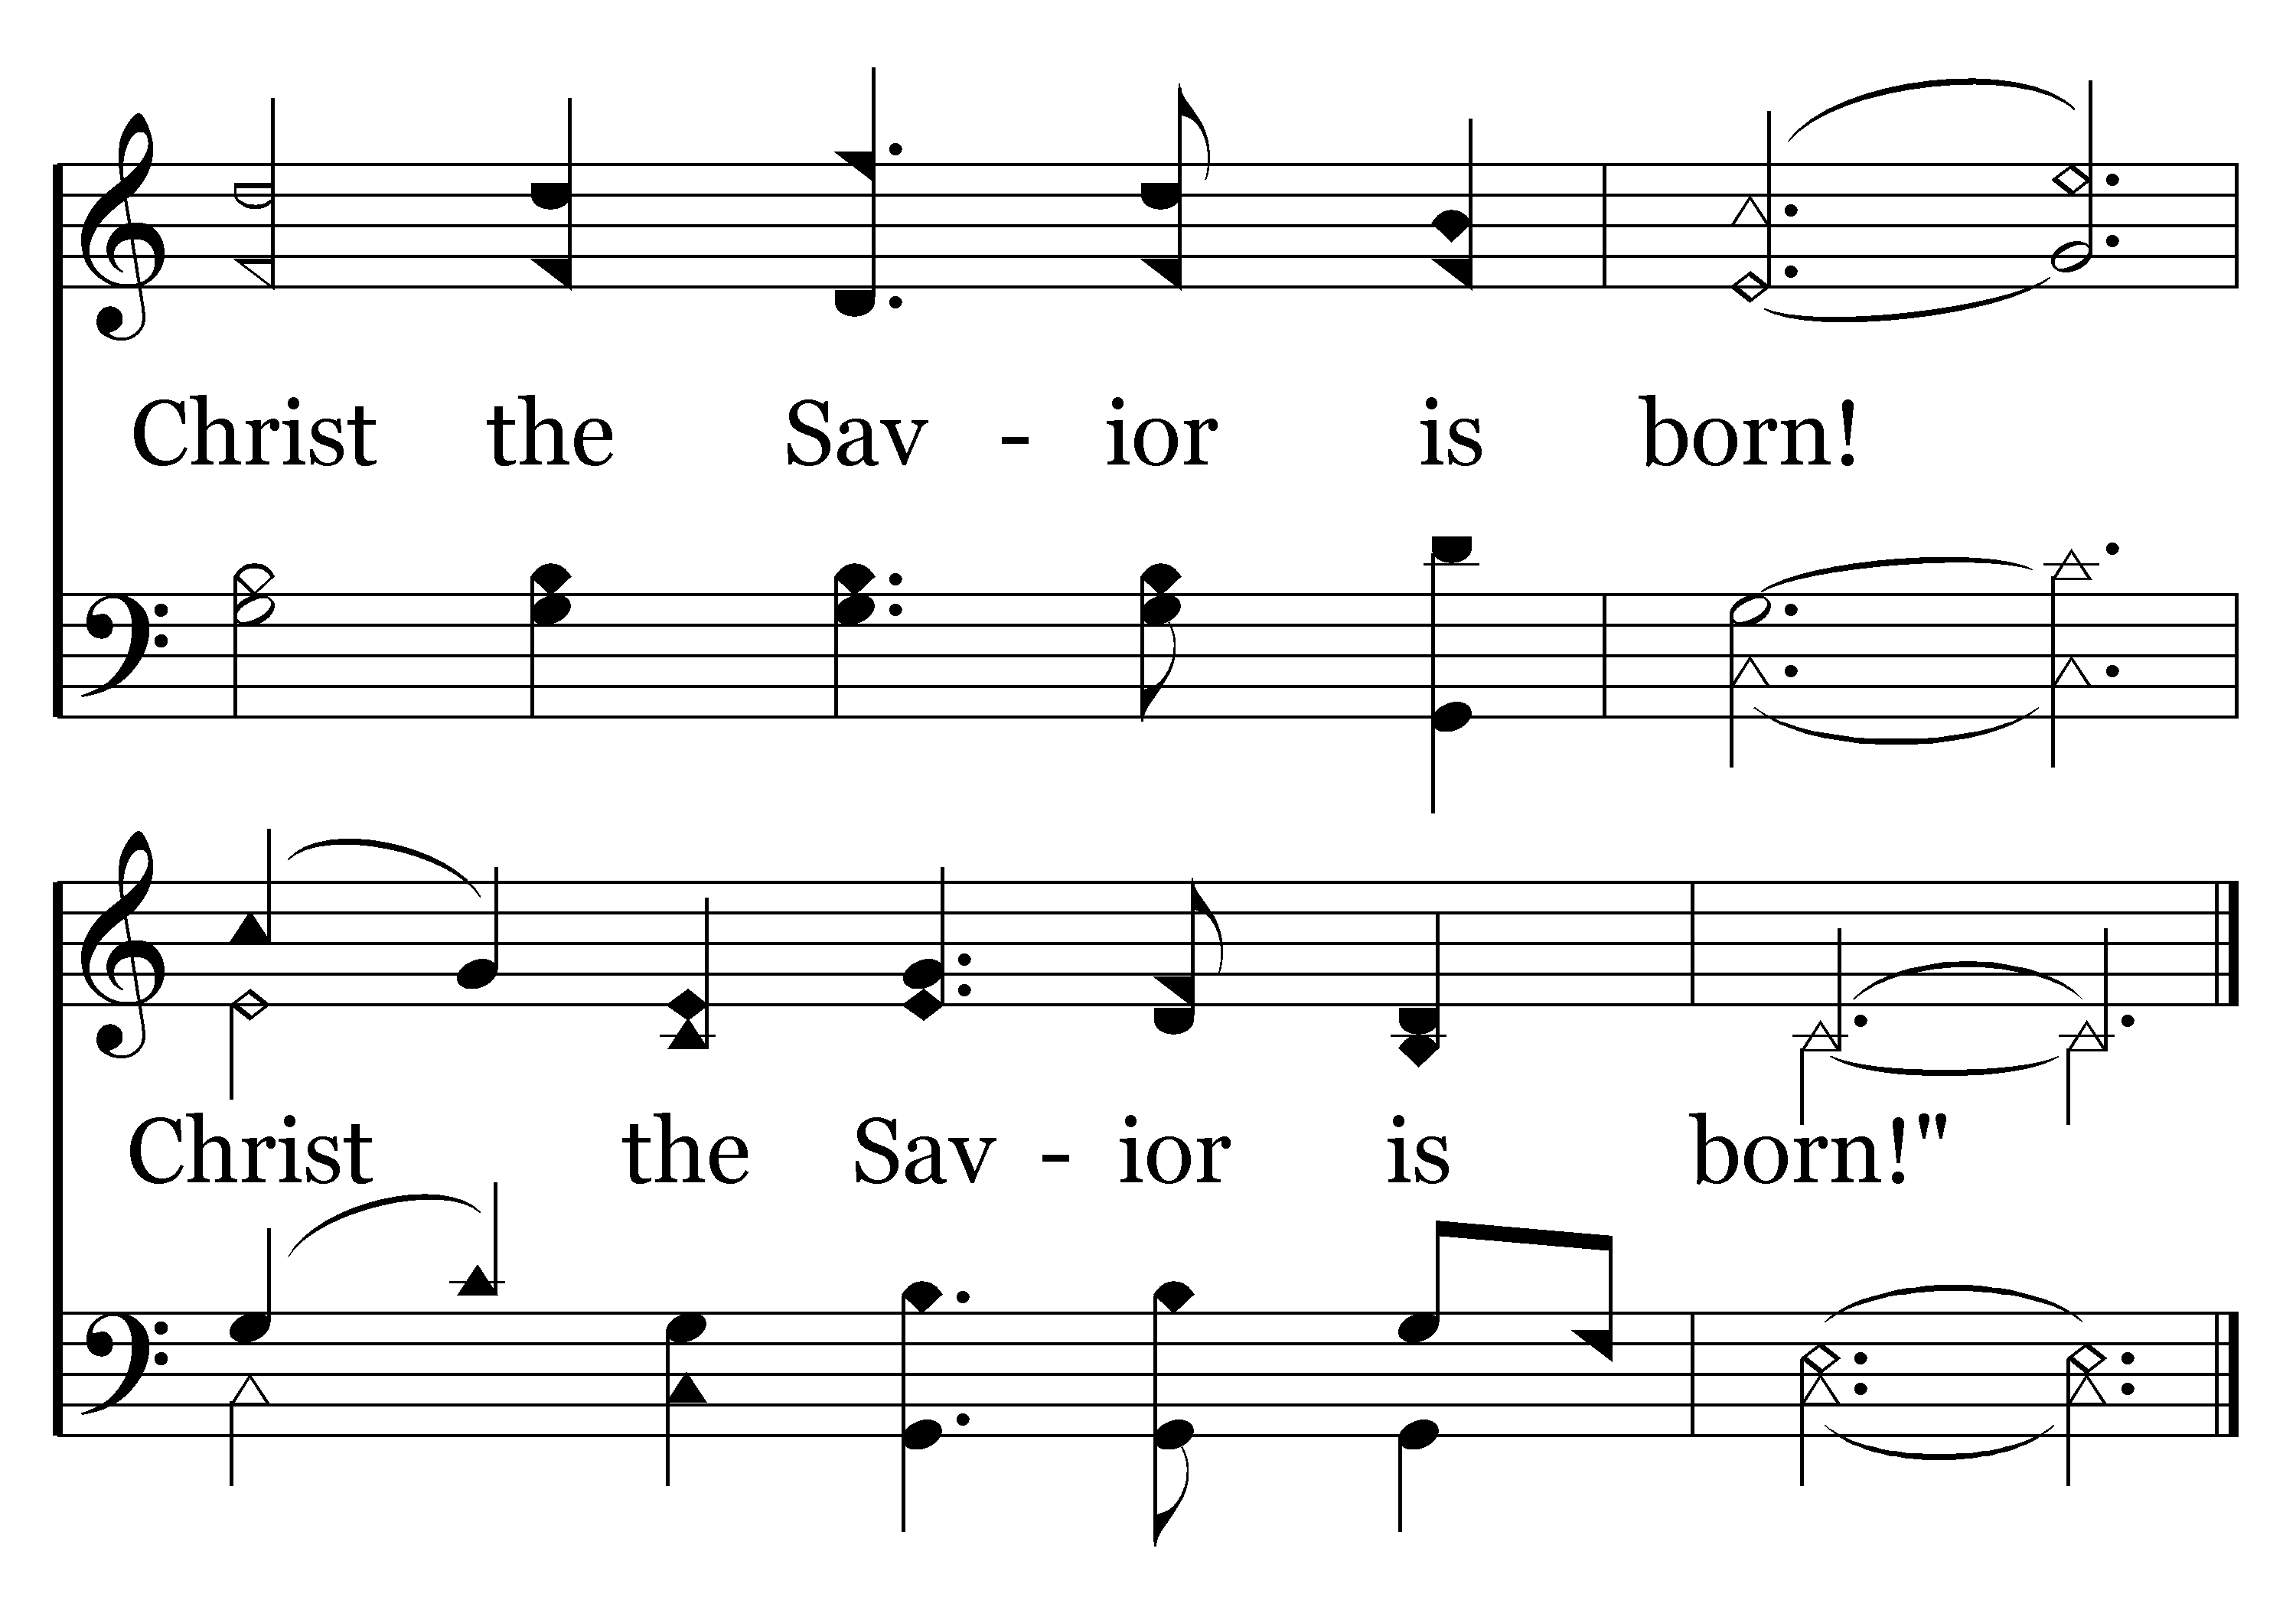
440 - Silent Night, Holy Night - 2.3
End of Verse 2

Slide 52
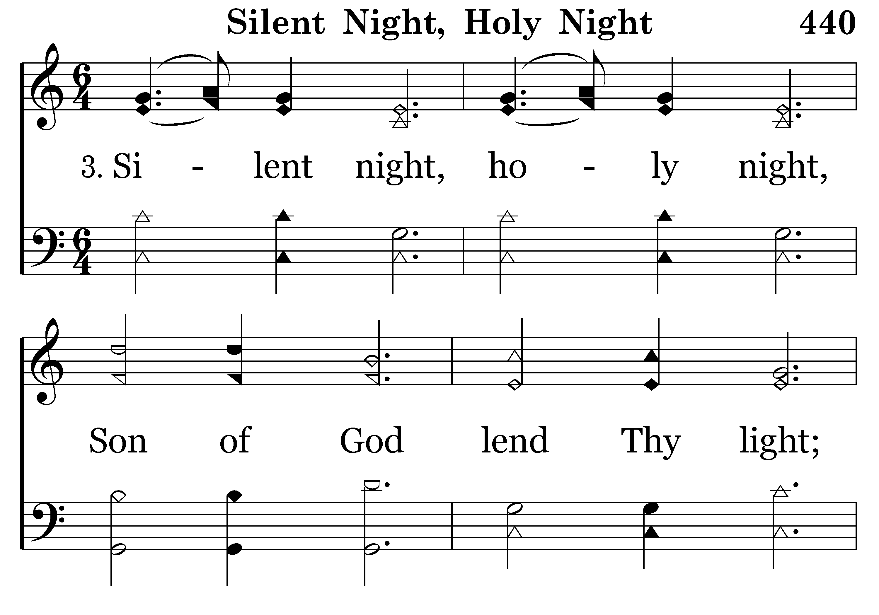
440 - Silent Night, Holy Night - 3.1

Slide 53
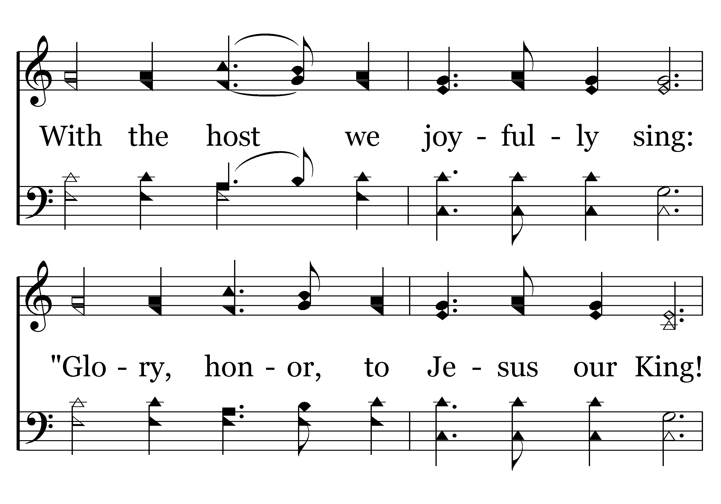
440 - Silent Night, Holy Night - 3.2

Slide 54
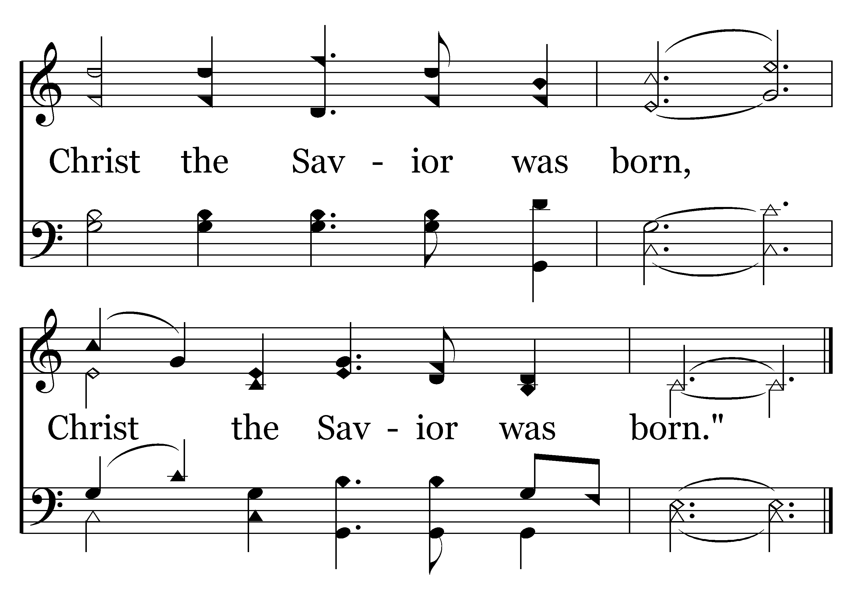
440 - Silent Night, Holy Night - 3.3
End of Song

Slide 55
Prayer for Spirit of Christ to live in us

Slide 56
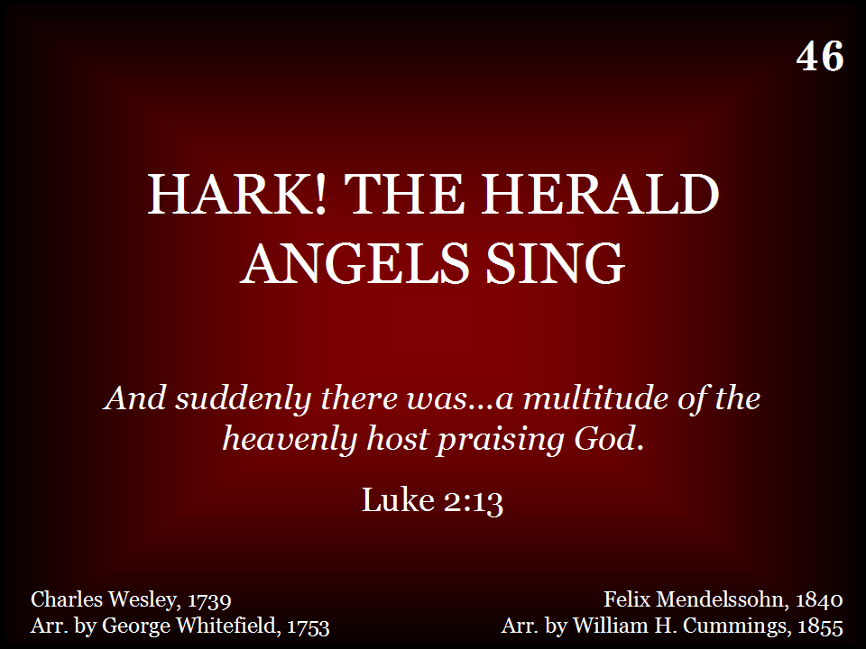
046 - Hark, The Herald Angels Sing - Title

Slide 57
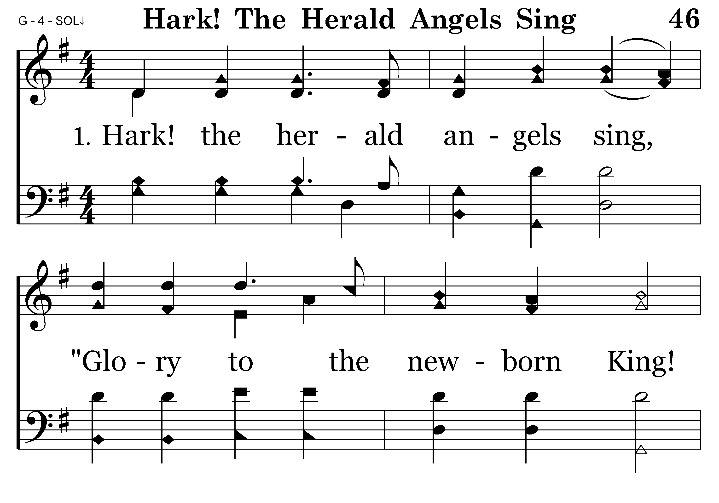
046 - Hark, The Herald Angels Sing - 1.1

Slide 58
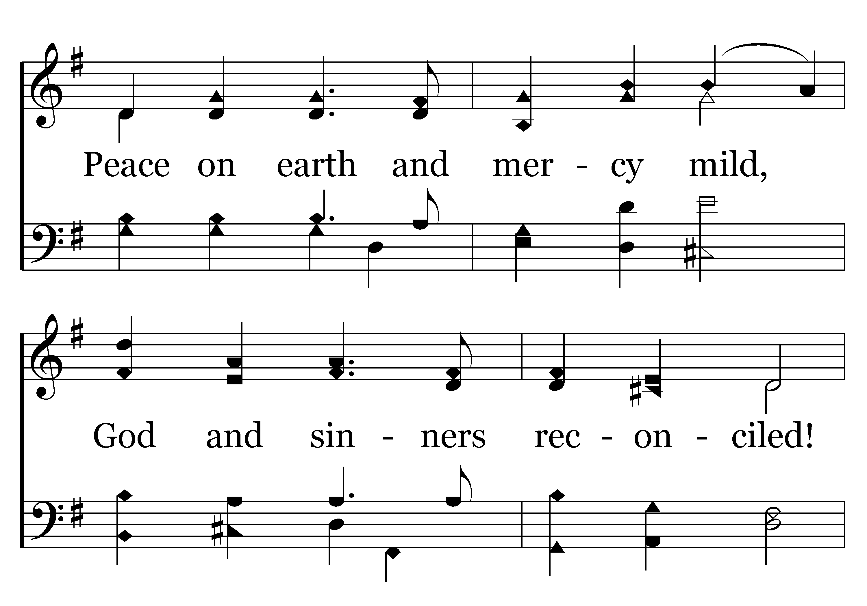
046 - Hark, The Herald Angels Sing - 1.2

Slide 59
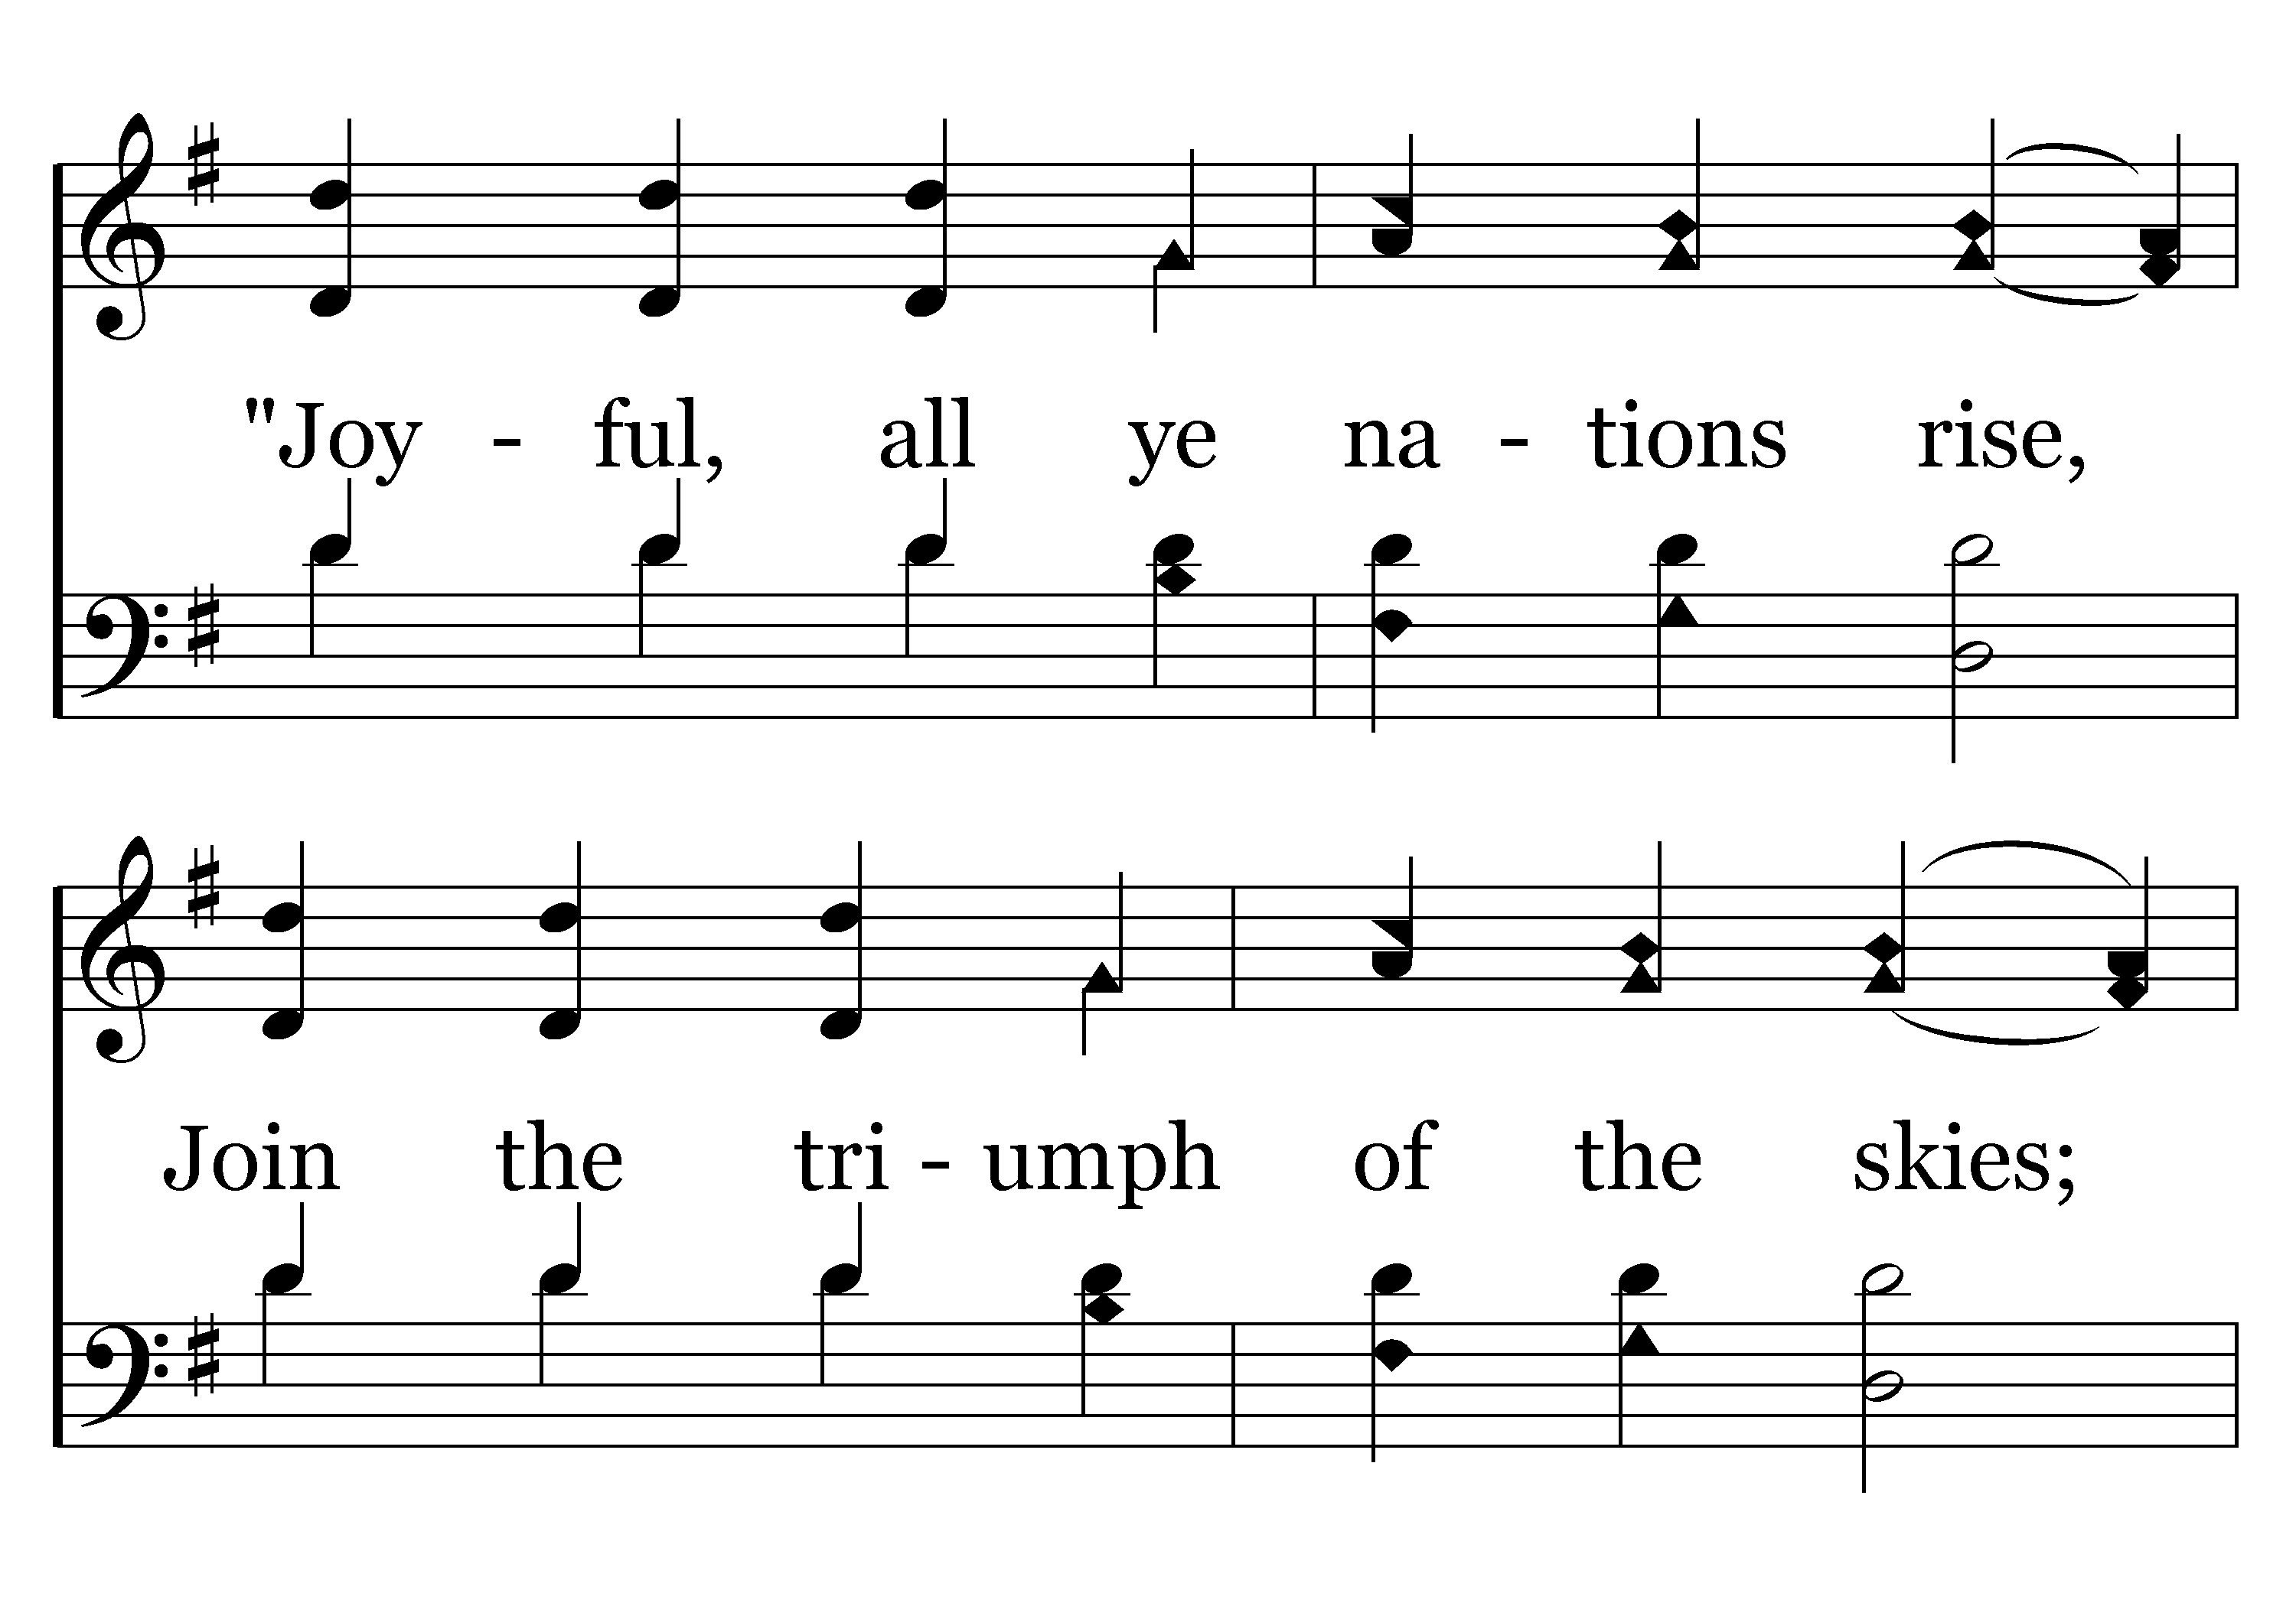
046 - Hark, The Herald Angels Sing - 1.3

Slide 60
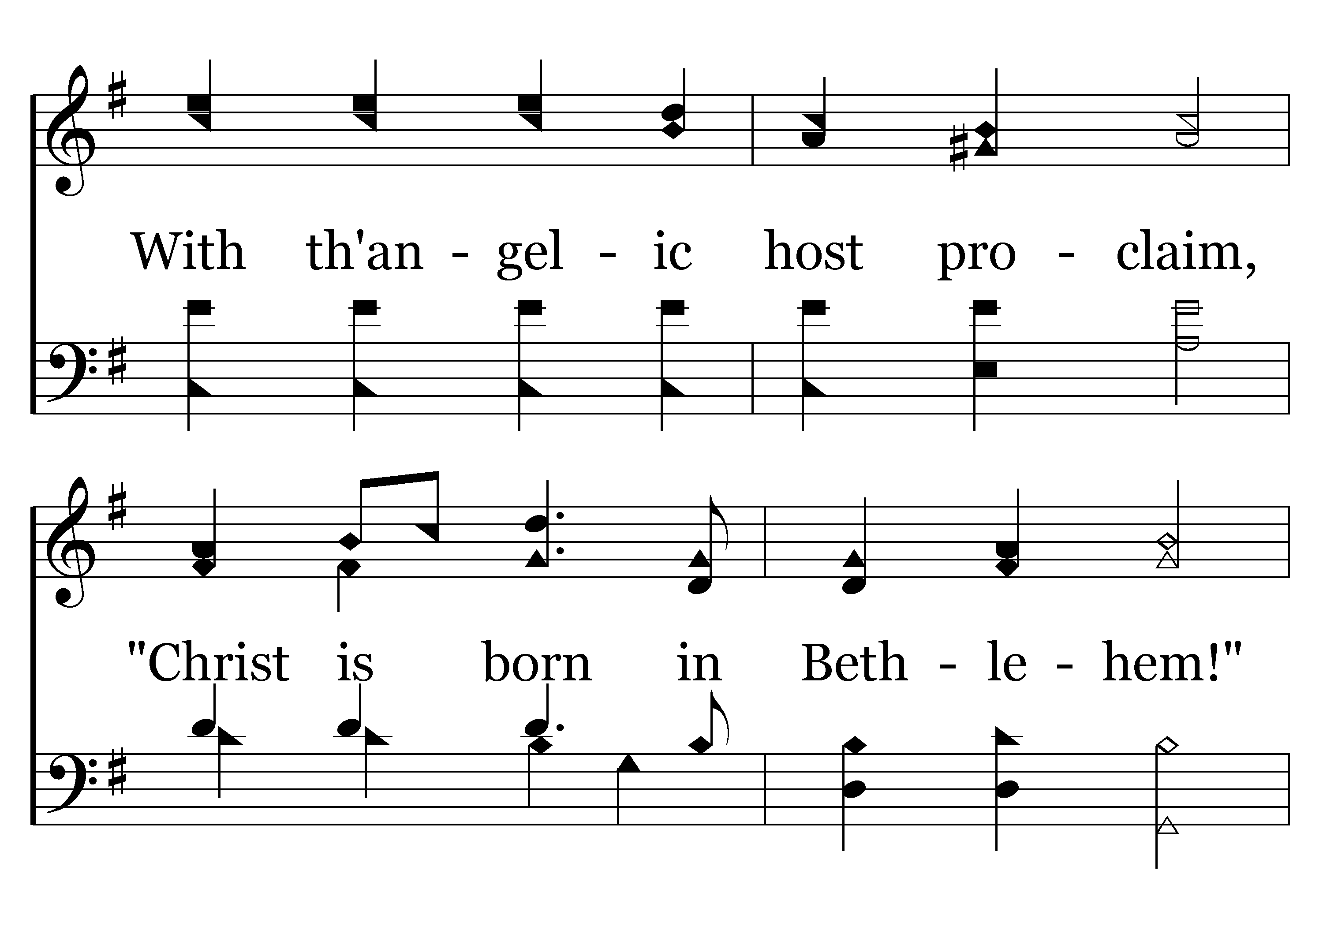
046 - Hark, The Herald Angels Sing - 1.4

Slide 61
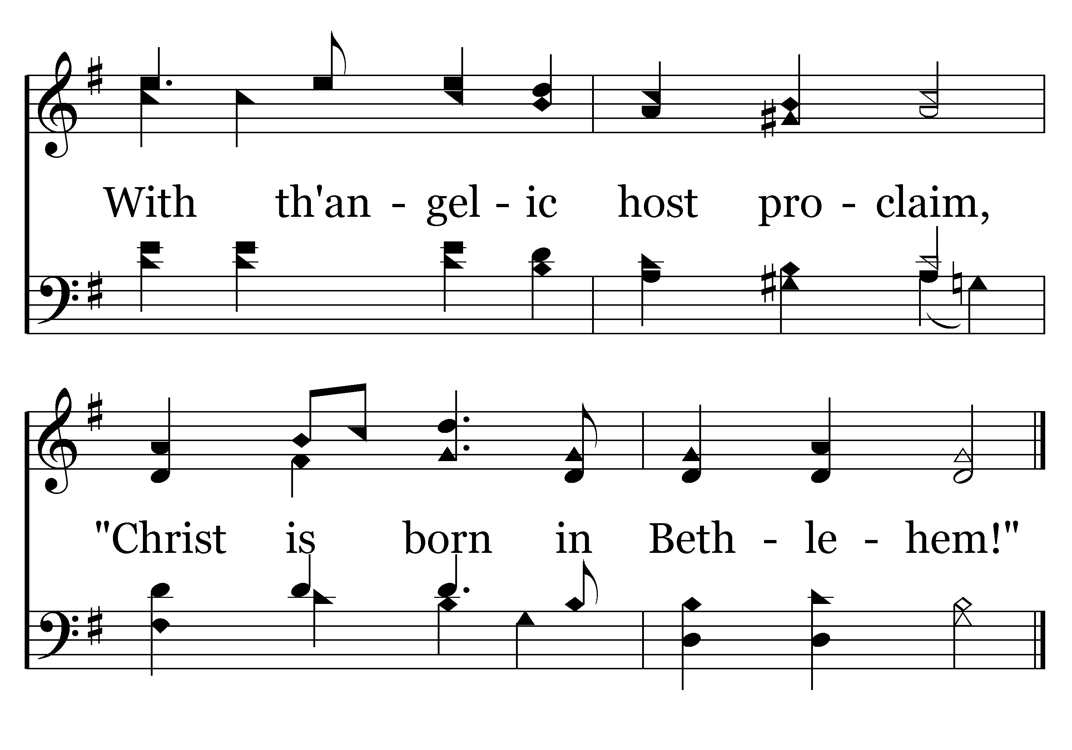
046 - Hark, The Herald Angels Sing - 1.5
End of Verse 1

Slide 62
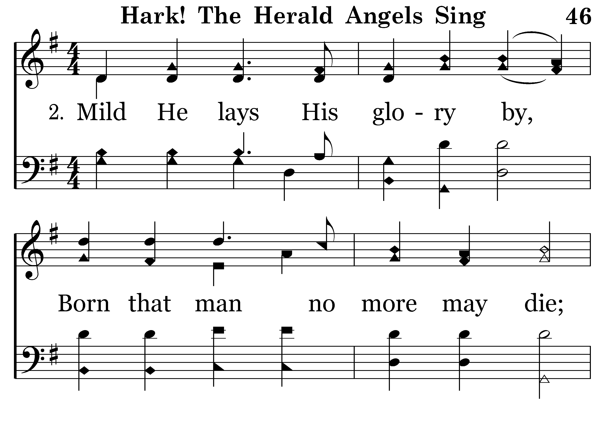
046 - Hark, The Herald Angels Sing - 2.1

Slide 63
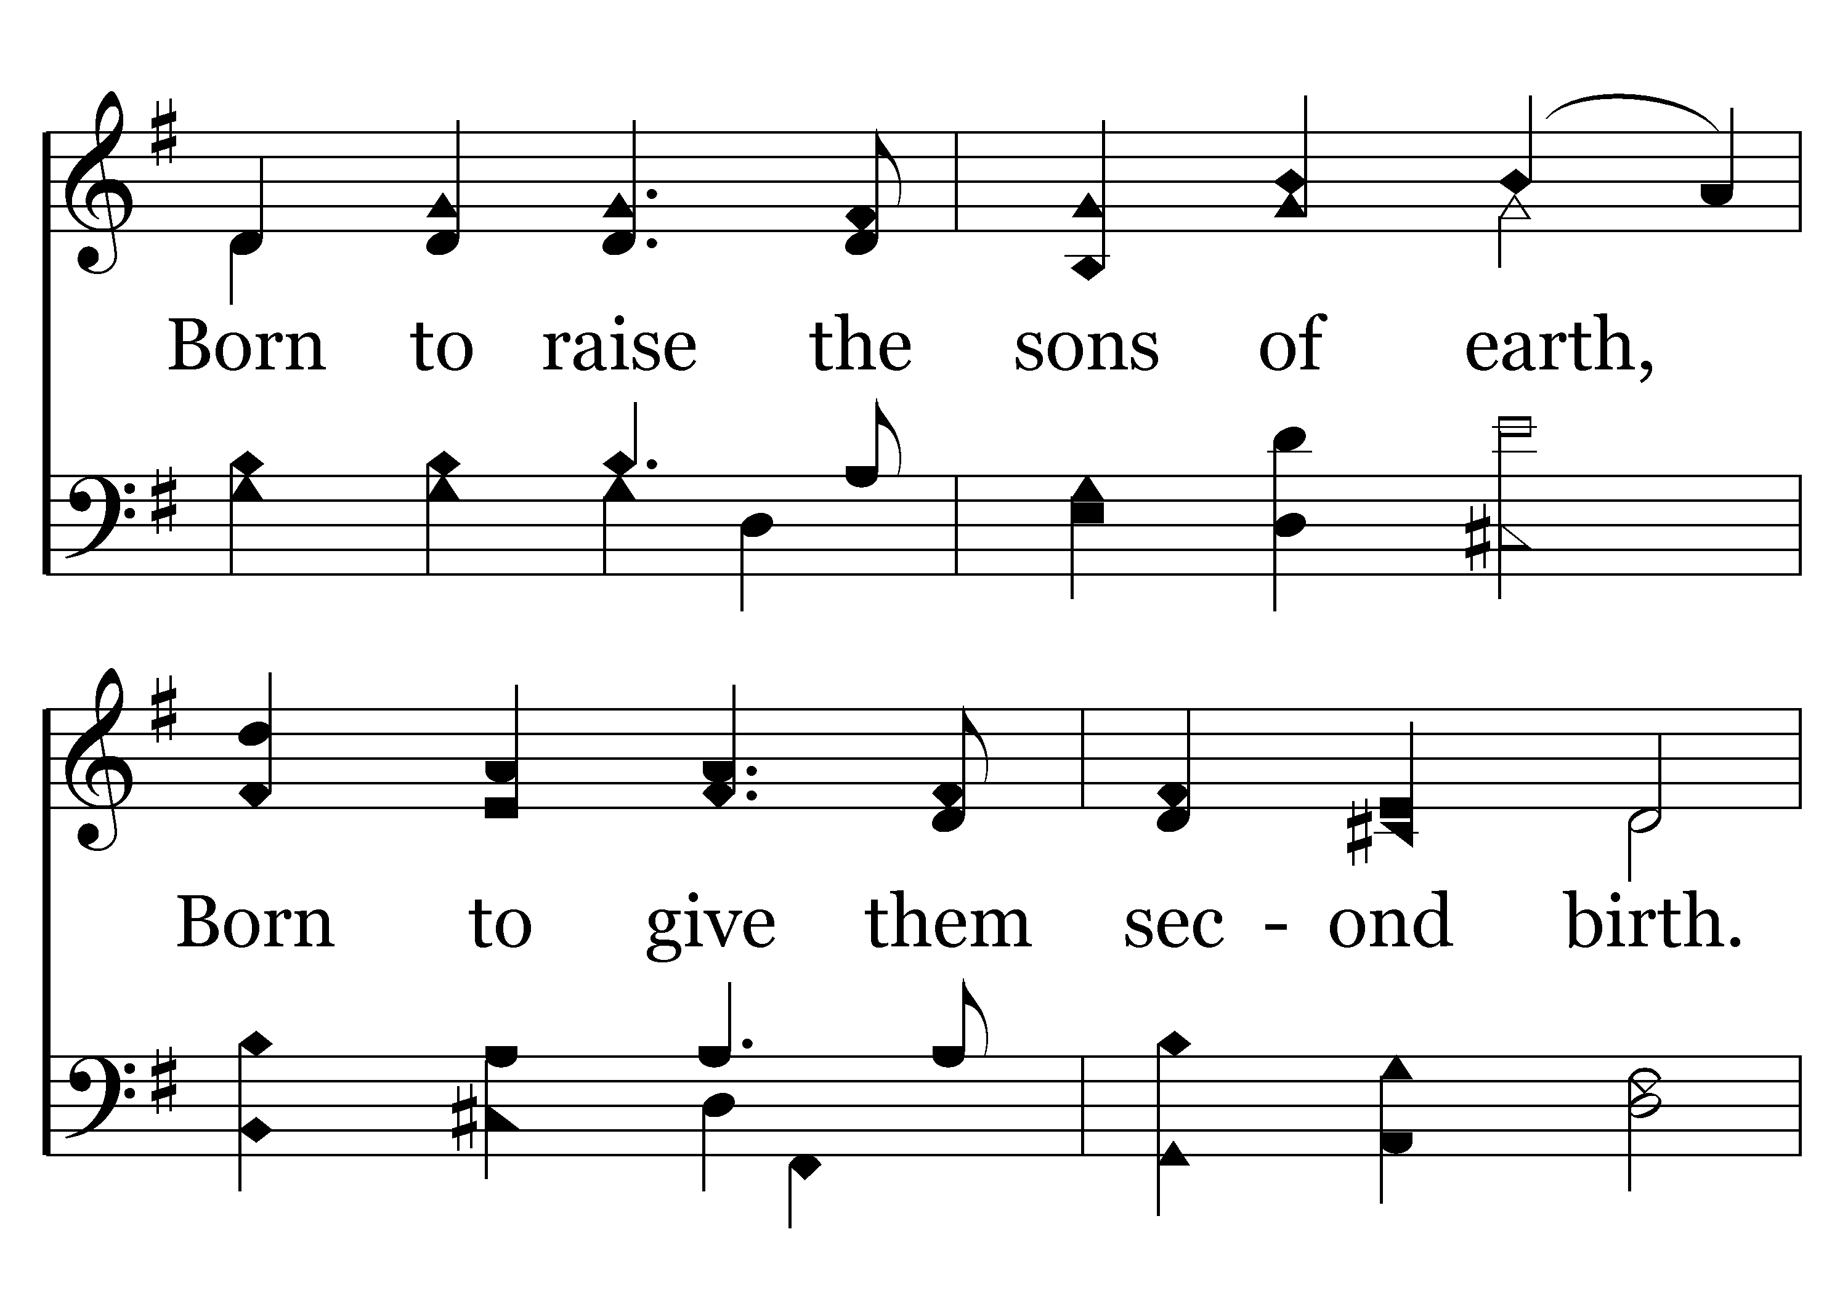
046 - Hark, The Herald Angels Sing - 2.2

Slide 64

046 - Hark, The Herald Angels Sing - 2.3

Slide 65

046 - Hark, The Herald Angels Sing - 2.4

Slide 66

046 - Hark, The Herald Angels Sing - 2.5
End of Verse 2

Slide 67

046 - Hark, The Herald Angels Sing - 3.1

Slide 68

046 - Hark, The Herald Angels Sing - 3.2

Slide 69

046 - Hark, The Herald Angels Sing - 3.3

Slide 70

046 - Hark, The Herald Angels Sing - 3.4

Slide 71

046 - Hark, The Herald Angels Sing - 3.5
End of Song

Slide 72
Reading Luke 2:1-20

Slide 73

495 - Joy To The World - Title

Slide 74

495 - Joy To The World - 1.1

Slide 75

495 - Joy To The World - 1.2

Slide 76

495 - Joy To The World - 1.3

Slide 77

495 - Joy To The World - 1.4
End of Verse 1

Slide 78

495 - Joy To The World - 2.1

Slide 79

495 - Joy To The World - 2.2

Slide 80

495 - Joy To The World - 2.3

Slide 81

495 - Joy To The World - 2.4
End of Verse 2

Slide 82

495 - Joy To The World - 3.1

Slide 83

495 - Joy To The World - 3.2

Slide 84

495 - Joy To The World - 3.3

Slide 85

495 - Joy To The World - 3.4
End of Verse 3

Slide 86

495 - Joy To The World - 4.1

Slide 87

495 - Joy To The World - 4.2

Slide 88

495 - Joy To The World - 4.3

Slide 89

495 - Joy To The World - 4.4
End of Song

Slide 90

160 - One Day - Title

Slide 91

160 - One Day - 1.1

Slide 92

160 - One Day - 1.2

Slide 93

160 - One Day - 1.3

Slide 94

160 - One Day - C.1

Slide 95

160 - One Day - C.2

Slide 96

160 - One Day - C.3
End of Verse 1

Slide 97

160 - One Day - 2.1

Slide 98

160 - One Day - 2.2

Slide 99

160 - One Day - 2.3

Slide 100
160 - One Day - C.1

Slide 101
160 - One Day - C.2

Slide 102
160 - One Day - C.3
End of Verse 2

Slide 103

160 - One Day - 3.1

Slide 104

160 - One Day - 3.2

Slide 105

160 - One Day - 3.3

Slide 106
160 - One Day - C.1

Slide 107
160 - One Day - C.2

Slide 108
160 - One Day - C.3
End of Verse 3

Slide 109

160 - One Day - 4.1

Slide 110

160 - One Day - 4.2

Slide 111

160 - One Day - 4.3

Slide 112
160 - One Day - C.1

Slide 113
160 - One Day - C.2

Slide 114
160 - One Day - C.3
End of Song

Slide 115
Prayer of thanks for Christ’s coming

Slide 116


Slide 117
I heard the bells on Christmas Day
Their old, familiar carols play,
and wild and sweet
The words repeat
Of peace on earth, good-will to men!
And thought how, as the day had come,
The belfries of all Christendom
Had rolled along
The unbroken song
Of peace on earth, good-will to men!
Till ringing, singing on its way,
The world revolved from night to day,
A voice, a chime,
A chant sublime
Of peace on earth, good-will to men!

Slide 118
Then from each black, accursed mouth
The cannon thundered in the South,
And with the sound
The carols drowned
Of peace on earth, good-will to men!
It was as if an earthquake rent
The hearth-stones of a continent,
And made forlorn
The households born
Of peace on earth, good-will to men!
And in despair I bowed my head;
"There is no peace on earth," I said;
"For hate is strong,
And mocks the song
Of peace on earth, good-will to men!"

Slide 119
Then pealed the bells more loud and deep:
“God is not dead, nor doth He sleep;
The Wrong shall fail,
The Right prevail,
With peace on earth, good-will to men.”

Slide 121

150 - Let It Begin With Me - Title

Slide 122

150 - Let It Begin With Me - 1.1

Slide 123

150 - Let It Begin With Me - 1.2

Slide 124

150 - Let It Begin With Me - 1.3

Slide 125

150 - Let It Begin With Me - 1.4

Slide 126

150 - Let It Begin With Me - 1.5

Slide 127

150 - Let It Begin With Me - 1.6

Slide 128

150 - Let It Begin With Me - 1.7
End of Song

Slide 129

“Give thanks to the Lord, for he is good,
For his steadfast love endures forever.”
Psalm 136:1

