Slide 2
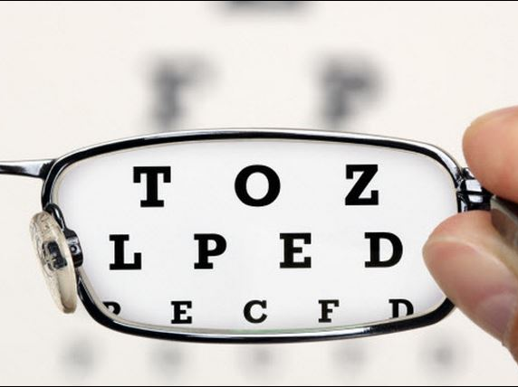
Better Vision

Slide 3
So when the woman saw that the tree was good for food, and that it was a delight to the eyes, and that the tree was to be desired to make one wise, she took of its fruit and ate, and she also gave some to her husband who was with her, and he ate.
Genesis 3:6

Slide 4
When the people saw that Moses delayed to come down from the mountain, the people gathered themselves together to Aaron and said to him, “Up, make us gods who shall go before us. As for this Moses, the man who brought us up out of the land of Egypt, we do not know what has become of him.” Exodus 32:1

Slide 5
when I saw among the spoil a beautiful cloak from Shinar, and 200 shekels of silver, and a bar of gold weighing 50 shekels, then I coveted them and took them. And see, they are hidden in the earth inside my tent, with the silver underneath.” Joshua 7:21

Slide 6
It happened, late one afternoon, when David arose from his couch and was walking on the roof of the king's house, that he saw from the roof a woman bathing; and the woman was very beautiful. 2 Samuel 11:2

Slide 7
That which was from the beginning, which we have heard, which we have seen with our eyes, which we looked upon and have touched with our hands, concerning the word of life…we have seen it…that which we have seen…
1 John 1:1-3

Slide 8
No one has seen God at any time. The only begotten Son, who is in the bosom of the Father, He has declared Him. John 1:18

Slide 9
If you had known Me, you would have known My Father also; from now on you know Him, and have seen Him. John 14:7

Slide 10
Then He said to Thomas, “Reach here with your finger, and see My hands; and reach here your hand and put it into My side; and do not be unbelieving, but believing.” Thomas answered and said to Him, “My Lord and my God!” John 20:27-28

Slide 11
Jesus said to him, “Thomas, because you have seen Me, you have believed. Blessed are those who have not seen and yet have believed.” John 20:29

Slide 12
The one who keeps His commandments abides in Him, and He in him. We know by this that He abides in us, by the Spirit whom He has given us. 1 John 3:24

Slide 13
No one has seen God at any time; if we love one another, God abides in us, and His love is perfected in us. By this we know that we abide in Him and He in us, because He has given us of His Spirit.
1 John 4:12-13

