Slide 2
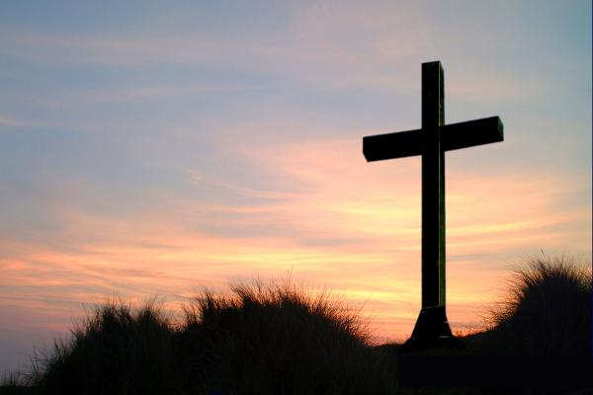
Matthew 16:21-23
Matthew 17:22-23
Matthew 20:17-19

Slide 3
In Jesus’ Kingdom
Matthew 20:20-28

Slide 4
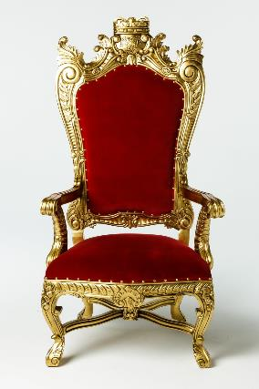
And He said to her, “What do you wish?”
She said to Him, “Command that in Your kingdom these two sons of mine may sit one on Your right and one on Your left.”
Matthew 20:21

Slide 5
power
honor
significance
status
notoriety
prestige
prominence
importance

Slide 6
And hearing this, the ten became indignant with the two brothers.
Matthew 20:24

Slide 7
But Jesus answered, “You do not know what you are asking. Are you able to drink the cup that I am about to drink?”
They said to Him, “We are able.”
Matthew 20:22

Slide 8
It is not this way among you, but whoever wishes to become great among you shall be your servant, and whoever wishes to be first among you shall be your slave; just as the Son of Man did not come to be served, but to serve, and to give His life a ransom for many.”
Matthew 20:26-28

Slide 9
The Spirit Himself testifies with our spirit that we are children of God, and if children, heirs also, heirs of God and fellow heirs with Christ, if indeed we suffer with Him so that we may also be glorified with Him. Romans 8:16-17

