Slide 2
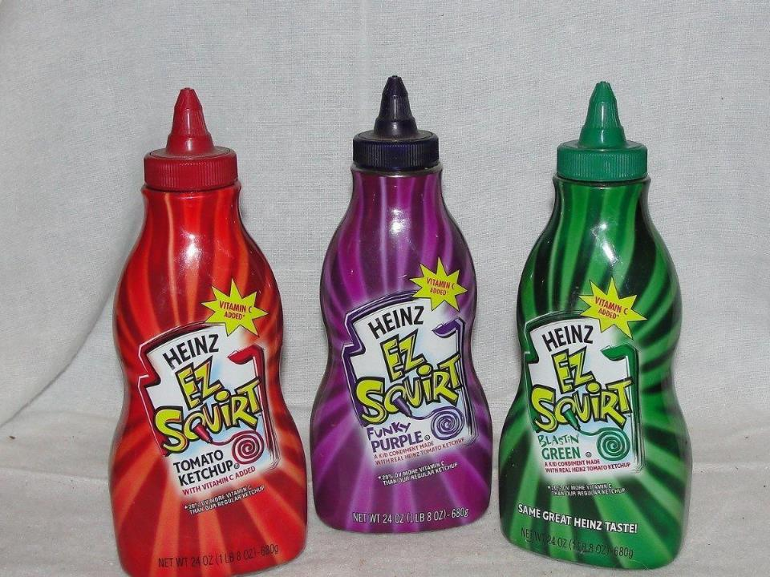

Slide 4
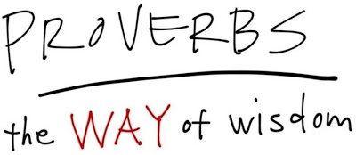

Slide 6
⁶ Go to the ant, O sluggard, Observe her ways and be wise, ⁷ Which, having no chief, Officer or ruler, ⁸ Prepares her food in the summer And gathers her provision in the harvest.
Proverbs 6:6-8

Slide 8
The fear of the Lord is the beginning of knowledge; Fools despise wisdom and instruction.
Proverbs 1:7

Slide 9
⁵ See, I have taught you statutes and judgments just as the Lord my God commanded me, that you should do thus in the land where you are entering to possess it. ⁶ So keep and do them, for that is your wisdom and your understanding in the sight of the peoples who will hear all these statutes and say, ‘Surely this great nation is a wise and understanding people.’
Deuteronomy 4:5-6

Slide 12
He who blesses his friend with a loud voice early in the morning, It will be reckoned a curse to him.
Proverbs 27:14

Slide 13
⁴ Do not answer a fool according to his folly, Lest you also be like him.
⁵ Answer a fool according to his folly, Lest he be wise in his own eyes.
Proverbs 26:4-5

Slide 16
A hot-tempered man stirs up strife, But the slow to anger calms a dispute. Proverbs 15:18

Slide 17
When there are many words, transgression is unavoidable, But he who restrains his lips is wise. Proverbs 10:19
Even a fool, when he keeps silent, is considered wise; When he closes his lips, he is considered prudent. Proverbs 17:28
A fool does not delight in understanding, But only in revealing his own mind. Proverbs 18:2

Slide 18
Like one who takes a dog by the ears Is he who passes by and meddles with strife not belonging to him. Proverbs 26:17

Slide 19
Iron sharpens iron, So one man sharpens another. Proverbs 27:17

Slide 20
Like cold water to a weary soul, So is good news from a distant land. Proverbs 25:25

