Slide 2
Now Ben-hadad king of Aram gathered all his army, and there were thirty-two kings with him, and horses and chariots. And he went up and besieged Samaria and fought against it. 1 Kings 20:1

Slide 3
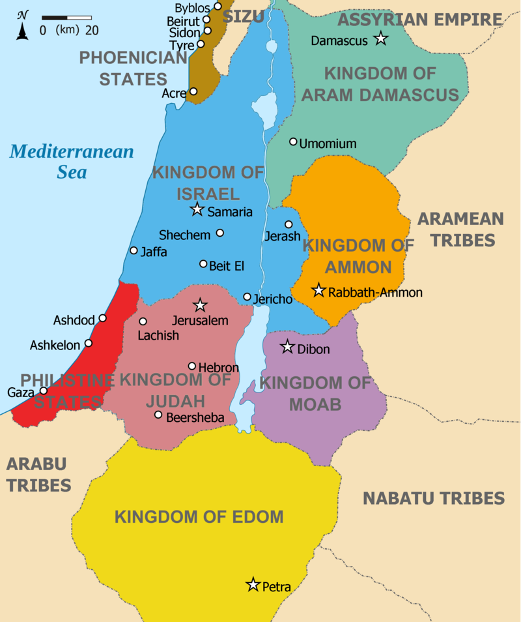

Slide 4
Now behold, a prophet approached Ahab king of Israel and said, “Thus says the Lord, ‘Have you seen all this great multitude? Behold, I will deliver them into your hand today, and you shall know that I am the Lord.’” …They killed each his man; and the Arameans fled and Israel pursued them, and Ben-hadad king of Aram escaped on a horse with horsemen. The king of Israel went out and struck the horses and chariots, and killed the Arameans with a great slaughter.
1 Kings 20:13, 20-21

Slide 5
Now the servants of the king of Aram said to him, “Their gods are gods of the mountains, therefore they were stronger than we; but rather let us fight against them in the plain, and surely we will be stronger than they.
1 Kings 20:23

Slide 6
Then a man of God came near and spoke to the king of Israel and said, “Thus says the Lord, ‘Because the Arameans have said, “The Lord is a god of the mountains, but He is not a god of the valleys,” therefore I will give all this great multitude into your hand, and you shall know that I am the Lord.’
1 Kings 20:28

Slide 7
…And Ben-hadad fled and came into the city into an inner chamber. His servants said to him, “Behold now, we have heard that the kings of the house of Israel are merciful kings, please let us put sackcloth on our loins and ropes on our heads, and go out to the king of Israel; perhaps he will save your life.”
1 Kings 20:31-32

Slide 8
He said to him, “Thus says the Lord, ‘Because you have let go out of your hand the man whom I had devoted to destruction, therefore your life shall go for his life, and your people for his people.’” So the king of Israel went to his house sullen and vexed, and came to Samaria.
1 Kings 20:42-43

Slide 9
² Ahab spoke to Naboth, saying, “Give me your vineyard, that I may have it for a vegetable garden because it is close beside my house, and I will give you a better vineyard than it in its place; if you like, I will give you the price of it in money.” ³ But Naboth said to Ahab, “The Lord forbid me that I should give you the inheritance of my fathers.” ⁴ So Ahab came into his house sullen and vexed because of the word which Naboth the Jezreelite had spoken to him; for he said, “I will not give you the inheritance of my fathers.” And he lay down on his bed and turned away his face and ate no food.
1 Kings 21:2-4

Slide 10
¹⁵ When Jezebel heard that Naboth had been stoned and was dead, Jezebel said to Ahab, “Arise, take possession of the vineyard of Naboth, the Jezreelite, which he refused to give you for money; for Naboth is not alive, but dead.” ¹⁶ When Ahab heard that Naboth was dead, Ahab arose to go down to the vineyard of Naboth the Jezreelite, to take possession of it.
1 Kings 21:15-16

Slide 11
²⁷ It came about when Ahab heard these words, that he tore his clothes and put on sackcloth and fasted, and he lay in sackcloth and went about despondently. ²⁸ Then the word of the Lord came to Elijah the Tishbite, saying, ²⁹ “Do you see how Ahab has humbled himself before Me? Because he has humbled himself before Me, I will not bring the evil in his days, but I will bring the evil upon his house in his son’s days.” 1 Kings 21:27

Slide 12
²⁶ Then the king of Israel said, “Take Micaiah and return him to Amon the governor of the city and to Joash the king’s son; ²⁷ and say, ‘Thus says the king, “Put this man in prison and feed him sparingly with bread and water until I return safely.”’ ²⁸ Micaiah said, “If you indeed return safely the Lord has not spoken by me.” And he said, “Listen, all you people.” 1 Kings 22:26-28

Slide 13
Now a certain man drew his bow at random and struck the king of Israel in a joint of the armor. So he said to the driver of his chariot, “Turn around and take me out of the fight; for I am severely wounded.” The battle raged that day, and the king was propped up in his chariot in front of the Arameans, and died at evening, and the blood from the wound ran into the bottom of the chariot. Then a cry passed throughout the army close to sunset, saying, “Every man to his city and every man to his country.” So the king died and was brought to Samaria, and they buried the king in Samaria. They washed the chariot by the pool of Samaria, and the dogs licked up his blood (now the harlots bathed themselves there), according to the word of the Lord which He spoke. 1 Kings 22:34-38

Slide 15
Now behold, a prophet approached Ahab king of Israel and said, “Thus says the Lord, ‘Have you seen all this great multitude? Behold, I will deliver them into your hand today, and you shall know that I am the Lord.’”
1 Kings 20:13

Slide 16
Then a man of God came near and spoke to the king of Israel and said, “Thus says the Lord, ‘Because the Arameans have said, “The Lord is a god of the mountains, but He is not a god of the valleys,” therefore I will give all this great multitude into your hand, and you shall know that I am the Lord.’
1 Kings 20:28

