Slide 2
Elijah sent to Ahab
18:1-2

Slide 3
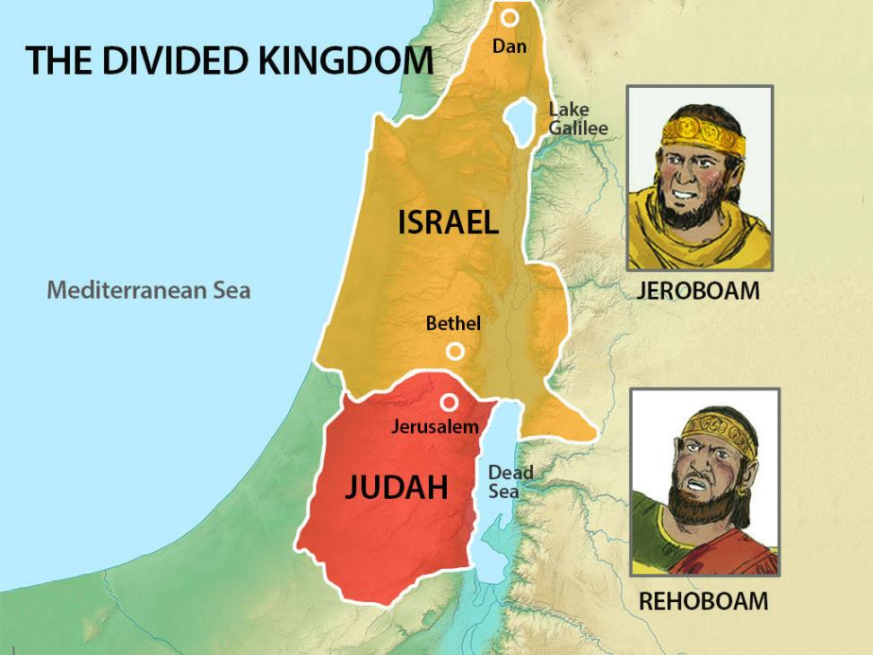

Slide 4
Ahab and Obadiah
18:3-6

Slide 5
Obadiah and Elijah
18:7-15

Slide 6
Ahab and Elijah
18:16-19

Slide 8
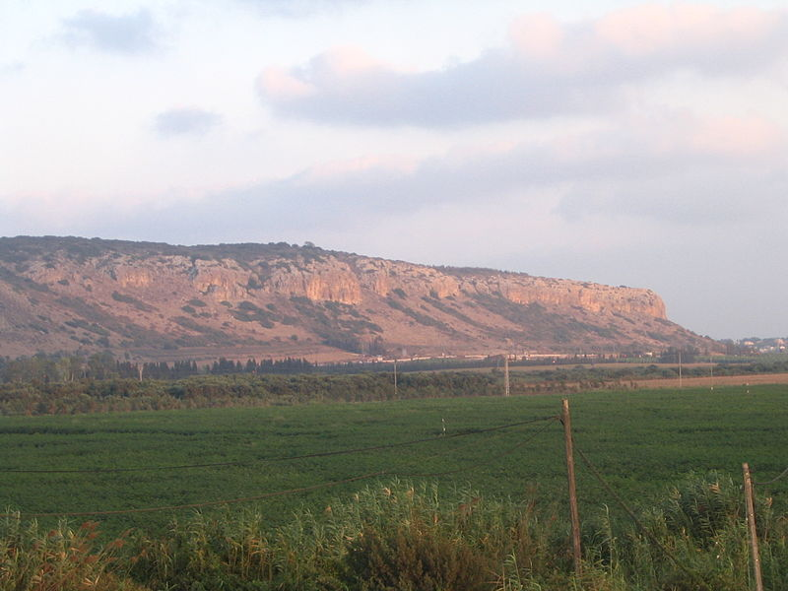

Slide 9
Elijah and the People
18:20-24

Slide 10
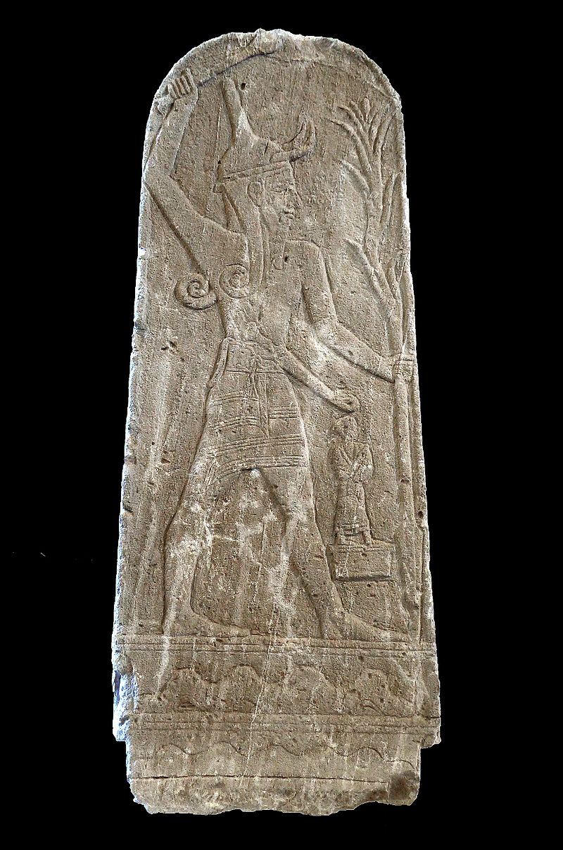

Slide 11
Elijah and the Prophets
18:25-29

Slide 12
Elijah and the People
18:30-35

Slide 13
The LORD, He is God
18:36-40

Slide 14
Elijah and Ahab
18:41-46

Slide 17
“I was glad when they said to me, ‘Let us go to the house of the Lord.’”
- Psalm 122:1

Slide 19
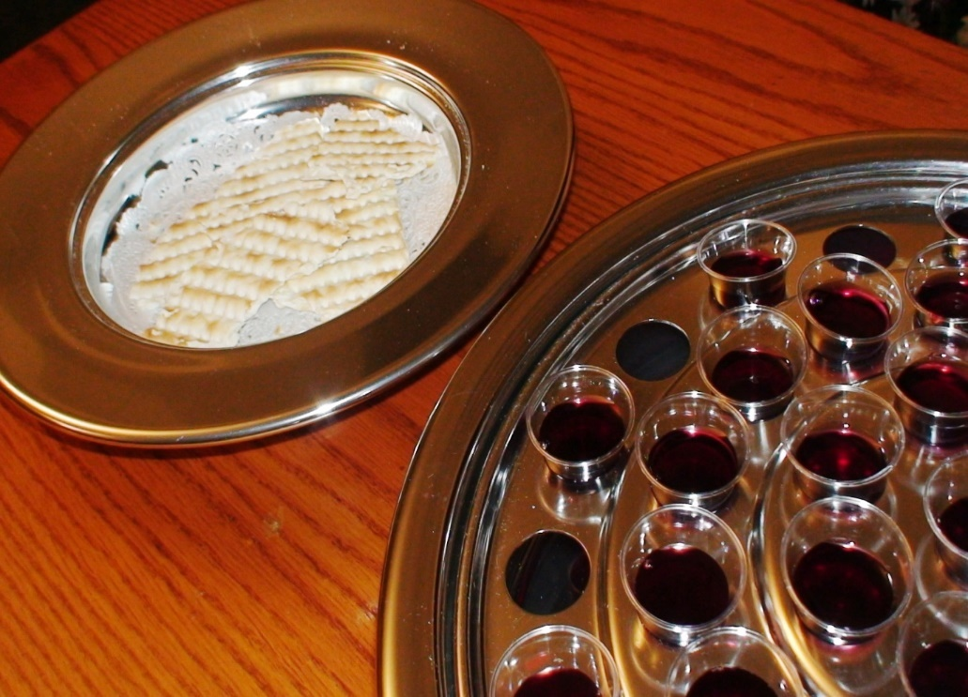
The Communion
“The cup of blessing that we bless, is it not a participation in the blood of Christ? The bread that we break, is it not a participation in the body of Christ? Because there is one bread, we who are many are one body, for we all partake of the one bread.”
1 Corinthians 9:16-17

Slide 20
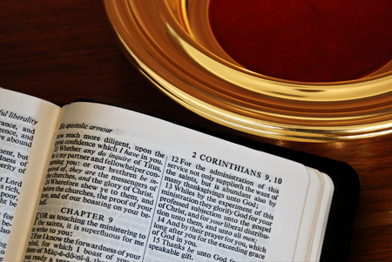
The Giving
“You will be enriched in every way to be generous in every way, which through us will produce thanksgiving to God. For the ministry of this service is not only supplying the needs of the saints but is also overflowing in many thanksgivings to God”.
2 Corinthians 9:11-12

Slide 21
Scripture Reading

Slide 23
“Give thanks to the Lord, for he is good,
For his steadfast love endures forever.”
Psalm 136:1

