Slide 2
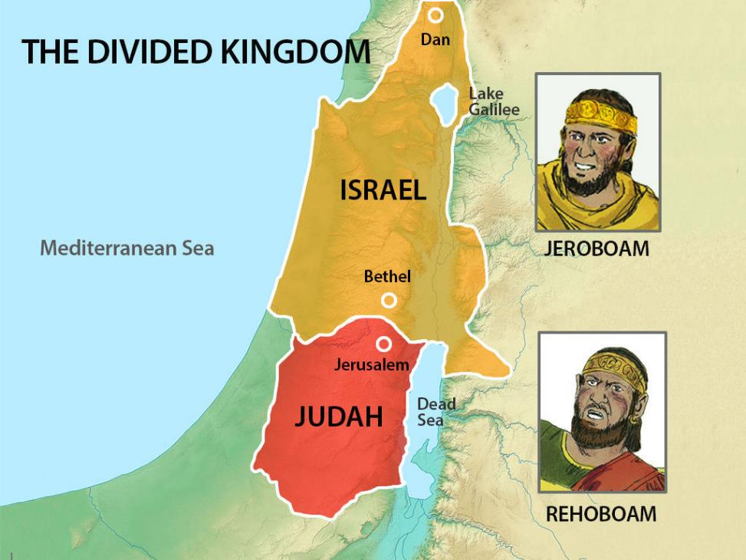
Jeroboam
Reigned 22 years 1 Kings 14:20

Slide 3
Jeroboam
Rehoboam 14:21-31

Slide 4
Jeroboam
Rehoboam 14:21-31
“His mother's name was Naamah the Ammonite.” 1 Kings 14:21,31

Slide 5
Jeroboam
“he reigned seventeen years in Jerusalem, the city that the Lord had chosen out of all the tribes of Israel, to put his name there.” 1 Kings 14:21
Rehoboam 14:21-31

Slide 6
Jeroboam
“they provoked Him to jealousy” 1 Kings 14:22
Rehoboam 14:21-31

Slide 7
Jeroboam
Rehoboam 14:21-31
“there was war between Rehoboam and Jeroboam continually.” 1 Kings 14:30

Slide 8
“And he walked in all the sins that his father did before him, and his heart was not wholly true to the Lord his God, as the heart of David his father. Nevertheless, for David's sake the Lord his God gave him a lamp in Jerusalem, setting up his son after him, and establishing Jerusalem.” 1 Kings 15:3-4
Jeroboam
Rehoboam 14:21-31
Abijam 15:1-7

Slide 9
Jeroboam
Rehoboam 14:21-31
“And Asa did what was right in the eyes of the Lord, as David his father had done.” 1 Kings 15:11
Abijam 15:1-7
Asa
15:8-24

Slide 10
¹² He put away the male cult prostitutes out of the land and removed all the idols that his fathers had made. ¹³ He also removed Maacah his mother from being queen mother because she had made an abominable image for Asherah. And Asa cut down her image and burned it at the brook Kidron. 1 Kings 15:12-13
Jeroboam
Rehoboam 14:21-31
Abijam 15:1-7
Asa
15:8-24

Slide 11
At that time Hanani the seer came to Asa king of Judah and said to him, “Because you relied on the king of Syria, and did not rely on the Lord your God, the army of the king of Syria has escaped you. … In the thirty-ninth year of his reign Asa was diseased in his feet, and his disease became severe. Yet even in his disease he did not seek the Lord, but sought help from physicians. 2 Chronicles 16:7,12
Jeroboam
Rehoboam 14:21-31
Abijam 15:1-7
Asa
15:8-24

