Slide 2
>

Slide 3
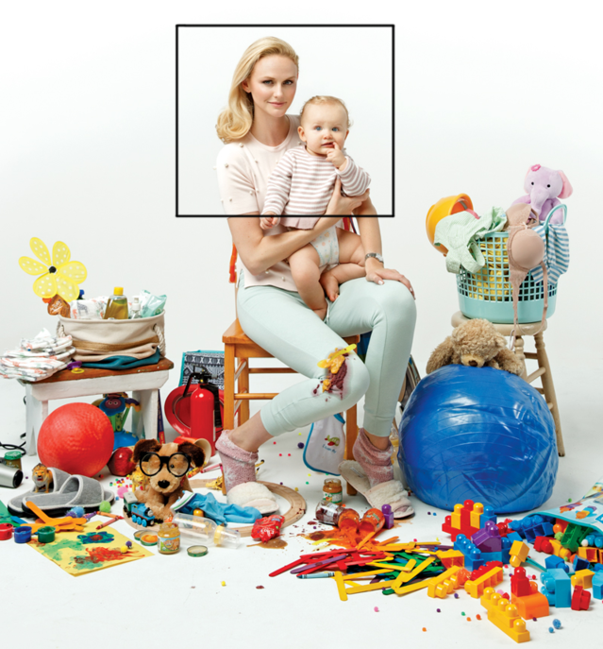

Slide 4
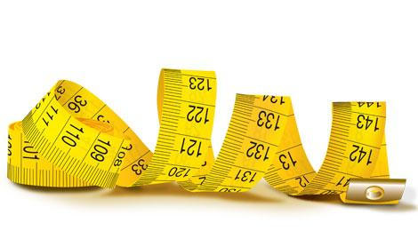

Slide 5
⁴ The serpent said to the woman, “You surely will not die! ⁵ For God knows that in the day you eat from it your eyes will be opened, and you will be like God, knowing good and evil.” ⁶ When the woman saw that the tree was good for food, and that it was a delight to the eyes, and that the tree was desirable to make one wise, she took from its fruit and ate; and she gave also to her husband with her, and he ate.
Genesis 3:4-6

Slide 6
² The whole congregation of the sons of Israel grumbled against Moses and Aaron in the wilderness. ³ The sons of Israel said to them, “Would that we had died by the Lord’s hand in the land of Egypt, when we sat by the pots of meat, when we ate bread to the full; for you have brought us out into this wilderness to kill this whole assembly with hunger.”
Exodus 16:2-3

Slide 7
² All the sons of Israel grumbled against Moses and Aaron; and the whole congregation said to them, “Would that we had died in the land of Egypt! Or would that we had died in this wilderness! ³ Why is the Lord bringing us into this land, to fall by the sword? Our wives and our little ones will become plunder; would it not be better for us to return to Egypt?” ⁴ So they said to one another, “Let us appoint a leader and return to Egypt.”
Numbers 14:2-4

Slide 8
¹⁹ Nevertheless, the people refused to listen to the voice of Samuel, and they said, “No, but there shall be a king over us, ²⁰ that we also may be like all the nations, that our king may judge us and go out before us and fight our battles.”
1 Samuel 8:19-20

Slide 9
An argument arose among them as to which of them was the greatest.
Luke 9:26

Slide 11
God created man in His own image, in the image of God He created him; male and female He created them.
Genesis 1:27

Slide 13
¹³ For You formed my inward parts; You wove me in my mother’s womb. ¹⁴ I will give thanks to You,
for I am fearfully and wonderfully made; Wonderful are Your works, And my soul knows it very well. ¹⁵ My frame was not hidden from You, When I was made in secret, And skillfully wrought in the depths of the earth; ¹⁶ Your eyes have seen my unformed substance; And in Your book were all written The days that were ordained for me, When as yet there was not one of them.
Psalm 139:13-16

Slide 14
⁶ Are not five sparrows sold for two pennies? And not one of them is forgotten before God. ⁷ Why, even the hairs of your head are all numbered. Fear not; you are of more value than many sparrows.
Luke 12:6-7

Slide 16
¹⁸ knowing that you were not redeemed with perishable things like silver or gold from your futile way of life inherited from your forefathers, ¹⁹ but with precious blood, as of a lamb unblemished and spotless, the blood of Christ.
1 Peter 1:18-19

Slide 17
but God shows his love for us in that while we were still sinners, Christ died for us.
Romans 5:8

Slide 18
The saying is trustworthy and deserving of full acceptance, that Christ Jesus came into the world to save sinners, of whom I am the foremost.
1 Timothy 1:15

Slide 19
But whatever gain I had, I counted as loss for the sake of Christ.
Philippians 3:7

Slide 20
Or do you not know that all of us who have been baptized into Christ Jesus have been baptized into His death?
Romans 6:3

