Slide 2
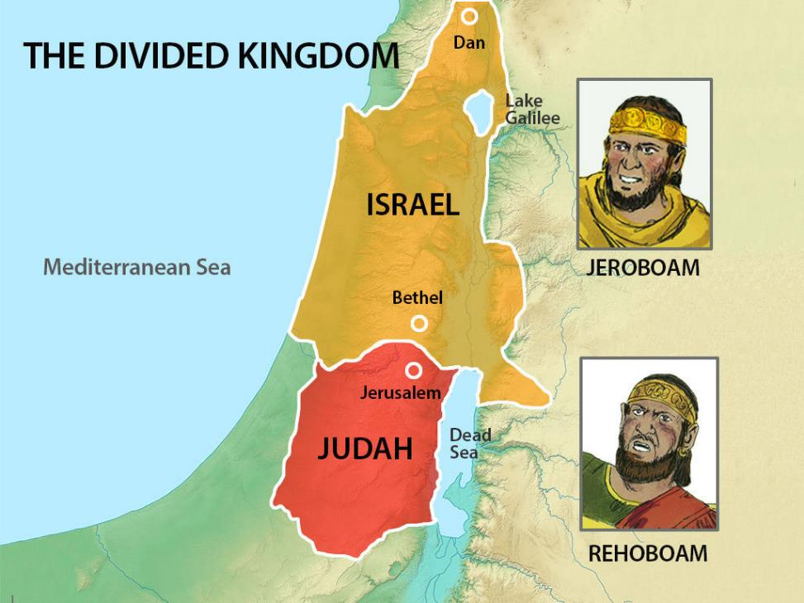
Jeroboam
Reigned 22 years 1 Kings 14:20

Slide 3
Jeroboam
Rehoboam 14:21-31

Slide 4
Jeroboam
Rehoboam 14:21-31
Abijam 15:1-7

Slide 5
Jeroboam
Rehoboam 14:21-31
Abijam 15:1-7
Asa
15:8-24

Slide 6
Asa
15:8-24
Reigned 41 years

Slide 7
Nadab 15:25-32
Asa

Slide 8
²⁵ Nadab the son of Jeroboam began to reign over Israel in the second year of Asa king of Judah, and he reigned over Israel two years. ²⁶ He did what was evil in the sight of the Lord and walked in the way of his father, and in his sin which he made Israel to sin.
Nadab 15:25-32
Asa

Slide 9
Nadab 15:25-32
²⁸ So Baasha killed him in the third year of Asa king of Judah and reigned in his place.
Asa

Slide 10
Nadab 15:25-32
³⁴ He did what was evil in the sight of the Lord and walked in the way of Jeroboam and in his sin which he made Israel to sin.
Baasha 15:33-16:7
Asa

Slide 11
⁸ In the twenty-sixth year of Asa king of Judah, Elah the son of Baasha began to reign over Israel in Tirzah, and he reigned two years. ⁹ But his servant Zimri, commander of half his chariots, conspired against him. When he was at Tirzah, drinking himself drunk in the house of Arza, who was over the household in Tirzah, ¹⁰ Zimri came in and struck him down and killed him, in the twenty-seventh year of Asa king of Judah, and reigned in his place.
Nadab 15:25-32
Baasha 15:33-16:7
Elah 16:8-14
Asa

Slide 12
¹⁵ In the twenty-seventh year of Asa king of Judah, Zimri reigned seven days in Tirzah.
Nadab 15:25-32
Baasha 15:33-16:7
Elah 16:8-14
Zimri 16:15-20
Asa

Slide 13
¹⁷ So Omri went up from Gibbethon, and all Israel with him, and they besieged Tirzah. ¹⁸ And when Zimri saw that the city was taken, he went into the citadel of the king's house and burned the king's house over him with fire and died
Nadab 15:25-32
Baasha 15:33-16:7
Elah 16:8-14
Zimri 16:15-20
Asa

Slide 14
²¹ Then the people of Israel were divided into two parts. Half of the people followed Tibni the son of Ginath, to make him king, and half followed Omri. ²² But the people who followed Omri overcame the people who followed Tibni the son of Ginath. So Tibni died, and Omri became king.
Nadab 15:25-32
Baasha 15:33-16:7
Elah 16:8-14
Zimri 16:15-20
Omri 16:21-28
Asa

Slide 15
²⁴ He bought the hill of Samaria from Shemer for two talents of silver, and he fortified the hill and called the name of the city that he built Samaria, after the name of Shemer, the owner of the hill.
Nadab 15:25-32
Baasha 15:33-16:7
Elah 16:8-14
Zimri 16:15-20
Omri 16:21-28
Asa

Slide 16
²⁵ Omri did what was evil in the sight of the Lord, and did more evil than all who were before him.
Nadab 15:25-32
Baasha 15:33-16:7
Elah 16:8-14
Zimri 16:15-20
Omri 16:21-28
Asa

Slide 17
³⁰ And Ahab the son of Omri did evil in the sight of the Lord, more than all who were before him. ³¹ And as if it had been a light thing for him to walk in the sins of Jeroboam the son of Nebat, he took for his wife Jezebel the daughter of Ethbaal king of the Sidonians, and went and served Baal and worshiped him. ³² He erected an altar for Baal in the house of Baal, which he built in Samaria. ³³ And Ahab made an Asherah. Ahab did more to provoke the Lord, the God of Israel, to anger than all the kings of Israel who were before him.
Nadab 15:25-32
Baasha 15:33-16:7
Elah 16:8-14
Zimri 16:15-20
Omri 16:21-28
Ahab 16:29-34
Asa

Slide 18
³ For I delivered to you as of first importance what I also received, that Christ died for our sins according to the Scriptures, ⁴ and that He was buried, and that He was raised on the third day according to the Scriptures
1 Corinthians 15:3-4

