Slide 4
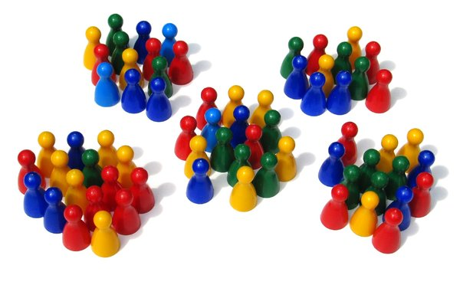

Slide 5
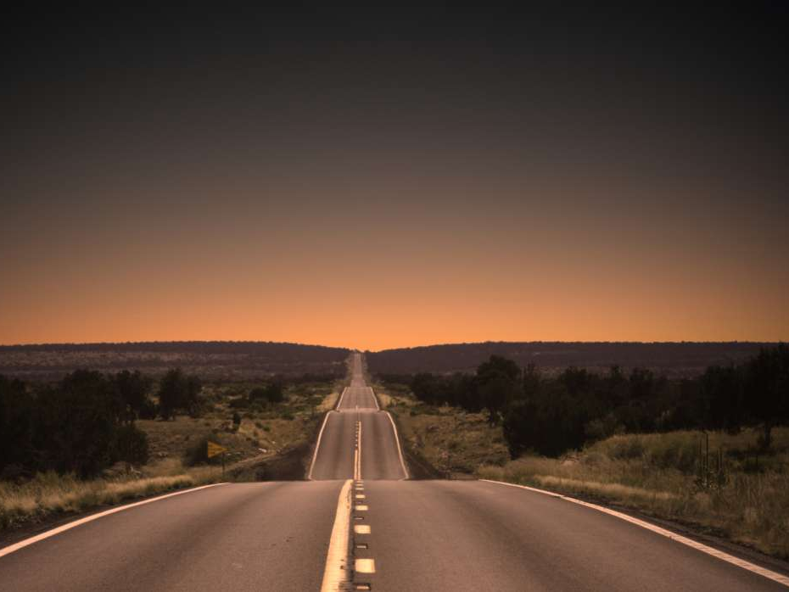
Where did we come from?

Slide 6
¹ In the beginning was the Word, and the Word was with God, and the Word was God. ² He was in the beginning with God. ³ All things came into being through Him, and apart from Him nothing came into being that has come into being.
John 1:1-3

Slide 7
Why are things the way they are?

Slide 8
¹⁰ He was in the world, and the world was made through Him, and the world did not know Him. ¹¹ He came to His own, and those who were His own did not receive Him. John 1:10-11

Slide 9
What about when I’ve done wrong?

Slide 10
³¹ So Jesus was saying to those Jews who had believed Him, “If you continue in My word, then you are truly disciples of Mine; ³² and you will know the truth, and the truth will make you free. …³⁶ So if the Son makes you free, you will be free indeed.” John 8:31-32,36

Slide 11
Where are we going?

Slide 12
¹“Do not let your heart be troubled; believe in God, believe also in Me. ² In My Father’s house are many dwelling places; if it were not so, I would have told you; for I go to prepare a place for you. ³ If I go and prepare a place for you, I will come again and receive you to Myself, that where I am, there you may be also. John 14:1-3

Slide 13
¹“Do not let your heart be troubled; believe in God, believe also in Me. ² In My Father’s house are many dwelling places; if it were not so, I would have told you; for I go to prepare a place for you. ³ If I go and prepare a place for you, I will come again and receive you to Myself, that where I am, there you may be also. John 14:1-3

Slide 14
⁴ And you know the way where I am going.” ⁵ Thomas said to Him, “Lord, we do not know where You are going, how do we know the way?” ⁶ Jesus said to him, “I am the way, and the truth, and the life; no one comes to the Father but through Me.” John 14:4-6

